Slide 1
ICTR COVID-19 Clinical Research Center Town Hall
Thursday October 14th, 2021

Slide 2
Town Hall Agenda
General Introduction – Kelly Dooley
Defining PASC, Introduction to PACT clinic, and Pulmonary Research – Ann Parker
Neurological Manifestations of PASC – Tracy Vannorsdall
Cardiac Manifestations of PASC – Nisha Gilotra
PASC Patient Perspective
PASC Research Summary and Future Goals – Kelly Gebo
PASC Collaboratory and Q&A – Kelly Dooley

Slide 3
PASC Clinical Care & Research at Hopkins
Kelly Dooley

Slide 4
Context: Post-Acute COVID Syndrome (PASC)
103M (31%) of Americans had had COVID-19 by December 2021
10-30% with long-term, multi-system symptoms
Pulmonary and neuropsychiatric sequelae leading to disability, reduced quality of life common
Variability in ‘syndrome’ manifestations, limited understanding underlying mechanisms, lack of trials data, no therapeutics, definition?
JHHS patients (and patients outside Hopkins network) continue to seek treatments and services for PASC
December, 2020, Congress earmarked $1.15B for research into the prolonged health consequences of SARS-CoV-2 infection
https://www.nih.gov/about-nih/who-we-are/nih-director/statements/nih-launches-new-initiative-study-long-covid

Slide 5
Clinical & Research Resources at JHU
Johns Hopkins Post-Acute COVID-19 Team (PACT) Clinic
  Ann Parker and Alba Azola
  >700 patients
HOPE Registry
  Pts who have a test at JHMI facility
  11,731 participants, 18% COVID+
COVID-19 Precision Medicine Analytics Platform (JH CROWN)
  Pts with COVID-19 diagnosis at JHMI facility
  EMR resource
JH ThRIVE consortium
  Kelly Gebo, Keri Althoff
  Autopsy cohort, selected for funding
Christopher Chute, award for EHR project (220K-person virtual cohort, machine learning)

Slide 6









Patients with COVID-19 in
Community and Regional
Hospitals in JHCRN
Urban, suburban and rural locations
18,611 total COVID admissions
(Anne Arundel, Reading and Peninsula Sytems)
Over 5,000 Participants Enrolled in research studies
Johns Hopkins Clinical Research Network
Thanks to Adrian Dobs, MD MHS

Slide 7
PASC Projects at Hopkins
PI | Study Title
Sami Alasfar | A study to assess physical, mental and cognitive impairments in kidney transplant patients who had COVID-19 infection"
Leah Rubin | Neuropsychiatric sequela of SARS-COV-2 infection
Sung-Min Cho | Tele-Yoga for COVID Long Haulers: A digital interventional trial to improve physical and mental health
Anupama Kumar | Cognitive Assessment in COVID Positive Patients Using the DANA App
Sung Min Cho | Long-term impAct in inTEnsive caRe survivors of CORonavirus Disease-19 (The AFTERCOR Study)
Annie Antar | Symptoms and Biomarkers of Long COVID in People Living with HIV
Ann Parker | COVID Patient Registry
Jun Hua | Impact of COVID-19 on Dementia Risk, Progression and Outcomes in Dementia Population
Kelly Gebo & Keri Althoff | Johns Hopkins PASC CollaboraToRy for DIVersity and HEalth Disparities (JH ThRIVE): The PASC Autopsy Cohort
Sevil Yasar | Imaging based neurobiological underpinnings of post-COVID cognitive sequelae
Yvonne Commodore-Mensah, Bunmi Ogungbe | Cardiac-related Post-acute Sequela of COVID-19
Martin B. Brodsky | COVID-19 Recovery Trends during SLP Acute Care Rehabilitation
Steven Menez | Multi-center Assessment of Survivors for Kidney Disease after COVID-19: MASKeD-COVID
Sarah Irani | Return to Sport Outcomes after COVID-19 in Pediatric Athletes
Karly Murphy | Outcomes after COVID-19 diagnosis for people with versus without serious mental illness
Laura Malone& A. Morrow | Description of Pediatric PASC/Long COVID Cohort
Daniel Sun | Sudden Sensorineural Health Loss after COVID-19 Vaccination: A Retrospective Study
Ann Parker | Post-discharge and longitudinal outcomes for survivors of COVID-19
Esther Oh | Long-term Cognitive Impact of Acute Illness
Glenn Whitman | Evaluating the Recovery Trajectory and Long-Term Survivorship of Critically Ill COVID-19 Patients Supported by ECMO
Ilya Shpitser | Clinical Analysis of Recovery Trajectory of Emergency Medicine Patients
Christopher Chute | Characterization of long-COVID: definition, stratification, and multimodal analysis
Shenandoah Robinson, Lauren Jantzie | Neuro-immunomodulation to Prevent Post-Acute COVID Neurological Sequelae
Nisha Gilotra | Myocardial involvement in post-acute COVID syndrome

Slide 8
Johns Hopkins PASC Collaboratory
First meeting September 27th, 28 attendees
  PASC investigators in ‘one room’, share current progress, review recruitment resources, explore supports/services that would help, identify existing resources, discuss how CRC could support PASC research moving forward
Organized by the COVID Research Center
Presentations- Ann Parker/Alba Azola(PACT), Kelly Gebo/Keri Althoff (JH ThRIVE), Cassie Lewis-Land (HOPE registry), Matt Robinson (CROWN)
Breakout sessions- projects, needs, resources
  Introductions, Challenges, Support services that would be helpful, resources/support/expertise you may be able to contribute to others
TEAMS channel created, with sub-channels pending

Slide 9






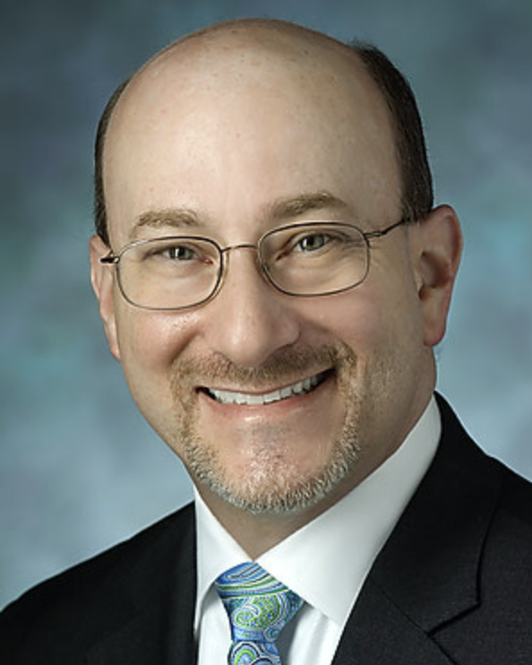



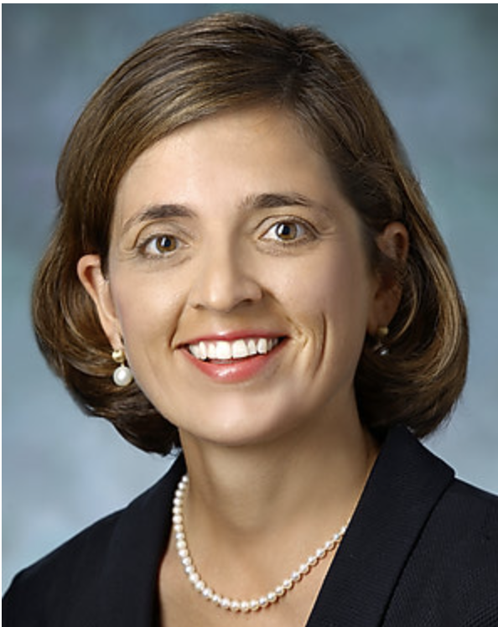




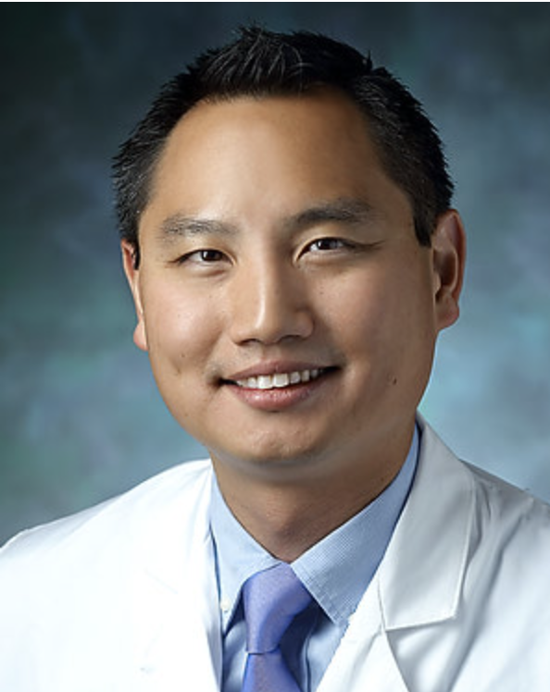
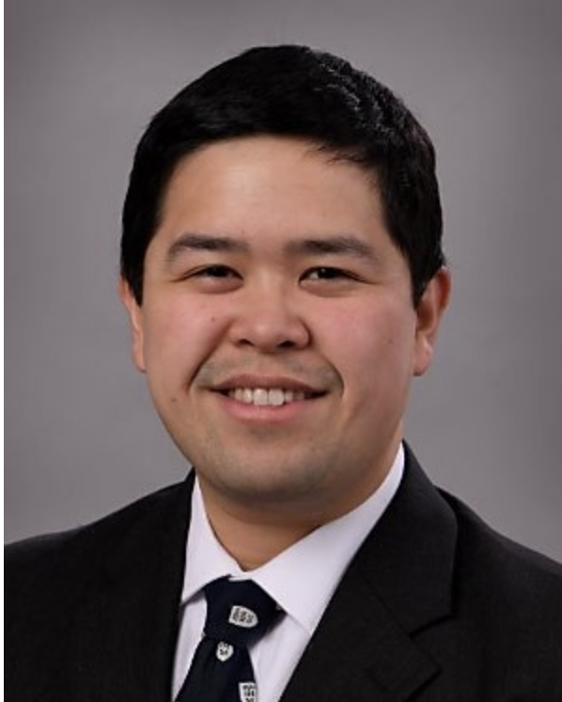







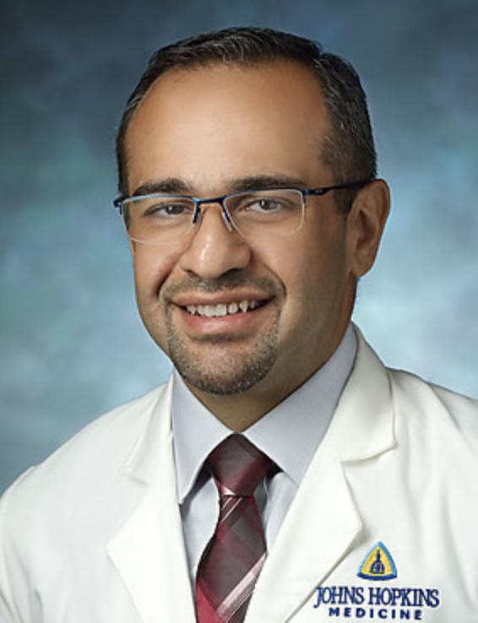



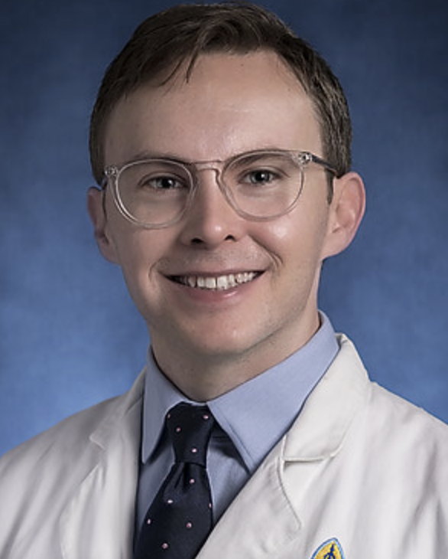


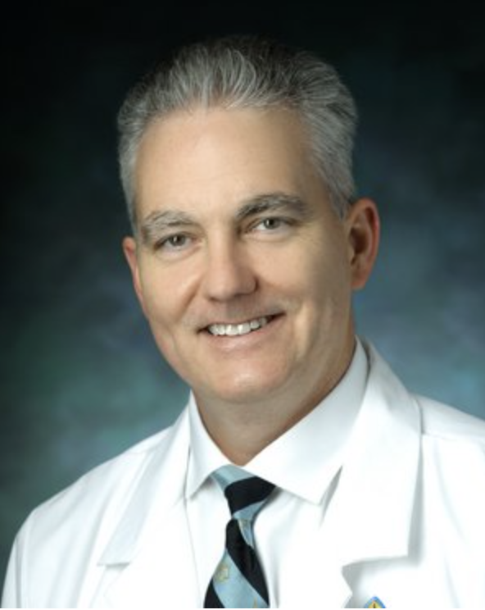
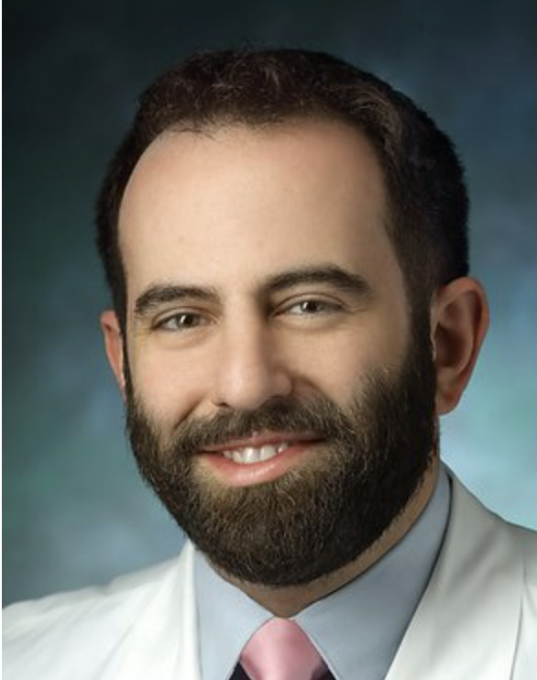




Who is working on PASC?

Slide 10


The Johns Hopkins Post-Acute COVID-19 Team (JH PACT)
Pulmonary & Critical Care Medicine
Ann M. Parker, MD, PhD
Physical Medicine & Rehabilitation
Alba Azola, MD

Slide 11
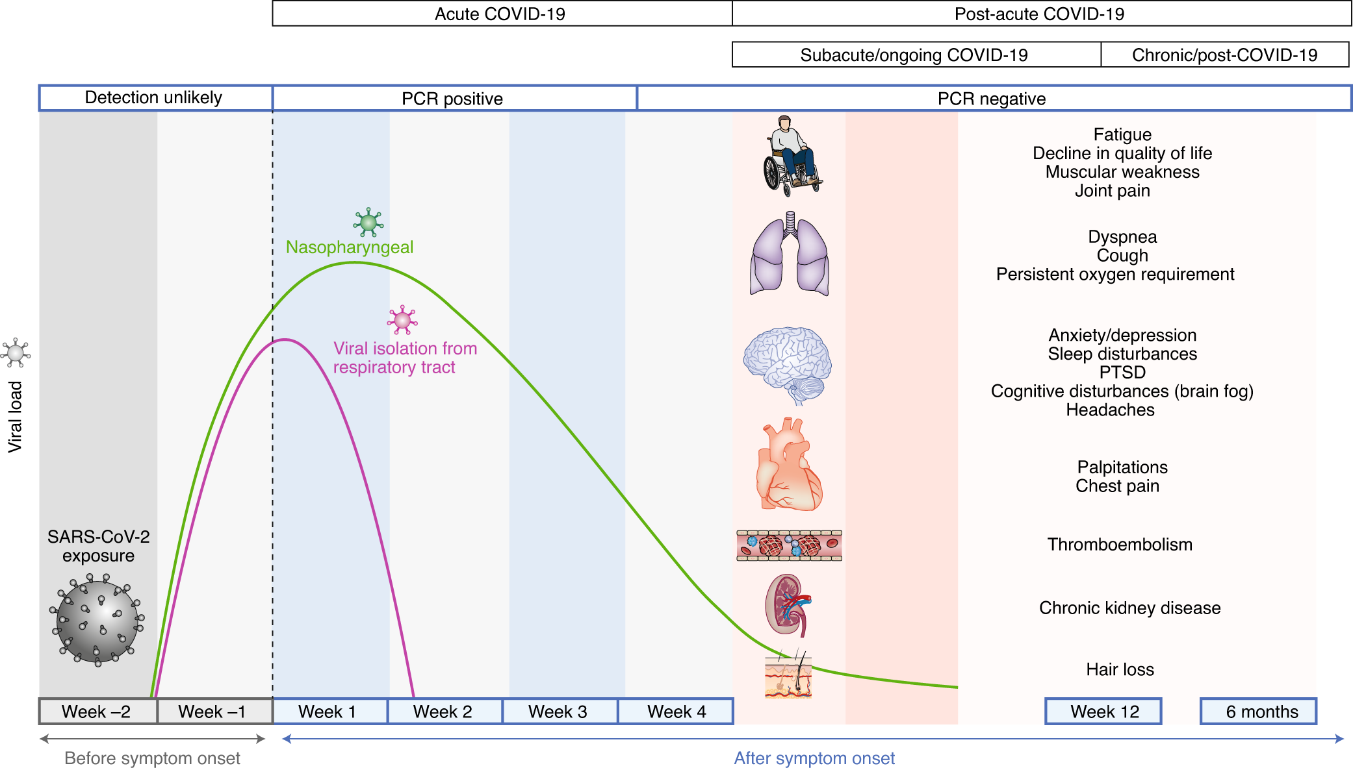

Post-Acute Sequelae SARS-CoV-2
Nalbandian & Sehgal Nature Medicine. 2021. 27:601–615
Notes:
Focus on timeline
Mechanism unknown
Trajectory unclear – china and italy

Slide 12
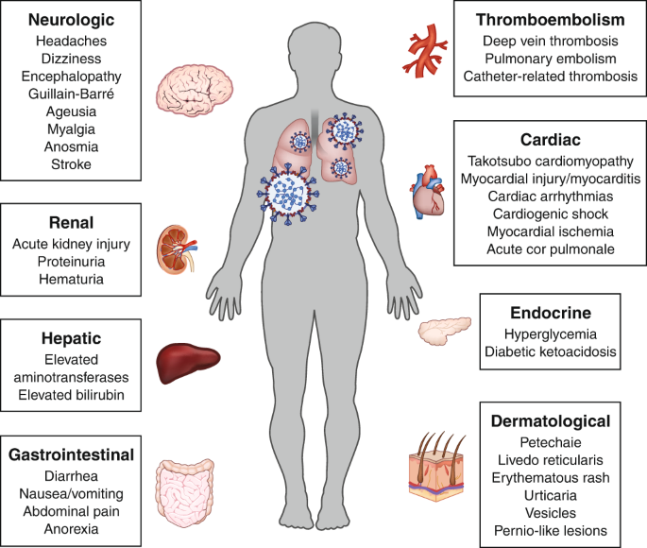

Post-Acute Sequelae SARS-CoV-2
incidence of neuromuscular, metabolic,
cardiovascular disorders…
mental health burden…..
healthcare utilization
risk of death (8 extra deaths/1000 pts)
10-30% w/ persistent symptoms
Notes:
Focus on organ systems
10-30% of patients (>10 million people in the US)
So the implications are huge in terms of raw numbers of patients affected and the impact on the healthcare system – what does 10-30% translate to in MD or in US?

Slide 13

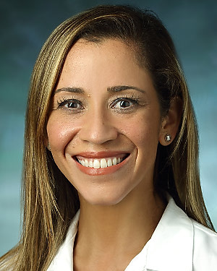
JH PACT: Who We Are
Established April 7, 2020
Post-Intensive Care Syndrome (PICS) framework
Multi-D: PCCM, PM&R, JH Homecare
Telemed/In-person Hybrid
JH PACT-ICU: Severe initial COVID-19
(ICU LOS > 48hrs)
JH PACT-Base: Mild to moderate initial COVID-19
Ann M. Parker, MD, PhD Alba Azola, MD
PCCM PM&R
Notes:
Early out of the gate
PICS framework
Both mild and severe initial disease
Personal passion

Slide 14


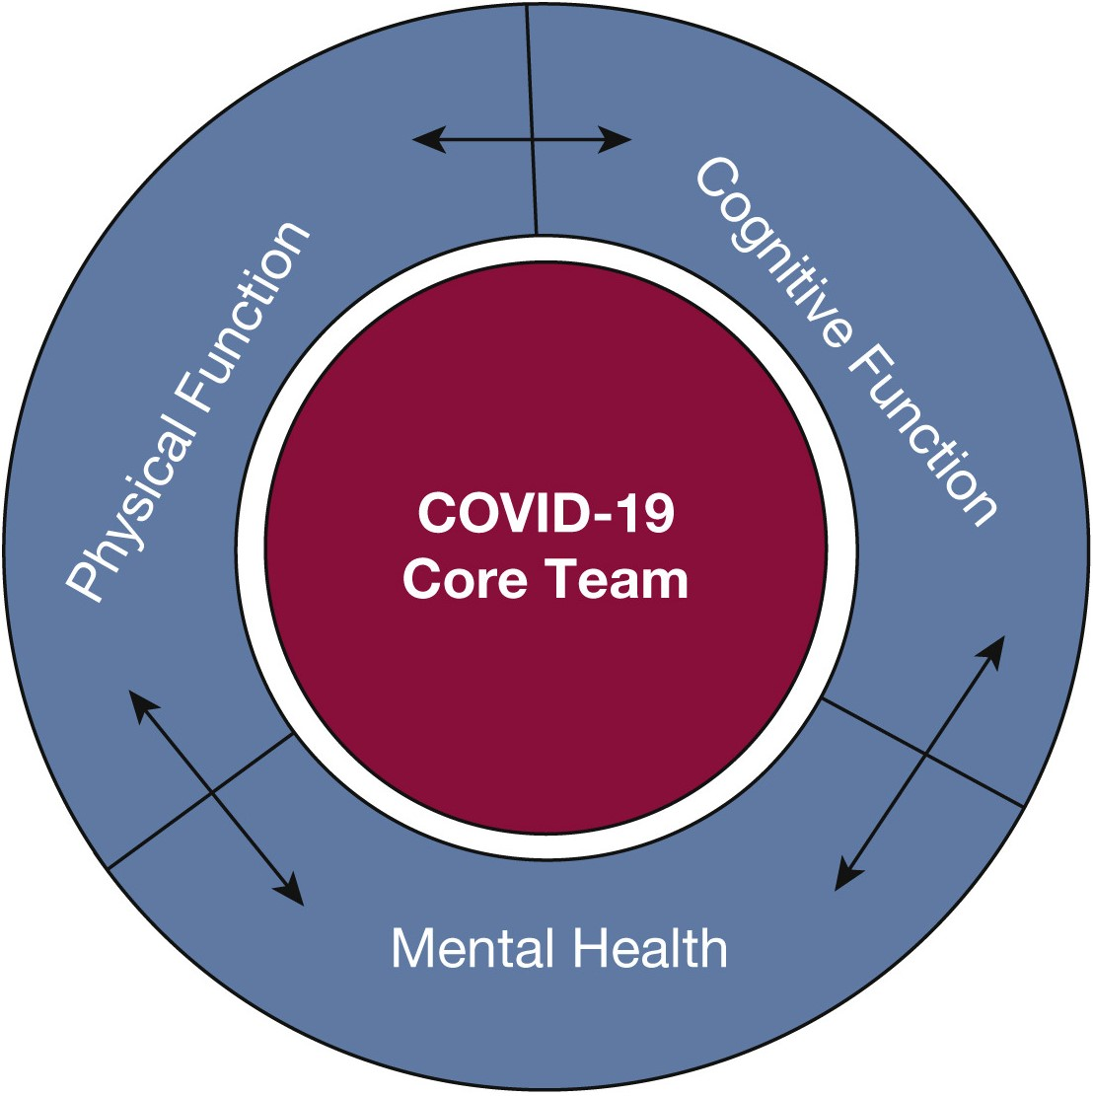
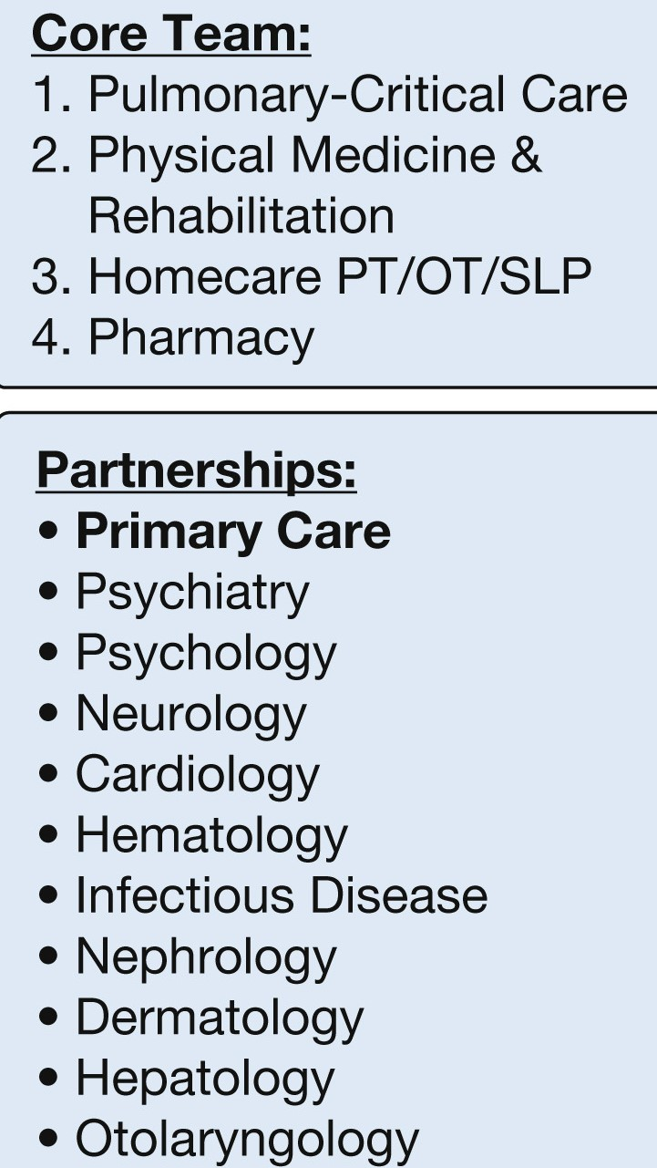
JH PACT: Who We Are
JH PACT

Slide 15
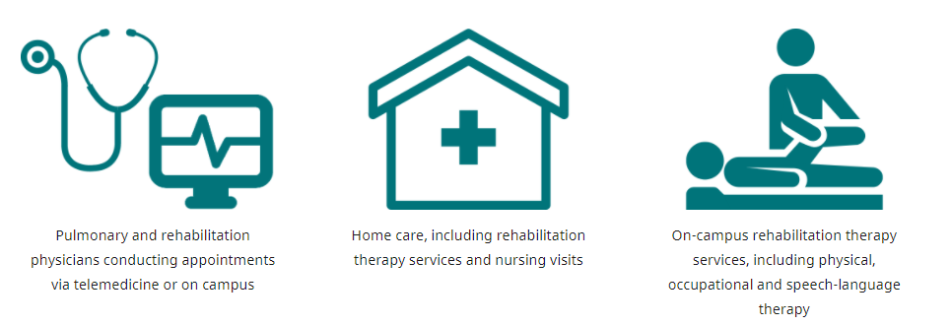
JH PACT: What We Do
Pulmonary & Rehabilitation Medicine including:
Interstitial lung disease
Postural orthostatic tachycardia syndrome (POTS)
Homecare
Rehabilitation services
Nursing
On-Campus Rehabilitation
Physical Therapy
Occupational Therapy
Speech-Language Pathology
Rehab Psychology
JH PACT 30% reduction in readmissions (16% to 11%)
https://www.hopkinsmedicine.org/coronavirus/pact/
Notes:
Cite our website

Slide 16

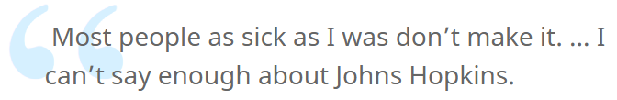
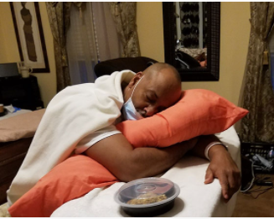

JH PACT: Who We Serve
>700 patients
50-70% Admitted to the ICU
Average age 54 years
50% Male
33% Black or African American
30% Hispanic or Latino
20% Require interpreter services
https://www.hopkinsmedicine.org/coronavirus/patient-stories/theirrien-clark.html
Notes:
What is the demand? Waitlist

Slide 17

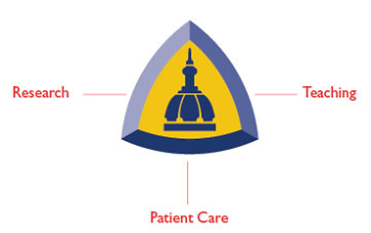



JH PACT: Research
Registry (IRB00249062) (Parker)
Retrospective Review (IRB00259205) (Parker)
Biorepository (IRB pending) (Suresh/Parker)
ECMO Longitudinal follow-up (IRB00259048) (Whitman)
Cognitive outcomes (IRB00261035) (Oh)
Johns Hopkins PMCoE-AD
Notes:
Breaking from the traditional model of research where years of epidemiological studies and clinical trials ultimately result in implementation of therapeutic interventions. Instead, we are building a program that conducts research alongside clinical care in a truly patient-centered way where we provide multi-D support for patients and families while advancing the field and answering key research questions.

Slide 18
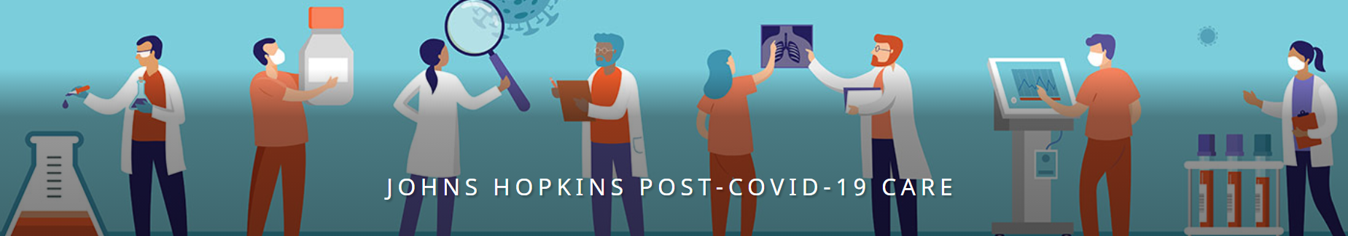
https://www.hopkinsmedicine.org/coronavirus/pact/
Ann M. Parker, MD, PhD @AnnEkedahl
Alba Azola, MD @AzolaAlba
PACT@jhmi.edu

Slide 19
Johns Hopkins Post-Acute COVID-19 Team:
Neurological Manifestations of PASC
Tracy Vannorsdall, PhD, ABPP/CN
tvannor1@jhmi.edu

Slide 20
Guiding Expectations
Prior CVs
ICU
What we might expect with COVID-19
Notes:
Given that this is a NOVEL coronavirus, there is a substantial lack of knowledge regarding cognitive and psychiatric outcomes that we might expect
That said, we can guide our thinking based on what we know about the neuropsychiatric symptoms in prior coronaviruses
**SLIDE**
Both the SARS and MERS epidemics were characterized by delirium, cognitive impairment, mood disturbances, and anxiety that persisted beyond the acute phase of illness.
And when we think about patients who have required hospitalization in the ICU for respiratory failure or shock, 1/4 to 1/3 of survivors experience clinically significant symptoms of anxiety, depression and PTSD as well as cognitive impairment that persists for years after hospital discharge

Slide 21
Guiding Expectations
Prior CVs
ICU
What we might expect with COVID-19
1/4 to 1/3 of patients have lasting:
Cognitive impairments
Anxiety
Depression
PTSD
Notes:
Given that this is a NOVEL coronavirus, so we don’t have any direct knowledge about the cognitive and psychiatric outcomes that we might expect
That said, we can guide our thinking based on what we know about the neuropsychiatric symptoms in prior coronaviruses
Both the SARS and MERS epidemics were characterized by delirium, cognitive impairment, mood disturbances, and anxiety that persisted beyond the acute phase of illness.
Similarly, patients who have required hospitalization in the ICU for respiratory failure or shock, 1/4 to 1/3 of survivors experience symptoms of anxiety, depression and PTSD as well as cognitive impairment that persists for years after hospital discharge
It has been estimated that by the pandemic peters out, about one in every 200 persons world- wide will have been infected with SARS-CoV-2
Given how many people have had COVID-19, if even a small proportion have persistent symptoms, we need to be prepared to understand those issues and provide appropriate care

Slide 22
JH PACT 4-month Outcomes
 | NON-ICU (N= 34) | Post-ICU (N = 48)
Age (Mean (SD) years) | 49.5 (13) | 58.0 (15)*
Male (%) | 11 (32) | 23 (48)
Race (%) White Black or African Am. Asian or other | 47 44 9 | 27 60 10
Education (Mean (SD) years) | 15.7 (3) | 14.0 (3)*
Estimated WAIS-IV FSIQ | 101 (9) | 96 (8)*
Notes:
Data for first 82 patients who completed the TCOG battery
Assessments occurred between July 6, 2020 and January 22, 2021
mean 126.5 (70.1) days from + PCR test
The majority of our patients were women (59%) and members of racial/ethnic minority groups
The mean (SD) age was 54.5 (14.6) years.
The majority (95%) had at least a high school (12 year) education with mean (SD) 14.7 (3.1) years.
The mean estimated IQ score was 98.2 (8.6).
Post-ICU patients were older and had fewer years of education as well as lower estimated IQ scores than non-ICU patients (all p < 0.05).
but did not differ with respect to sex, race, ethnicity, or time since initial COVID-19 diagnosis.

Slide 23
Cognitive Performance 4 Months After COVID-19 Diagnosis
Age-adjusted Standard Scores
Lower scores reflect poorer performance
Notes:
Patients treated in the ICU as well as those who were not in the ICU tended to perform below expectations on most tests, particularly tests of fluency, processing speed, new learning, and memory
(Post-ICU scores are lower)
Overall, 67% of PACT patients produced ≥1 impaired score (65% non-ICU, 69% post-ICU).
more than 1 out of every 5 patients are producing low scores on tests of learning, memory, processing speed, and verbal fluency

Slide 24
Cognitive Performance 4 Months After COVID-19 Diagnosis
67% of PACT patients showed mild/moderate cognitive deficit on ≥ 1 test
≥2 scores mild/mod impaired:
32% Non-ICU
58% Post-ICU
≥2 scores severely impaired:
15% Non-ICU
31% Post-ICU
To ask a question: please use the Q&A feature to direct any questions to one of the moderators, Julia Maietta or Alexander Tan.
Notes:
Another way of showing this:
Overall, 67% of PACT patients produced ≥1 score in the mild/moderate or severe range of impairment
Similar rates of impairment across clinics 65% non-ICU, 69% post-ICU.
Rates of patients showing 2 or more deficits as we defined it, exceeds statistical expectation for a battery of this length

Slide 25
Mental Health 4 Months After COVID-19 Diagnosis
78% reported mild elevations on ≥ 1 measure
35% reported moderate elevations on ≥ 1 Measure
Notes:
Note QDRS is heavily weighted to changes in fx due to mood and thinking
Scores on measures of depression, anxiety, and functional decline did not differ based on PACT clinic and were unrelated to cognitive composite scores

Slide 26
Multidisciplinary care teams including cognitive and mental health providers
  Neuropsychological services
  Cognitive rehabilitation
  Psychotherapy
  Psychiatry
Research that carefully follows patients
  Determine the trajectory of cognitive and neuropsychiatric symptoms, predictors of neuropsychiatric problems, and care needs
  What are the most effective treatments? Administered when? And to whom?

Slide 27
Cardiac manifestations of PASC
Nisha A. Gilotra, MD
Assistant Professor of Medicine
Director, Heart Failure Disease Management
Director, Cardiac Sarcoidosis Program
Advanced Heart Failure and Transplantation
Division of Cardiology, Department of Medicine
naggarw2@jhmi.edu @ngilotraMD
Notes:
ICTR covid town hall 10-2021

Slide 28
N. Gilotra: Disclosures
Presented work funded by NIH U54 SCORE program – Johns Hopkins Specialized Center for Research Excellence in Sex Differences (U54AG062333) and The Foundation for Gender-Specific Medicine; Bentivoglio Family Fund and the Post-acute COVID-19 Syndrome Discovery Fund of the Johns Hopkins University; Matthew Vernon Poyner Memorial Foundation

Slide 29
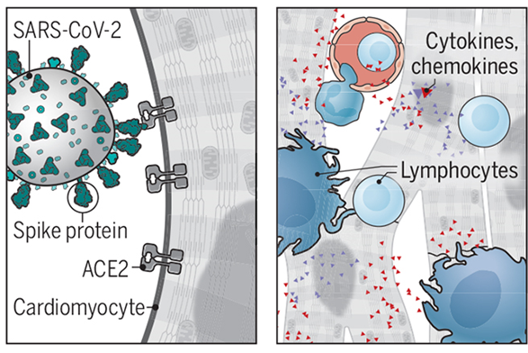
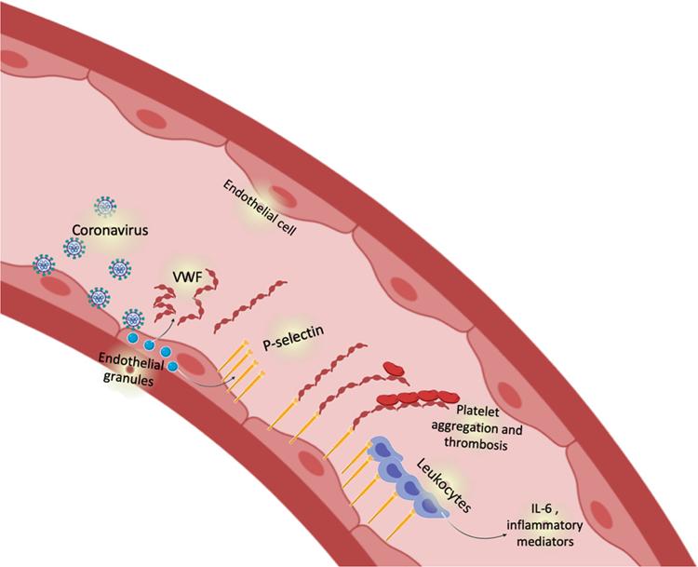
Mechanisms of COVID-19 Cardiac Involvement
Alterations in Immune Function
Systemic Inflammatory Response
Direct Viral Toxicity (ACE2)
Endothelial Dysfunction
Cardiovascular Manifestations
Diagnostic:
⬆ Troponin
⬆ Inflammatory/immune markers
Myocardial dysfunction (Echo)
Inflammation/fibrosis (CMR)
Clinical:
Symptoms: Palpitations, fatigue, dyspnea, chest pain
Functional limitations: 6MWT, NYHA, QOL
Clinical Syndromes:
  Myocarditis
  Cardiomyopathy
  Arrhythmia
  Acute coronary syndrome
  Thrombotic
Myocardial
injury
Topol EJ. Science 2020;370:408-409; Lowenstein CJ and Solomon SD. Circulation. 2020; 142: 1609-1611
Notes:
There are several proposed mechanisms under investigation for cardiac involvement of covid19. These include…
The resultant myocardial injury may clinical manifest both acutely or chronically as follows.
Diagnostic testing may reveal elevated markers of cardiac injury (ie troponin), myocardiac dysfunction on TTE which we will get more into, and abnl on CMR which has garnered a lot of attn with several conflicting studies on prevalence of myocardial involvement.
Clinically in addn to symptoms, this can result in CV syndromes which next slide

Slide 30
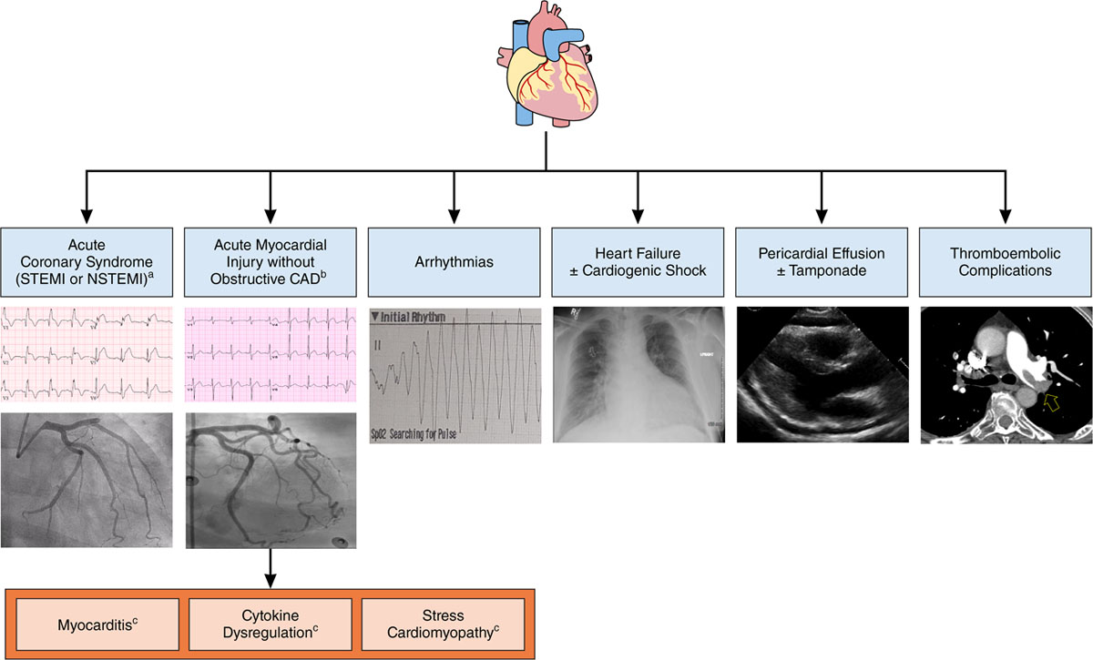
Clinical cardiac manifestations
Hendren NS et al. Circulation. 2020;141(23): 1903-1914
Notes:
Clinical syndromes summarized here
The challenge is when cardiac involvement is not so overt

Slide 31
Myocardial injury in acute COVID-19
Several early studies indicated high prevalence of myocardial injury (defined by elevated serum Troponin level) in acute, hospitalized patients
Elevated Troponin, along with underlying CV comorbidities, associated with more severe COVID-19 and worse survival
Markers of cardiac stress (pro-BNP) also associated with mortality, new HF, mechanical ventilation, even after adjusting for underlying comorbidities, BMI and troponin
Shi S et al. JAMA Cardiol. 2020 Mar 25.
De Michieli L et al. Clin Biochem. 2021 -01-30.
Lala A et al. J Am Coll Cardiol. 2020 -08-04;76(5):533-46.
Metkus TS et al. Circulation 2020.
Aslam MI, Gilotra NA et al. Crit Care Explor. 2021 Jul; 3(7)
Notes:
Upwards of 25% of hospitalized patients
Higher in those w severe disease

Slide 32
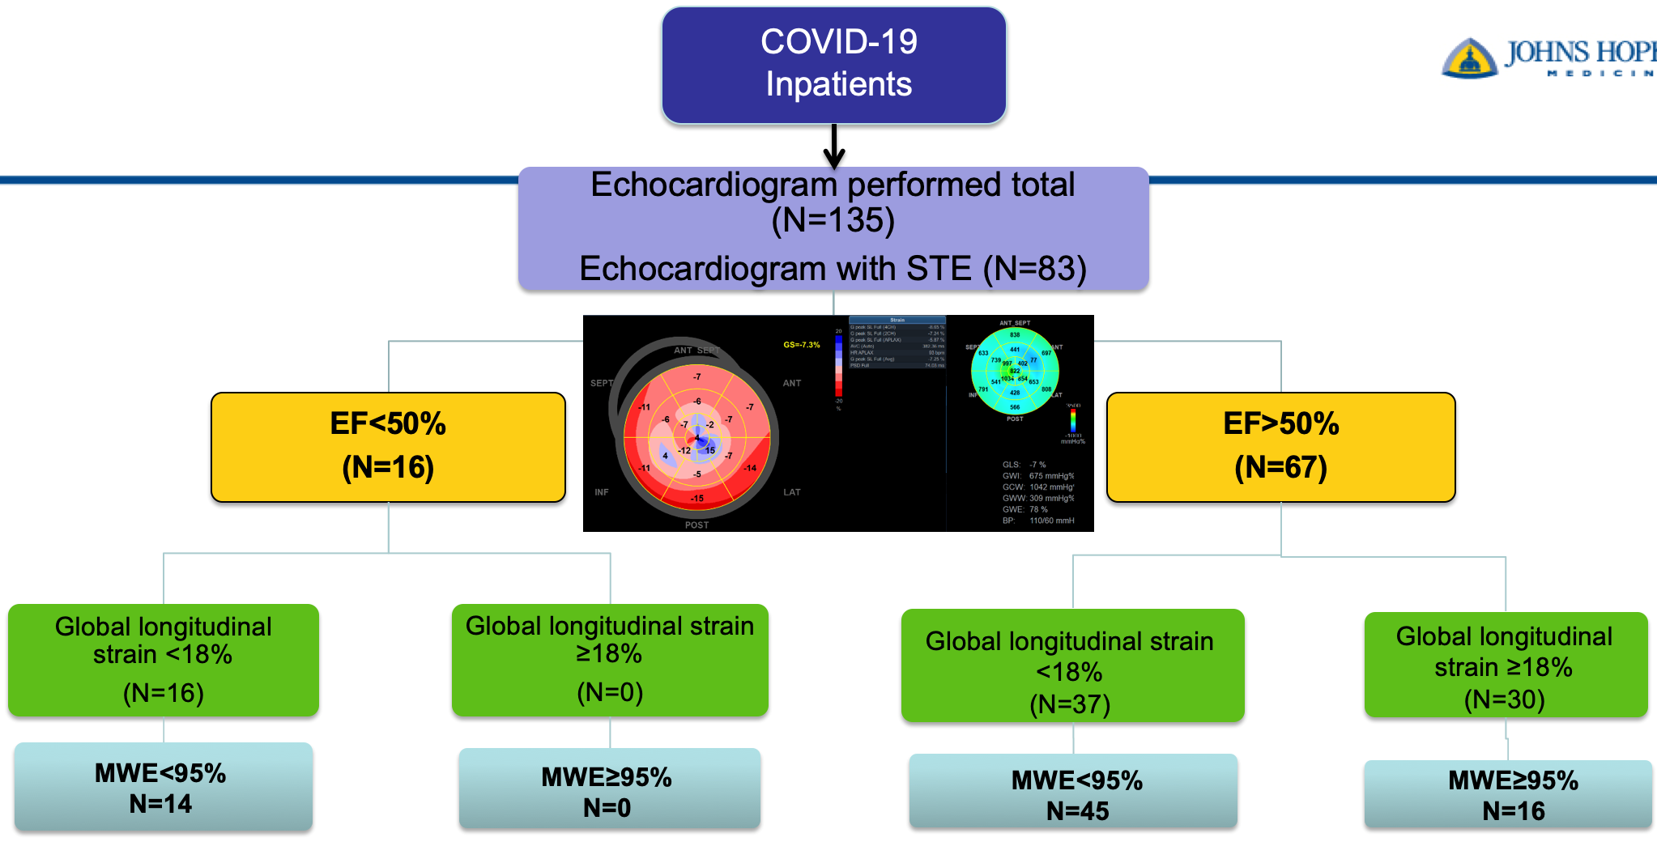
Subclinical cardiac dysfunction is prevalent:
JH study of COVID-19 inpatients
Unique reduced basal longitudinal pattern
↑IL-6
Goerlich E, Gilotra NA, Cingolani O et al. J Card Fail. 2021 Jan;27(1):100-104
Anum S. Minhas, MD, Nisha A. Gilotra, MD, Erin Goerlich MD, Brian Garibaldi, MD, …Allison G. Hays, MD. Front Cardiovasc Med. 2021 Jun 14;8:667721
Notes:
Early in the pandemic we worked with our covid clinical response team to incorporate cardiac evaluation, including echo protocol, into the inpatient covid clinical pathway. What we noticed was the majority of patients undergoing echo had ‘normal heart function’ , or EF. But given the reports of prevalent myocardial injury, we retrospectively looked at novel markers of cardiac function using speckle tracking echocardiography, such as myocardial work efficiency, light blue boxes, and found that myocardial dysfunction was actually highly prevalent despite normal LVEF.
In addition, increased systemic inflammation measured by interleukin-6 level was associated with reduced MWE, which in turn was also assoc with inc in hospital mortality after adjustment.

Slide 33
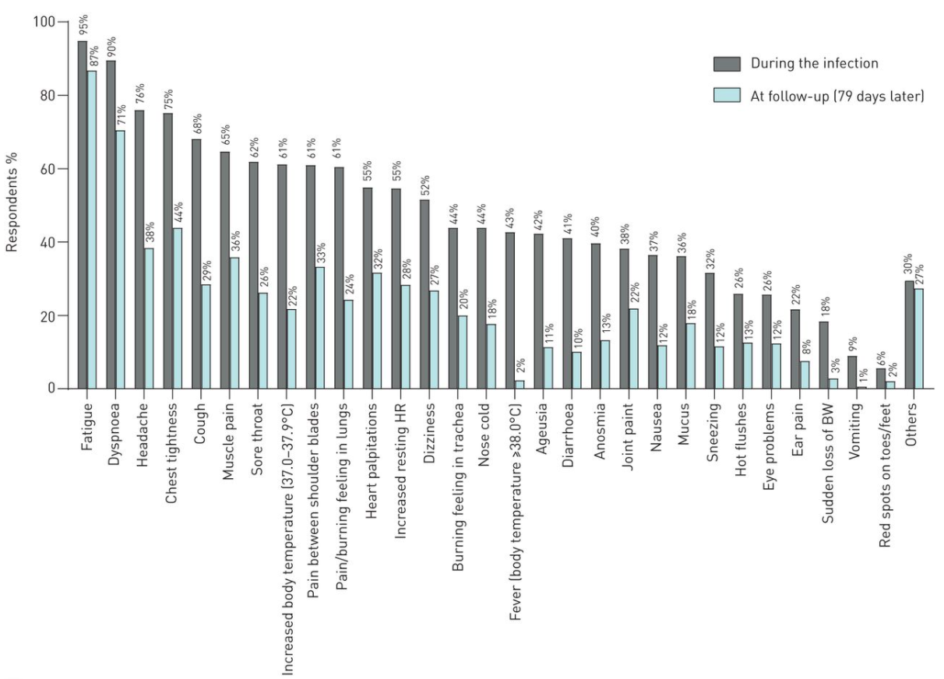
Post-acute COVID-19
Cardiac symptoms are prevalent
79 days post:
Fatigue 87%
Chest tightness 44%
Heart palpitations 32%
ERJ Open Res. 2020 Oct; 6(4): 00542-2020.
Notes:
As we enter our second year into the pandemic, attention has shifted to post acute covid19 syndrome which is characterized by ongoing symptoms after presumed convalescence from acute viral infection. These sxs overlap with CV sxs which are prevalent even 6 months out from infection as demonstrated in several cohorts

Slide 34
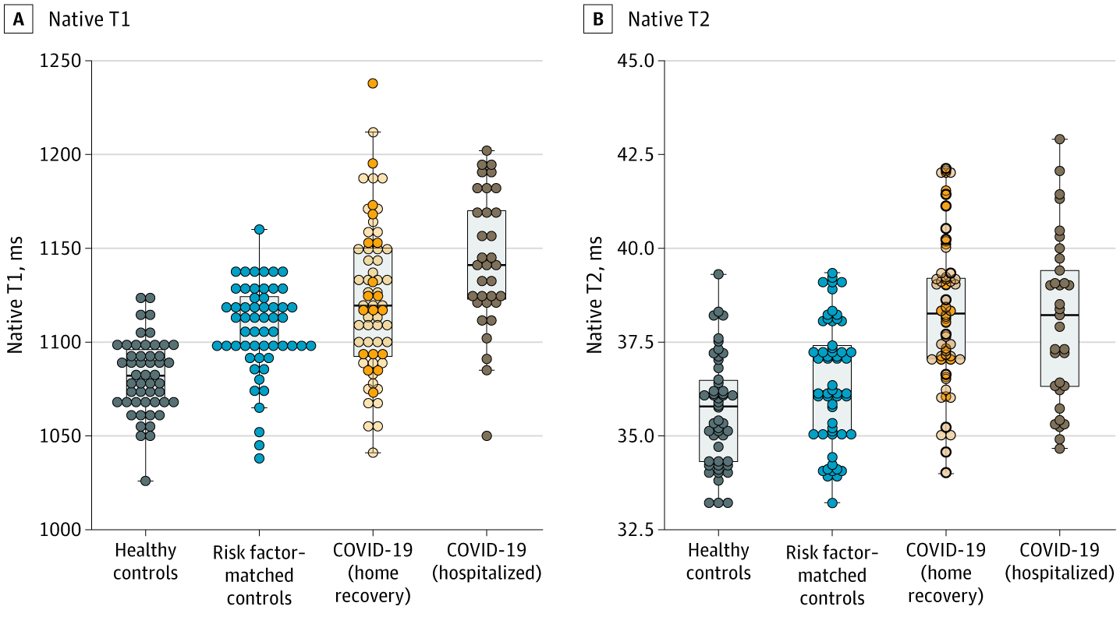
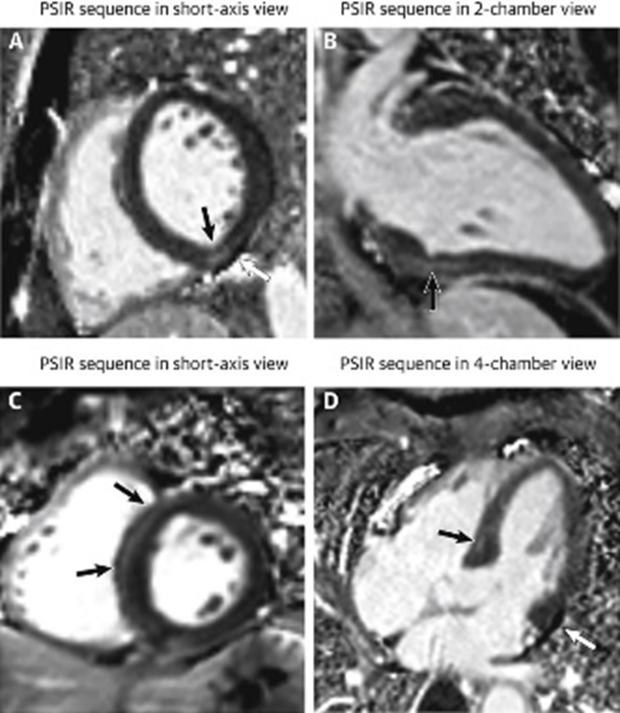
Post-acute COVID-19
Cardiac involvement on imaging
100 patients recovered from COVID-19
CMR at 71 d post infection (33% hospitalized)
Abnormal CMR findings: 78%
  Late gadolinium enhancement: 32%; Pericardial enhancement: 22%
26 patients, CV symptoms, CMR at 47 d Abnormal CMR findings: 58%
  Late gadolinium enhancement: 31%; Myocardial edema: 54%
Puntmann VO, et al. JAMA Cardiol. 2020; 5 (11): 1265-1173
Huang L, et al. JACC Img. 2020; 13: 2330-2339
Notes:
MRI studies in patients largely with CV symptoms or hospitalization so higher risk cohort
Much more rare in mild/asymptomatic disease as demonstrated in some screening studies of athletes
More to come

Slide 35
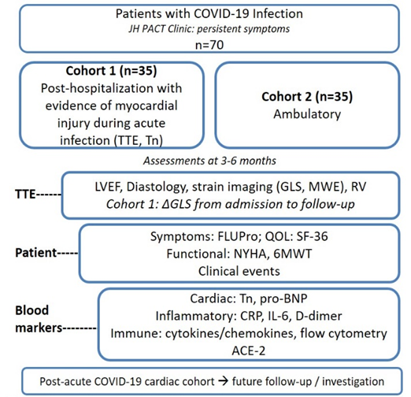
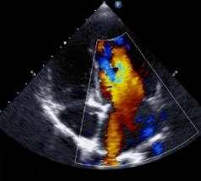


What are the longer term cardiac sequelae?
Hypothesis: myocardial dysfunction assessed by echocardiographic strain imaging is present in patients along the spectrum of COVID-19 severity and is associated with systemic inflammation, and functional CV status.
  Enrollment as of 10/1/21: N=22
  12 F;10 M
  15 post-hospitalization with myocardial injury; 7 non-hosp PACS
  8 White, 12 Black, 1 Hispanic, 1 Asian
Notes:
Bentivo
There were 22 participants enrolled. (F-12, M-10)
Hospitalized-15
Long Covid-7
White-8 (F-3, M-5)
Black-12(F-9, M-3)
Hispanic-M-1
Asian-M-1
glio Family Fund and the Post-acute COVID-19 Syndrome Discovery Fund of the Johns Hopkins University

Slide 36
Myocarditis in the COVID-19 pandemic
Acutely: may be due to direct viral replication and/or cytokine storm
Can result in cardiomyopathy, arrhythmia
Chest pain, dyspnea, fatigue, palpitations
Remains a diagnostic challenge with overlap with non-cardiac symptoms
Vaccine-related autoimmunity

Slide 37
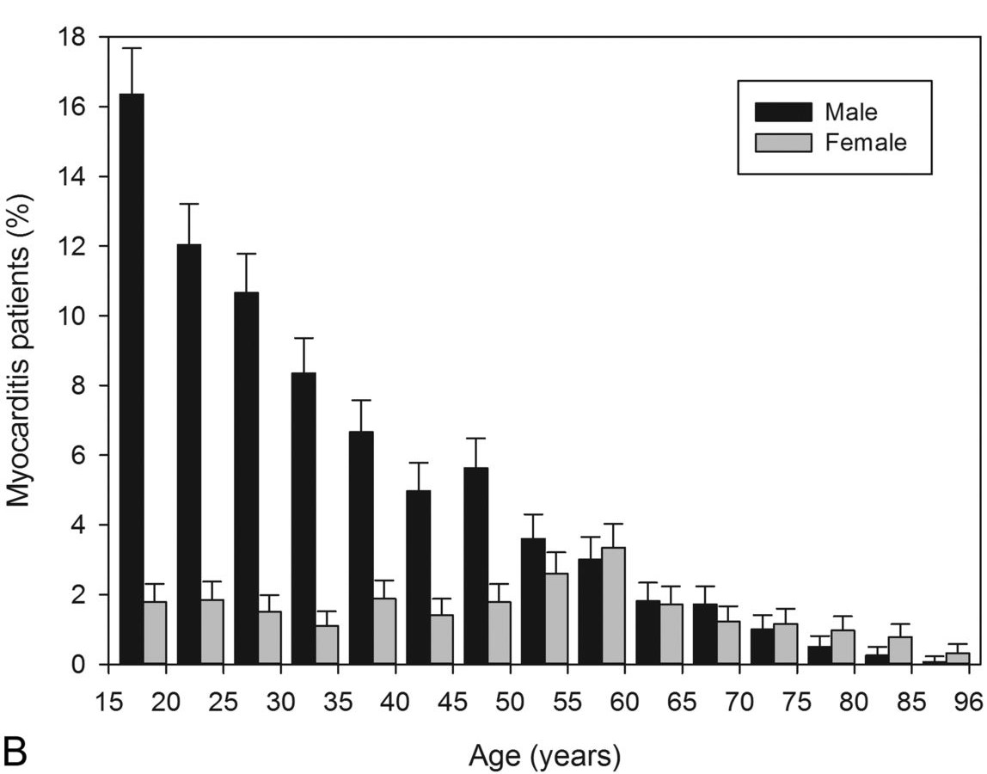
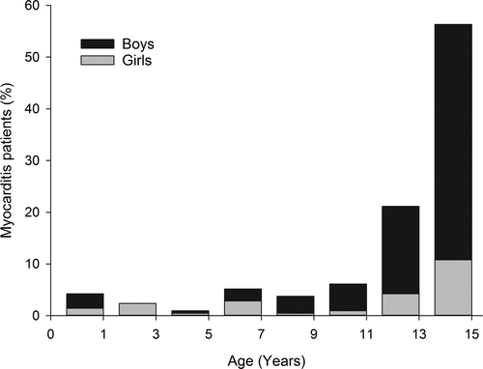
Effects of gender and age on myocarditis rate
Adults: higher overall male prevalence, pronounced at younger adult age
--women peak in post menopausal age (impact of sex hormones)
Children: increasing male prevalence with increasing age
--exercise, testosterone
Kyto et al. Heart 2013;99.
Notes:
Sex differences in long term pasc?

Slide 38
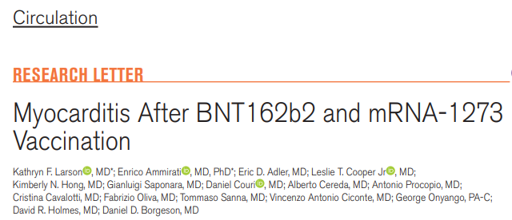
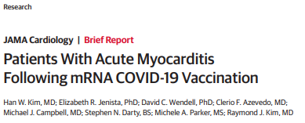
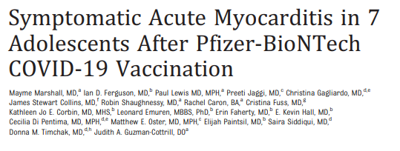
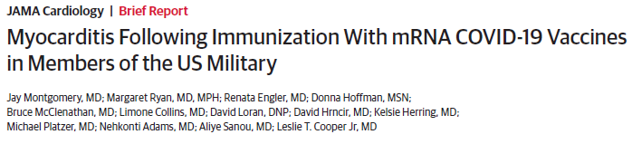
COVID-19 mRNA vaccine related myocarditis: early case series

Slide 39
COVID-19 mRNA vaccine related myocarditis: early case series
Generally, young adult males developing symptoms within days of mRNA vaccine
Diagnosis made based on clinical symptoms, elevated serum Troponin and CMR
Most cases self-resolving with treatments varied but including steroids, colchicine, NSAIDs, BB, ACEi/ARB
Limited histopathologic data

Slide 40
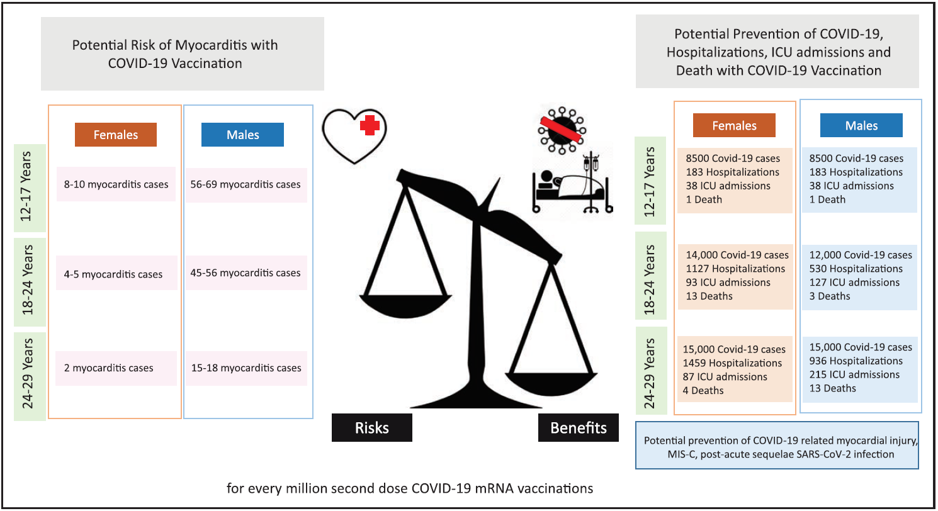
Bozkurt et al. Circulation 2021;144:471-484 CDC ACIP COVID-19 Vaccines. June 2021.

Slide 41
Knowledge gaps and opportunities in Post-acute COVID-19 and cardiovascular health
Identification of optimal cardiac screening post-acute COVID
Clinical significance of noninvasive, bedside diagnostics (i.e. speckle tracking echo) in subclinical disease
Partner cardiac imaging and ambulatory monitoring (rhythm) with data on viral dynamics and immunology
Prevalence of long-term CV impact, will require study of patients with asymptomatic/mild disease and cohort studies
Can long-term CV event risk be modified: HF GDMT, Exercise restriction, arrhythmia
Development of personalized treatment strategies: Targets, monitoring Rx Response

Slide 42
PASC Patient Perspective

Slide 43
PASC Research Summary and Future Goals

Slide 44
JHU PASC Autopsy Study
Kelly Gebo, MD MPH
Division of Infectious Diseases
Keri Althoff, MPH, PhD
Department of Epidemiology
Bloomberg School of Public Health

Slide 45

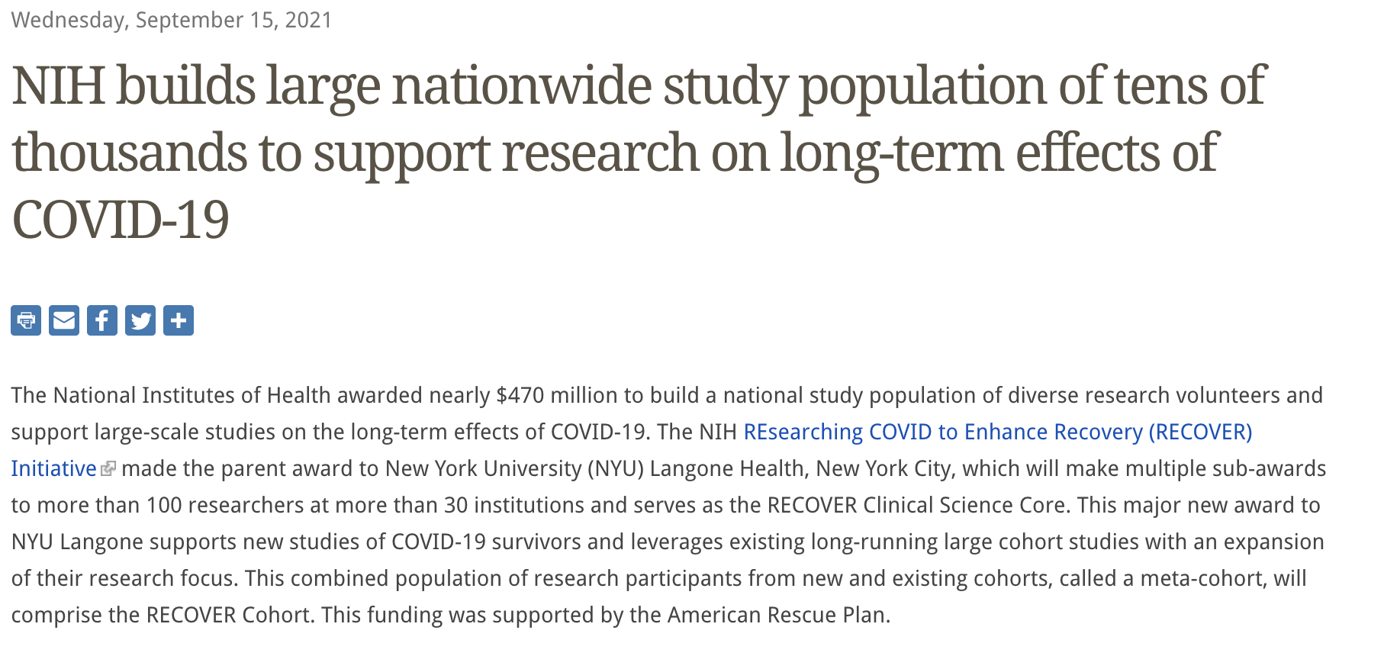

Slide 46
Clinical Science Core (NYU)
Data Resource Core (MGH/Harvard)
Biorepository (Mayo)
Data Repository
Mobile Health Platform
Autopsy
EHR
Clinical Cohorts
  Pediatrics
  Adult

Slide 47
Autopsy (Jody Hooper, Angelo DeMarzo)
  700 across 7 sites
  400 PASC, 200 Acute COVID, 100 controls
  Protocol being finalized
  Enrollment to begin soon

Slide 48
PASC Collaboratory
Kelly Dooley

Slide 49
Questions/Discussion
COVID-19 Clinical Research Center

