Slide 1
ICTR Clinical Research Professionals Lecture Series
Monday August 29th 2022

Slide 2
WELCOME
Clinical Research Professionals Lecture Series
New Lecture Series geared to bring innovative and new topics to Clinical Research Professionals at Johns Hopkins
https://ictr.johnshopkins.edu/events/clinical-research-professionals-lecture-series/
Topics are based on questions received from Clinical Research Professionals throughout Hopkins
Welcome topic suggestions: sswords1@jhmi.edu
Welcome speakers!

Slide 3
Agenda
Remote & eConsent:
Liz Martinez – Research Participant Advocate
Suzanna Roettger - Associate Director Compliance Monitoring
Lauren Swedberg - Sr. Consent Form Specialist
Questions and Discussion

Slide 4
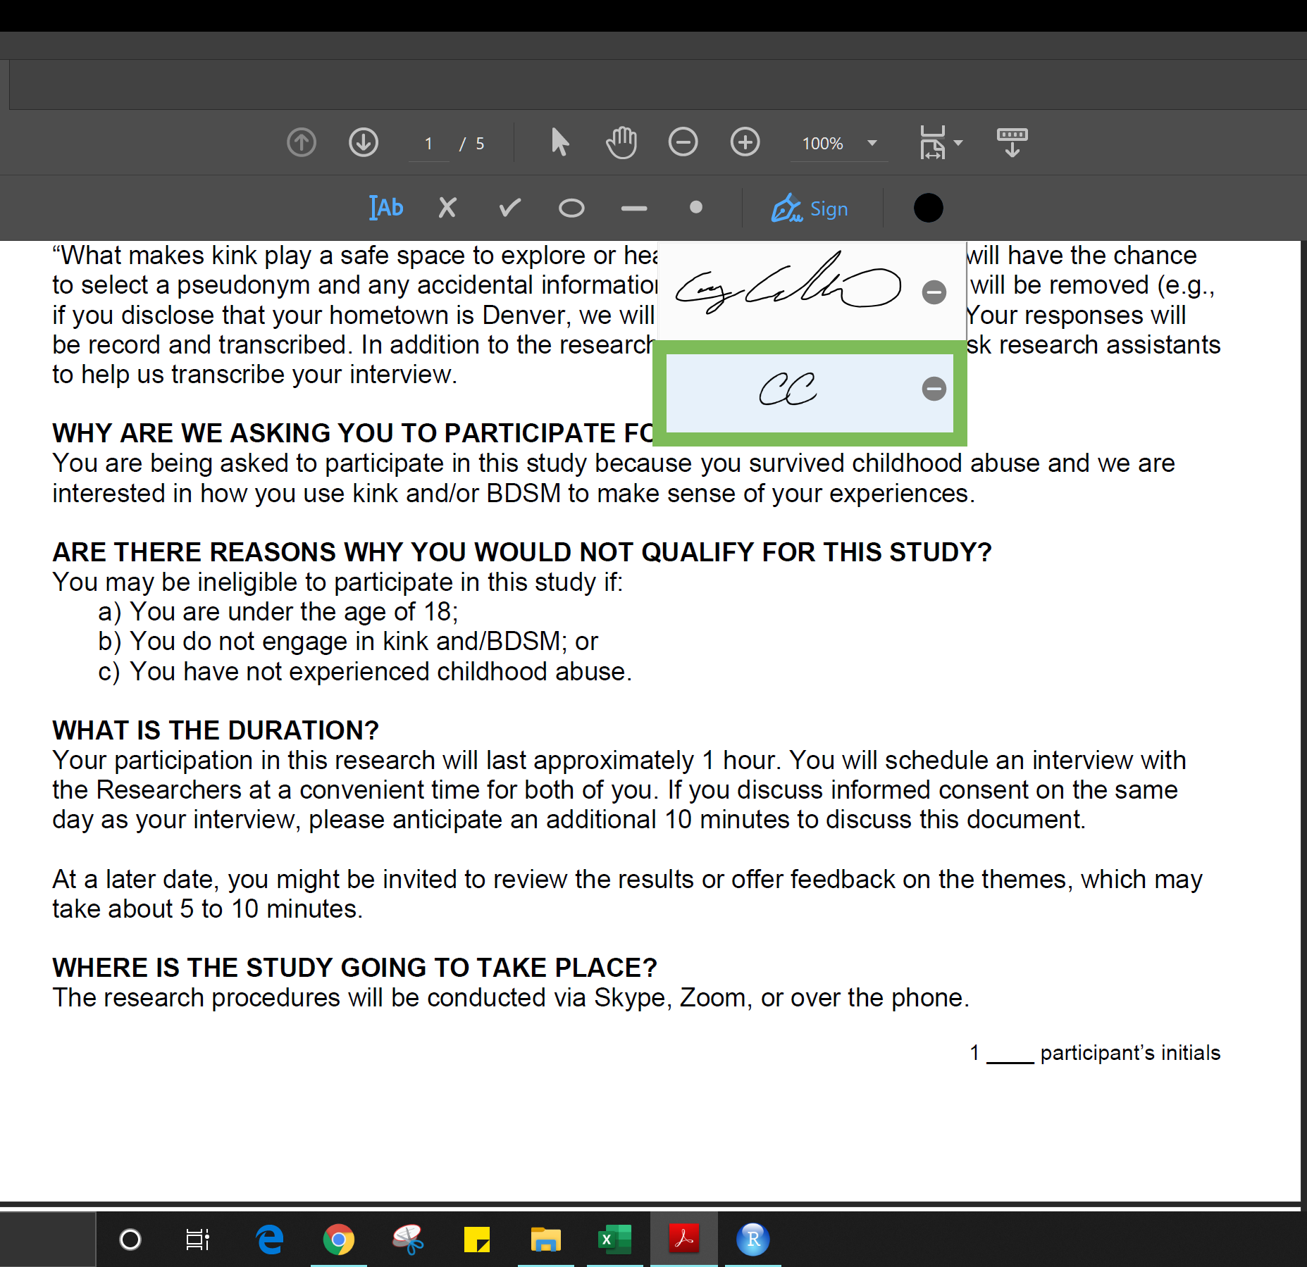
Remote Consent and eConsent
Both remote consent and eConsent were in limited use pre-pandemic.
Not surprisingly, there was an increase in their use during the Covid-19 pandemic.
Will there be continued or increasing use of these modalities in the consent process moving forward?

Slide 5
Remote Consent
Remote consent is a consent process that allows the person conducting the consent and the potential participant to engage in the informed consent process in a way that is similar to what would be conducted in-person under normal circumstances without being in the same physical location.

Slide 6
eConsent
eConsent is an electronic media/format that can be used to supplement or replace paper-based informed consent forms to provide information to a potential research participant. It can also be used to obtain documentation of consent (e-signatures.)
eConsent can be conducted both in person or remotely.

Slide 7
Remote and eConsent
Combinations of remote, e-consent, and or e-signatures can be used together to accomplish the Informed Consent Process.
How these modalities are implemented should take into consideration the qualities of the research study, the type of participants, regulations, institutional policies and the research team itself.
There is no single “best way” to execute these consent modalities for all research.

Slide 8
Use of Remote and eConsent
The Research
Level of Risk
Complexity of the Study
Acuity of Disease
# of consents
Research Team
Level of Training
Communication Ability
Access to Technology
Consent
Method
Participants*
Demographics
Access to Technology
Trust/Acceptance
Institution
Local Resources
IRB and Institutional Policy
Laws/Regulations
*See Resource: Chen C, Replacing Paper Informed Consent with Electronic Informed Consent for Research in Academic Medical Centers: A Scoping Review. (2020)

Slide 9
Remote Consent Best Practices
FDA Guidance provided during the Covid pandemic provided detailed considerations for conducting remote consent processes.
We can use this material to guide practices for appropriate conduct of remote consent processes.

Slide 10
Remote Consent Best Practices
The person providing consent must have a copy of the consent form
Best Practice:
Provide the consent form for review prior to discussion.
Ask the potential participant to write out their questions.
eConsent (to be discussed later in presentation)
email (secure release)
mail
text
provided “in-person”
at a visit

Slide 11
Remote Consent Best Practices
phone
videocall
telemedicine
Best Practice: landline
Best Practice: secure platform
Best Practice: when available
Best Practice:
Elements of the study described in the form will be presented
Conversation about these elements will occur
The participants questions will be answered
The participants understanding will be evaluated

Slide 12
Remote Consent Best Practices
Remote signatures must include a method to ensure that the signer of the consent form is the person who plans to enroll as a participant or is authorized to sign for the participant
Best Practice:
The person obtaining consent must verify the appropriate person physically signed the consent document :
view via video conference or,
obtain a photo of the signed consent document or,
obtain verbal confirmation that they signed the consent form or agreed to participate electronically.
A signed consent document must be in possession of the study team before any study related procedures are initiated.

Slide 13
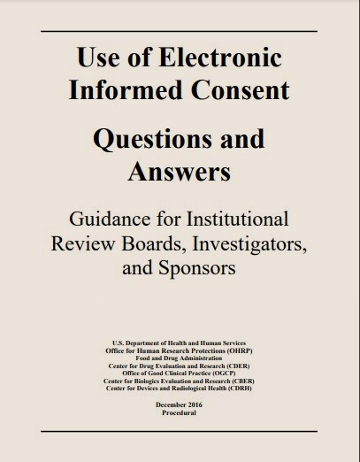
eConsent Best Practices
FDA Guidance document published in 2016 provides considerations for the use of electronic consent processes in research.

Slide 14
eConsent Best Practices
“Whether part or all of the eIC process takes place on-site or remotely, the responsibility for obtaining informed consent remains with the investigator and the study personnel to which responsibility has been appropriately delegated. The investigator cannot delegate the authority to obtain consent to the electronic system.” FDA Guidance “Use of Electronic Consent” (2016)
Best Practice:
As with in person consent using paper forms:
Present the elements described in the form
Converse about these elements
Answer the participants questions
Evaluate the participants understanding

Slide 15
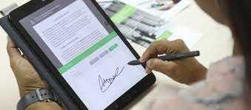
eConsent Best Practices
eSignatures are an important part of eConsent
Best Practice US:
FDA regulated Investigations:
In-person eSignatures -personnel may verify the persons identity
Remote eSignature -must comply with 21 CFR part 11 (user name password combinations, computer readable ID cards, biometrics, or digital signatures.)
OHRP/Research under 45 CFR part 46: Risk based identity verification which for minimal risk could mean no verification or waiver of documentation of consent.

Slide 16
Johns Hopkins DocuSign
Johns Hopkins Instituted DocuSign as eSignature tool in 2020
Attention:
DocuSign Costs may eventually be the responsibility of the study
Choice based on:
21 CFR part 11 compliance
Quick set up
Study team ability to add forms
Best Practice JH:
Used for FDA and non FDA regulated research* (*if requested by study)
IRB approved consent document uploaded as a pdf into DocuSign for use.
JH developed and provided training which is required for all users.

Slide 17
DocuSign Continued
To use DocuSign you will need to fill out a form from the DocuSign team at researchdocusign@lists.johnshopkins.edu
Study must be approved by DocuSign team before submission to the IRB
All signatures will be required as they would for any written consent form

Slide 18
Johns Hopkins DocuSign Experience
Top Perceived Issues in use of DocuSign at JH:
Participant problems logging in and/or accessing the consent in DocuSign
Pediatric consents when child has to sign are not feasible
Non-English consent problems
Set up effort too significant for low enrolling studies

Slide 19
Johns Hopkins REDCap
REDCap for eConsent and eSignature
Research not requiring 21 CFR part 11 compliance
System Readily available at JH
Support on site
Study team able to add forms

Slide 20
REDCap
Can be used without modifications if the study is minimal risk and has been IRB-approved for a waiver of documentation of consent
Modification is required to be used to obtain legally effective signatures (greater than minimal risk studies)
Subject’s identity can be verified with a code or authenticator
There is a place for the subject to enter name or click to agree to participate
Study team responsible for modifying REDCap
IRB approved consent language added into RedCap by trained team member.

Slide 21
Johns Hopkins REDCap Experience
RedCap eConsent/eSignature Experience
RedCap eConsent and eSignature in use pre pandemic
Roughly 110 studies currently using RedCap for research requiring a signature
More using it for research not requiring a signature
Top perceived issues with use of RedCap eConsent and eSignature at JH:
In order to use RedCap for research requiring part 11 compliance there is a complex certification process that the site must execute (JH currently not part 11 compliant).
Version control concerns with IC documents.

Slide 22
Remote and eConsent Best Practices
Remote/eConsent consent methods need to be accurately documented
When using remote consent/DocuSign a PDF copy (fully signed and dated by all necessary parties) of the consent should be uploaded to Epic with a research note indicating that remote/ eConsent was conducted.
Utilize a consent checklist to document the informed consent process to confirm consent process completeness and compliance.
A note to file or note on the consent checklist detailing specific dates when form was sent, when the conversation took place, who was there, explanation of differing signature dates, etc.
Assure the participant has a copy of the consent form for their records (signed is preferred).

Slide 23
REDCap versus DocuSign
Platform for presenting consent information electronically | Platform for obtaining electronic consent signatures
May included interactive elements: images, videos, narration or quizzes to aid and evaluate understanding | Uses standard pdf image of the consent document.
May not be used for FDA regulated research unless upgraded to Part 11 compliant | May be used for FDA regulated studies (and others.)
Signatures may not be legally valid (authentication and attestation needed) | Signatures legally valid

Slide 24
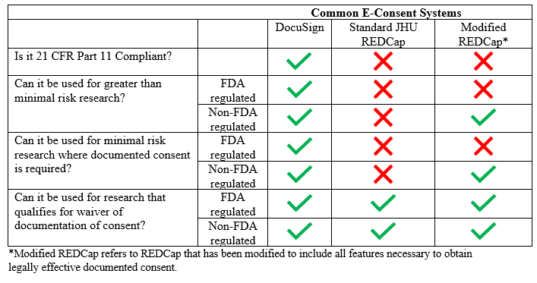
DocuSign versus REDCap cont.

Slide 25
IRB Approval
These Consent processes must be IRB approved prior to implementation.
Best Practice:
Provide information to the IRB as to how you will satisfy each of the items discussed in the previous slides with your remote/eConsent process.
When outlining your remote/eConsent plan for the IRB, include alternative options of obtaining consent from participants who cannot engage in a remote/eConsent process (*if this will be an option for your particular research.)

Slide 26
Submitting Remote/eConsent Requests to IRB
How to request IRB approval for remote/eConsent
Any consent method needs to be IRB approved before use
Currently the eIRB system does not have a separate section for remote/eConsent
Where you will include information and forms depends on whether the consent method is considered ‘documentation of consent’ or ‘waiver of documentation of consent’

Slide 27
Submitting Remote/eConsent Requests to IRB
Documentation of Consent | Waiver of Documentation of Consent
eIRB Section 15: “Written Consent” | eIRB Section 16: “Waiver of Documentation of Consent”
For documented consent methods: | For non-documented consent methods:
In-person consent with wet signature | Oral consent script
REDCap with ID verification | Standard JHU REDCap
Other eConsent where participant’s identity is verified | Other eConsent where participant’s identity is not verified
DocuSign

Slide 28
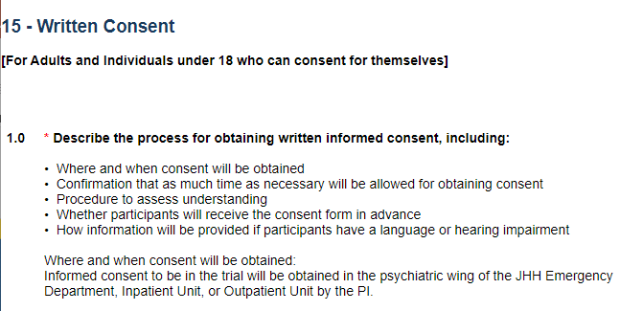
What to submit to the IRB: Remote/eConsent
eIRB Section 15
DocuSign:
Add language provided by the DocuSign team
Remote consent:
Add language from IRB website

Slide 29
What to submit to the IRB: Other eConsent
eIRB Section 15/16
Other eConsent Systems:
Explain the process for obtaining eConsent
State what system you will use
Explain that system is Part 11 compliant (if needed)
Explain that system is able to document and authenticate consent (if needed)
Confirm whether the electronic version includes all of the same information as non-electronic or explain differences
Ex: graphics in electronic version

Slide 30
What to submit to the IRB: Remote/eConsent
Consent Forms
Remote consent using wet signature:
No changes needed to the consent form
DocuSign:
Written consent form signature lines need extra space for DocuSign signature overlay
PDF of written consent is used in DocuSign system

Slide 31
What to submit to the IRB: Other eConsent
Consent Forms
If you will only use eConsent
Upload the eConsent form as a Word document
Include the signature/‘agree to participate’ page from the eConsent system in the Word document for the IRB to review
You will receive a stamped PDF of the eConsent form

Slide 32
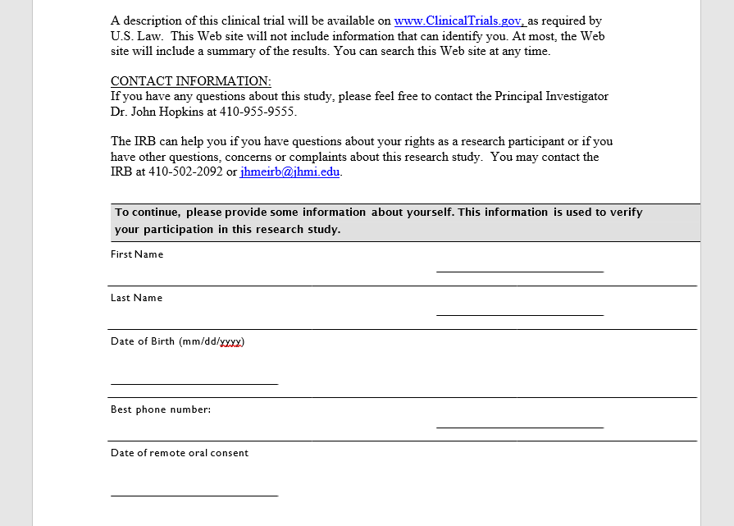
eConsent Script with REDCap ‘Agree to Participate’ Page

Slide 33
What to submit to the IRB: eConsent
Consent Forms
If you will use eConsent and non-electronic consent
Only upload the non-electronic version
Having 2 versions of the same form – greater chance of errors
The format and content of the consent in the eConsent system should be as similar as possible to the non-electronic version.
If there are differences between the non-electronic and electronic versions, explain in eIRB or upload the electronic version in a Word document for review

Slide 34
What to submit to the IRB: eConsent
Consent Forms
If you will use eConsent and non-electronic consent
Upload the eConsent ‘agree to participate’/signature page by itself in the eIRB consent section if:
The signatures will be considered legally effective documented consent
The page differs from the non-electronic version (e.g. if you will be collecting DOB or phone number in the eConsent system)
This page will be reviewed but not stamped

Slide 35
Sponsor/Other eConsent Systems
Sponsor or other institutions’ eConsent systems may be used if they can be modified to include state law and Hopkins institutional requirements:
Physician consent page
Financial Information Sheet signature line
Example: can add the physician consent as a separate “survey” in REDCap
Sometimes these systems cannot accommodate Hopkins requirements and the study teams are not able to use eConsent

Slide 36
eConsents
Consent Forms
Reminder: Whenever edits to the consent form are IRB approved, don’t forget to update the consent in the eConsent system

Slide 37
What to submit to the IRB: Outside eConsent Systems
eIRB Section 20.2
If using a Part 11 compliant eConsent system, upload any of the following:
A letter/email from the system “owner” verifying that the system is Part 11 compliant
An official product descriptor of the eConsent system (i.e. from the eConsent system’s official website) verifying it is Part 11 compliant
An email from an IT professional at the host institution verifying the system is Part 11 compliant
Documentation from the sponsor that the system is Part 11 compliant.

Slide 38
What a Monitor Expects
Per FDA, HHS, and JHU requirements, consent documentation, regardless of the modality, must be obtained prior to the initiation of study procedures.
The presence of fully signed and dated consent forms, in their original modality, either in hard-copy or electronic.
Additional signatures must be obtained for internal options, Financial Information, and MD/APP, if applicable.
That the methods employed are approved by the eIRB in 15.1/16.1 and specify the use of eConsent and/or remote consent

Slide 39
Remote/eConsent Questions?
Review the Remote/Electronic Consent FAQ on the IRB website
https://www.hopkinsmedicine.org/institutional_review_board/guidelines_policies/guidelines/remote_consent_and_eletronic_consent.html
Reach out to IRB staff with questions about remote or eConsent options

Slide 40
Questions?
Contact Information:
Stephanie Swords: sswords1@jhmi.edu
Liz Martinez: liz@jhmi.edu
Suzanna Roettger: sroettg1@jhmi.edu
Lauren Swedberg: lswedbe1@jhmi.edu

Slide 41
Reference
Rothwell, E., Brassil, D., Barton-Baxter, M., Brownley, K., Dickert, N., Ford, D., Wilfond, B. (2021). Informed consent: Old and new challenges in the context of the COVID-19 pandemic. Journal of Clinical and Translational Science, 5(1), E105. doi:10.1017/cts.2021.401

Slide 42
Resources
Chen C, Lee PI, Pain KJ, Delgado D, Cole CL, Campion TR Jr. Replacing Paper Informed Consent with Electronic Informed Consent for Research in Academic Medical Centers: A Scoping Review. AMIA Jt Summits Transl Sci Proc. 2020 May 30;2020:80-88. PMID: 32477626; PMCID: PMC7233043.
“Conduct of Clinical Trials of Medical Products During the COVID-19 Public Health Emergency Guidance for Industry, Investigators, and Institutional Review Boards March 2020 Updated on August 30, 2021” https://www.fda.gov/media/136238/download
“Use of Electronic Informed Consent Questions and Answers Guidance for Institutional Review Boards, Investigators, and Sponsors” December 2016 https://www.fda.gov/media/116850/download
Vanderbilt Institute for Clinical and Translational Research RedCap eConsent Website https://victr.vumc.org/econsent_basics/

Slide 43
Learning as we go
“The pandemic spurred innovation and demonstrated the feasibility of different approaches to informed consent. Most concretely, e-consent and other remote consent methods were rapidly implemented in order to facilitate important research in a situation where traditional methods could not be used. Moving forward, more tools are now available to research teams, but important questions remain regarding how to use these tools most effectively in order to advance key goals of consent. It is especially important that novel platforms be harnessed to address, and not exacerbate, well-known problems with traditional informed consent.”
Rothwell, E (2021) Journal of Clinical and Translational Science.

Slide 44
“Quick Look Data” at JH
The RPSS (Research Participant Satisfaction Survey)
For 5 years we have been asking questions about how well the consent and consent discussions prepared participants for what to expect during the study
During the pandemic we added a couple of questions about how consent was conducted
Surveys completed July 2021 and February 2022

Slide 45
“Quick Look Data” at JH

Slide 46
“Quick Look Data” at JH

