Slide 1
ICTR Summer Showcase
Friday, June 6, 2025
1:00pm – 2:00pm

Slide 2
Agenda
Dr. Daniel Ford – Overview of all programs
Programs
  Clinical Research Units - Todd Brown and Liz Martinez
  REDCap – Scott Carey
  Research Coordinator Support – Tony Keyes
  Recruitment Resources - Cassie Lewis-Land

Slide 3
Welcome
Daniel E Ford, MD, MPH
Senior Associate Dean for Clinical and Translational Research
Director, Institute for Clinical and Translational Research

Slide 4
Working with the ICTR
Partnering with and providing services to research teams since 2007
Have pilots that provide funds to teams, have free services including consultations, and have services that have a cost to research teams
Provide access to regional partners
  University of Maryland Baltimore
  Morgan State University
  Kaiser Permanente MidAtlantic
  Johns Hopkins Clinical Research Network
  PCORI funded PCORNet

Slide 5
Let Us Help You
Reach out to the ICTR when you are planning your study and submitting an application!!!

Slide 6
ICTR Programs
Accelerated Translational Incubator Pilot (ATIP) Program
Kaiser Permanente- JHM Pilot Program
Clinical Research Units (CRUs)
ClinicalTrials.gov Support
Community Collaboration Core
Henrietta Lacks Events
CCDA (Core for Clinical Research Data Acquisition)
Drug Discovery and Development (D3) Program
Education and Career Training – K12, Predoc T
BIRCWH NIH Training Program
ICTR Biostatistics Program and Johns Hopkins Biostatistics Center (JHBC)
Core Lab
Exercise and Body Composition Core
Johns Hopkins Clinical Research Network (JHCRN)
OpenSpecimen (Biospecimen IT)
TriNetX
PaTH PCORNet PCORI program
Research Coordinator Support Service (RCSS)
Data Managers Interest Group
Research Electronic Data Capture (REDCap)
Research Ethics and Regulatory Consultations
Recruitment Innovation Unit (RIU)
Research Nutrition
ICTR Research Studio Consultations
Trial Assistance Program
Trial Innovation Unit (TIU)

Slide 7
Clinical Research Programs
Todd Brown and Liz Martinez

Slide 8
Johns Hopkins ICTR Clinical Research Units
June 6, 2025

Slide 9
Overview of CRU Network
CRUs provide an essential service for the safe conduct of clinical research with specialized nursing staff and additional services for deep phenotyping of participants
CRUs provide unique services for prolonged and intensive research
Superb safety and quality performance record

Slide 10
Overview of JH Clinical Research Unit Network
  Bayview Domiciliary/Outpatient Unit
    Medical Director: Huhn; Nurse Manager: Dawson
  JHH Outpatient Research Unit
    Medical Director: Brown; Nurse Manager: De’Jarnette
  JH Pediatric Research Unit
    Medical Director: Wood; Nurse Manager: Salamone
  JHH Inpatient Research Unit
    Medical Director: Flexner; Nurse Manager: Street/Martinez

Slide 11
Bayview Domiciliary/Outpatient Unit
13,842 sq. ft. space on the 4th floor of the 301 Building; 24/7 service
10 overnight dedicated research beds including 8 overnight study rooms that have video and audio monitoring capability
Space shared with Outpatient Unit: phlebotomy, interview rooms, procedure rooms, gyn exam room, dental exam room, sample processing lab, -70 freezer,
8 nurses (6 RNs, 2 LPNs) and 2 technicians (who support overnight and outpatient visits)

Slide 12
JHH Outpatient Research Unit
5385 square foot unit space on the 3rd Floor of Blalock Building; M-F 7 AM-5 PM
11 full-service exam rooms, 2 interview rooms, a phlebotomy room, sample processing lab, -70 freezer, infusion center, and a DXA scanner.
3 nurses (2 RN, 1 LPN), a phlebotomist, 2 technicians
Negative pressure room
Scattersite Nursing Services in the afternoon

Slide 13
    JH Pediatric Research Unit
3,225 square foot space on 9N floor of Charlotte R Bloomberg Children’s Building
7 clinical exam rooms, an infusion facility, 2 procedure rooms, phlebotomy room, research kitchen
1 RN, 1 nursing assistant/phlebotomist

Slide 14
    JHH Inpatient Research Unit
Located on Nelson 5
Staffed by JHH clinical nurses, also trained on specific research protocols
Capacity for continuous cardiac monitoring and biologic isolation

Slide 15
Major Research Teams Supported by JH CRUs
Nephrology
Pulmonary
  CF group
  Sleep
ID
  HIV (ACTG)
  Emerging Infections (MPOX)
Endocrine
GI (Post-Pancreatitis DM U01)
Geriatrics (Pepper Center)
Rheumatology
Pediatrics
  Allergy
  Endocrine
  Genetics
  Renal
Psychiatry
  BPRU
  Carnell
Neurology
  MS Group
  Peripheral Nerve Group
  Neurovirology Group (Rubin)
  Neuroimmunology
  Alzheimer's
  Spinal Muscular Atrophy
PM&R: POTS
NIDA
BSPH
  Multicenter AIDS Cohort Study

Slide 16

JH Human Performance Core
Exercise testing (VO2 Max metabolic testing, stress testing)
  State of the art metabolic cart
  Upright bicycle and treadmill
6 minute walk testing
Certified exercise physiologist (Research/Clinical Hybrid)
Will Fountain, PhD, Director

Slide 17

The ICTR Research Nutrition Core provides nutrition research service and consultation for clinical investigators, for all disciplines in pediatric and adult research.
In-depth nutrition assessments
  Tastants
  Food challenges
  Food arrays
  Metabolic meals
Diet intake analysis for both macro- and micro-nutrients
Nutrition counseling
Anthropometric and body composition measurements
  DXA
  Bioelectrical impedance
  Anthropometric measurements
Energy expenditure assessments
Design and preparation of protocol-specific meals, snacks, and formulas.
Notes:
Staff:
Director Susan Oh
1 Sr. Nutritionist Bobbie Barron
2 Nutritionists Alice Lu, Jennifer Trost
1 Nutrition Tech Xiao Hu
1 Program Supervisor Liz Wilkins
Currently services 10 Departments , 15 PIs, 32 studies
Locations:
- PCRU – Bloomburg 9N
JH Adult CRU Blalock 3
BV CRU 301 Mason Lord Building
Pro Health

Slide 18
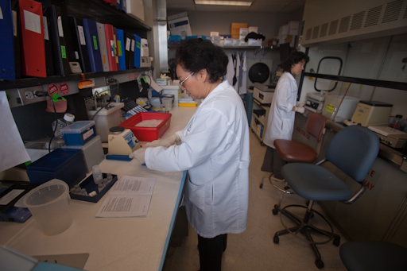

ICTR Bayview Core Laboratory
Provide technical support for sophisticated clinical research assays.
Provides facilities, technical experience and training for non-routine tissue, blood, saliva and urine sample analyses.
Provides consultation on research methodologies with respect to study design, selection of most appropriate assays, specimen logistics, data QC/QA and interpretation
Supports investigators
  Within the ICTR
  University of Maryland
  Mercy Medical Center
  University of Pennsylvania
  University of Pittsburgh
  Intramural Program at NIH
The Core is staffed by a director and three full-time technicians with the expertise to support investigators as they plan and implement their protocols.
Notes:
Staff:
Director Dr. Neal Fedarko
Research Specialist II Ying Ni
Research Specialist II Daisy Zhang
Provides over 200 Assays and services. Supports 9 departments, 21 PIs, over 20 protocols
The Core provides standardized sample handling that upholds high quality control. The high volume of assays processed in the lab supports reduced investigator cost through batch analysis of samples and direct manufacturer pricing. The Laboratory is staffed by a Director and three full-time technicians who have extensive experience in the theory and practice of clinical laboratory assays, and in prioritizing access to laboratory resources. The laboratory is a University Service Center and charges a service fee to cover costs and maintain revenue neutrality.

Slide 19
REDCap
Scott Carey

Slide 20



REDCap at Johns Hopkins
Scott Carey
REDCap Administrator
Senior Software Engineer
ICTR Informatics Core
Johns Hopkins University School of Medicine
Presentation: ICTR Summer Showcase – 2025.06.06

Slide 21

Folks generally fall into 1 of 4 categories when it comes to understanding REDCap and it’s features…
I know what REDCap can do and I know how to do it!
I know I can do this in REDCap, but I’m not sure how to do it
I had no idea REDCap could do that!
What’s REDCap?

Slide 22
REDCap
Goals for Today:
Understand what REDCap “is” and “is not”
Understand what REDCap can do (not necessarily how to do it)
Understand where to find more information

Slide 23



IRB Expectations for Your Research Data
Stored on a managed JH system
Restricted/controlled access
Appropriate permissions within the project
Audit trail of data and user activity
Well structured interface that facilitates adherence to the project design
Built-in data quality features (data type adherence, valid range checking…)

Slide 24
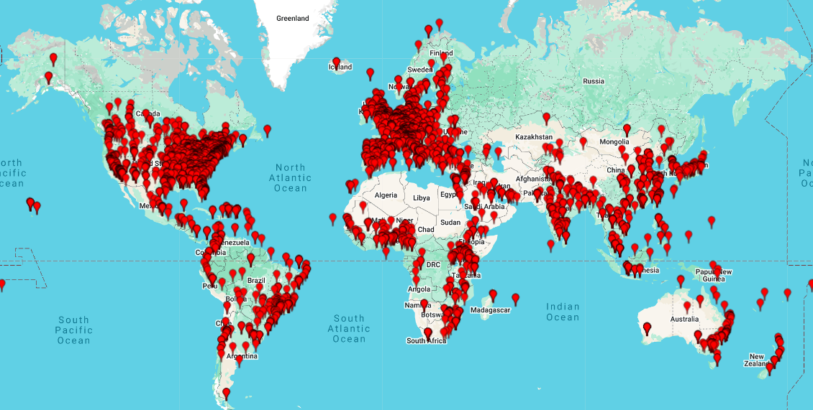
What is REDCap and How Can it Help?
REDCap: Research Electronic Data Capture
Developed at Vanderbilt University for use by universities and non-profit institutions
A secure web application for building and managing research data environments
Allows for direct data entry (study staff) as well as online surveys (study participants)
Accommodates multi-site collaborative studies via Data Access Groups (DAG’s)
JH IRB Approved
Worldwide:
  ~7850 institutions
  160 countries
  2.4m projects
  3.8m users
  46.4k citations
JH:
  ~9500 *projects
  ~24k users (~5.6k active)
  ~2.2m logged events (last 30-days)

Slide 25
REDCap: Key Features
Web-based
Secure
Integrative
Direct entry by staff
Survey-style entry by study participants
Extensive data quality features
JHED Authentication
MS Azure (for non-JH study team members)
Extensive user-level permissions mngt.
Role-based permissions
Single/Multi-Site Studies
EPIC Notes Interface
Direct EPIC-to-REDCap
Multi-Language Features

Slide 26
REDCap: Key Features (cont’d)
Project Types
Tools
Exports
Simple Surveys
One-and-Done
Structured Longitudinal
Unstructured Longitudinal
Automated Survey Invitations
Alerts / Notifications
Workflow Management
Mobile App
Randomization
eConsent Framework
CSV
SAS
Stata
SPSS
R
RC2SQL (translates a REDCap project into an SQL database where data for each RC instrument is in a separate table)

Slide 27

REDCap at JH
Co-Sponsored (actually tri-sponsored!)
  SPH/SOE (Andre Hackman, Danny Scerpella, Brian Dyer. Gwendolyn Clemens, Khaled Hasan…)
  SOM/SON/JHH/Bayview/KKI (Scott Carey, Mike Sherman, Terrence Turner)
  ACH (Nuredin Joehar, Karly Anderson)
3-Tiers
  Bronze:
    No cost… no support
    Intended for smaller, unfunded projects
    Some advanced features not available
    Up to 20k “collected” datapoints
  Silver:
    Includes support
    Includes all REDCap features
    Up to 1m “collected” datapoints
  Gold:
    Includes additional support
    Very large studies
    Up to 2.5m “collected” datapoints

Slide 28
21 CFR Part 11 Compliance (FDA Studies)
Important:
Part 11 Compliance refers to the STUDY, not just REDCap!
  REDCap is just one component of a Part 11 compliant study environment.
Currently, JH REDCap (Baltimore) is NOT Part 11 compliant
  We are spinning up a new REDCap instance that WILL be compliant (late 2025??)
  Technically, if data is collected on paper, REDCap CAN be used for a Part 11 Study
ACH REDCap has been validated for Part 11 compliance
  Pediatric only
  Currently NOT public facing (no surveys)

Slide 29

REDCap Resources
Training Videos
Help Files
Zoom Clinics (all project tiers)
1-on-1 Support (Silver / Gold tiers)
Online Support (REDCap Training Central)
www.redcap.jhu.edu

Slide 30
Let’s Look at a Few Screenshots

Slide 31
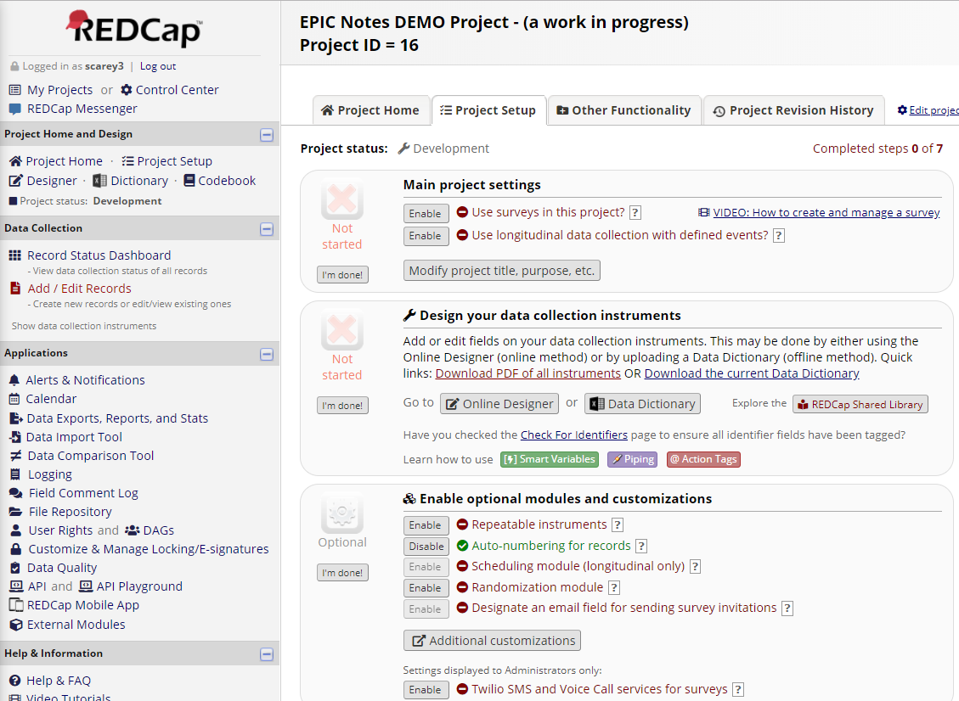
Project Setup (guided development)
Yikes! The PROJECT SETUP page looks a bit overwhelming!!!
Indeed! BUT… if we look a bit closer, we see that it is arranged in easily digestible sections.
User Information
Project Information
Data Collection
Applications / Features
Help
Step-by-step development tools

Slide 32
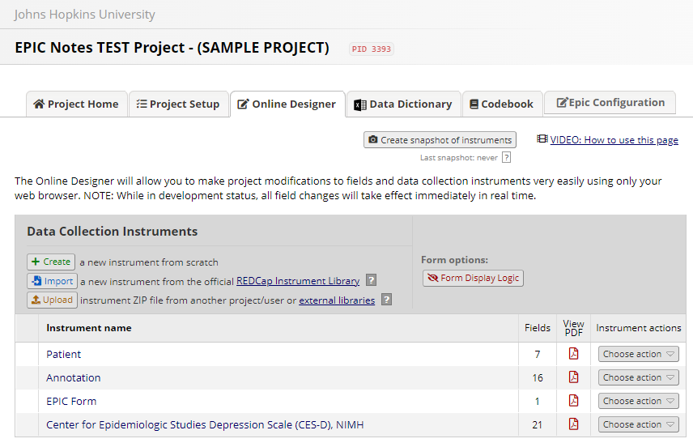
Project Setup (data collection instruments)
The ONLINE DESIGNER is where you build the projects INSTRUMENTS

Slide 33
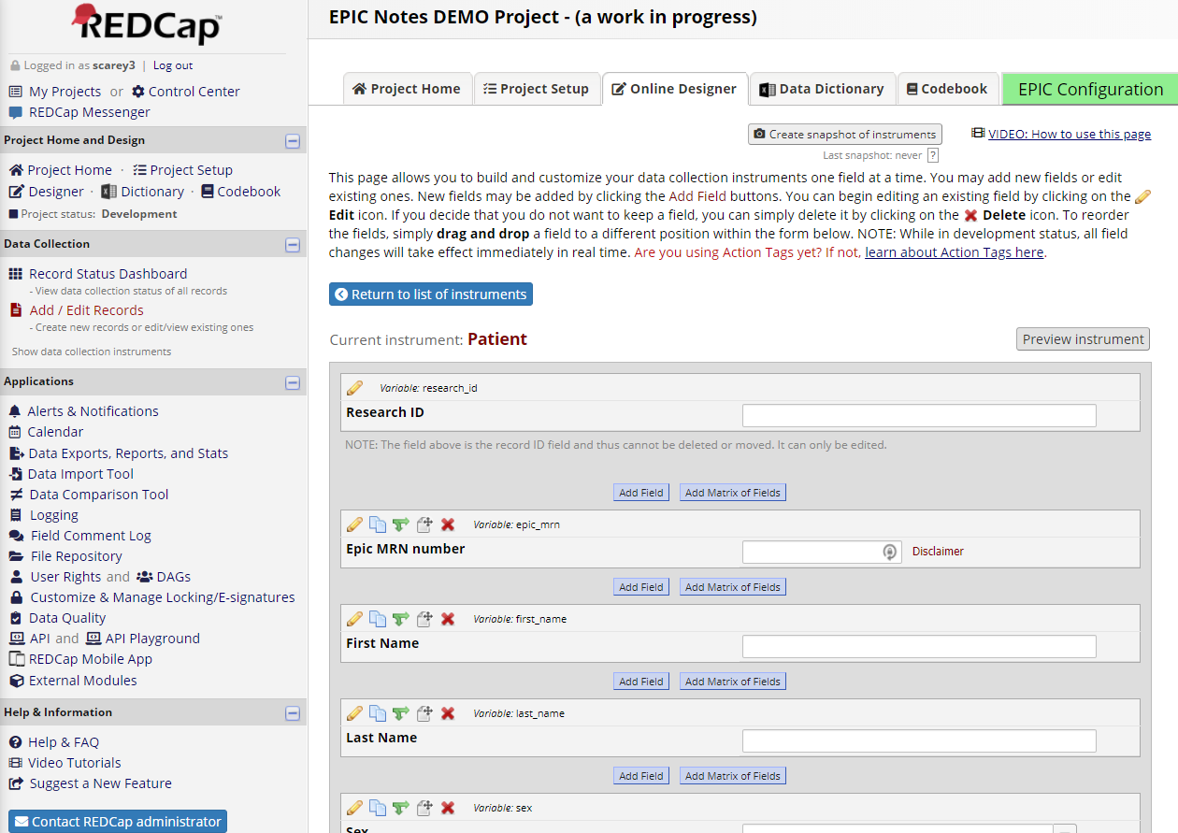
Project Setup (instrument development)
Instruments have FIELDS

Slide 34
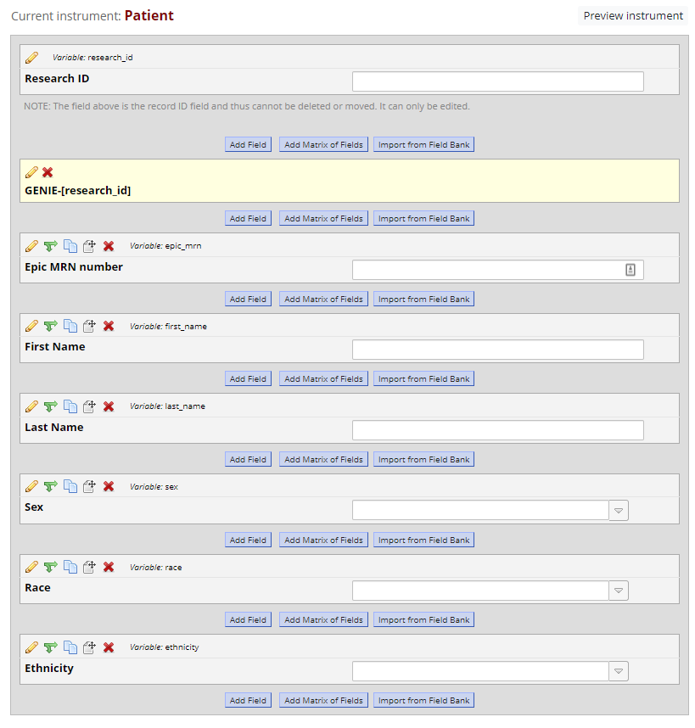

Project Setup (adding fields)
Fields can be:
Added
Assigned Branching Logic
Copied
Moved
Dropped

Slide 35
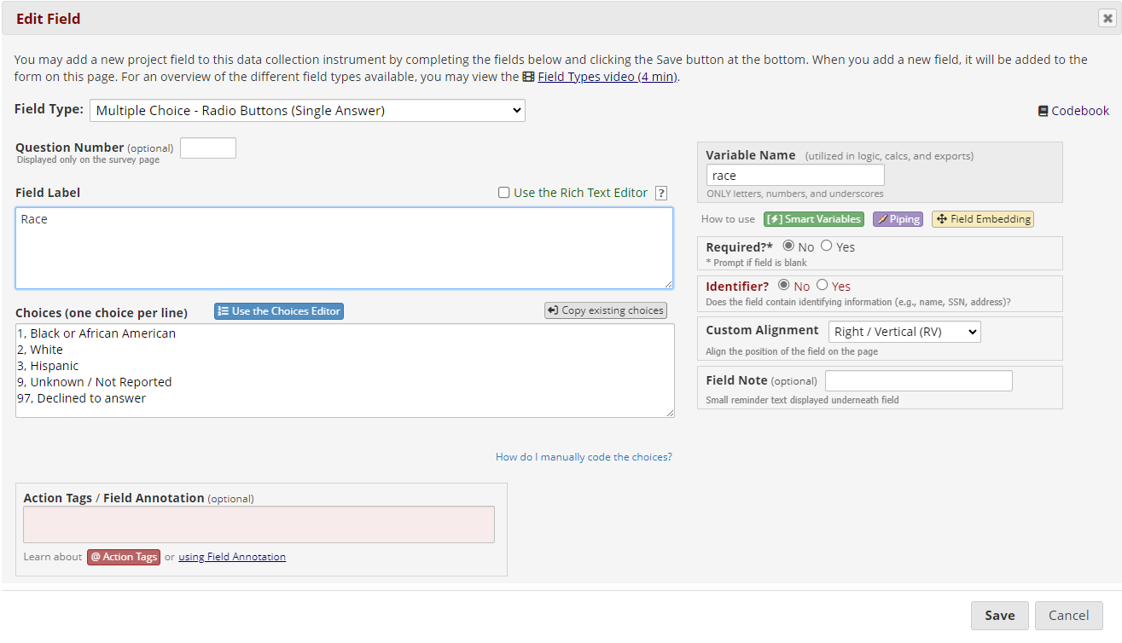
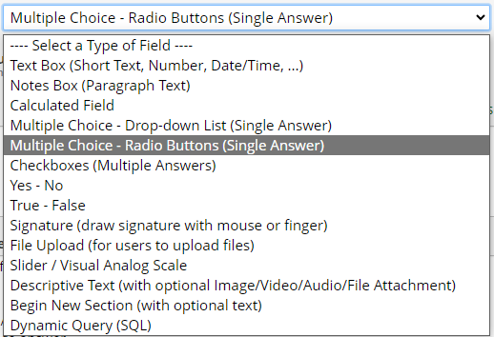
Project Setup (configuring fields)
And fields have ATTRIBUTES
Field type
Field Name
Label
Menu Options (if applicable)
Required?
PHI?
Alignment
Note
Action Tags

Slide 36
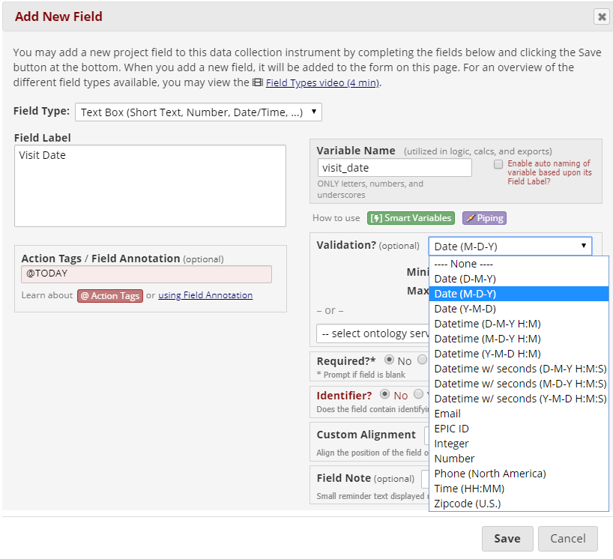
Project Setup (field validation)
For a TEXT BOX field, VALIDATION is used to control what is entered.
VALIDATION is a FUNDAMENTAL to ensuring high quality data. Any “text” datapoint used in analysis will likely benefit from validation.

Slide 37
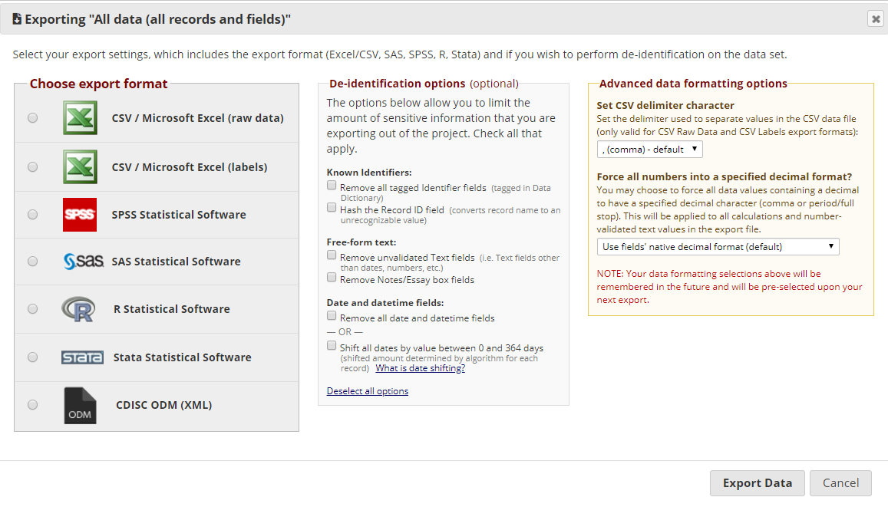
Project Setup (exporting data)

Slide 38

What’s New in REDCap?
It depends on the day!

Slide 39
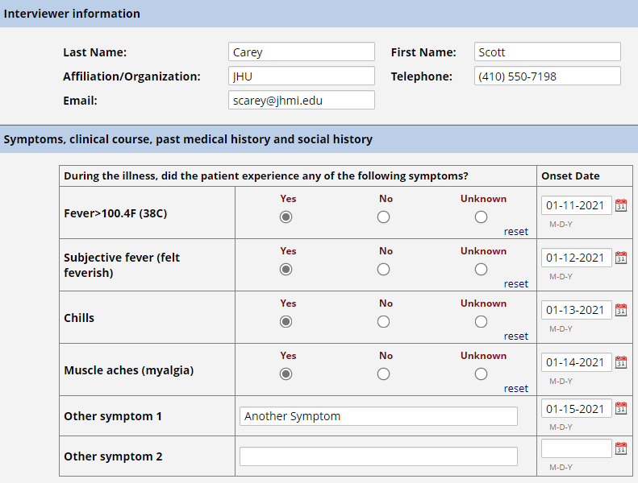
Field Embedding (somewhat new)

Slide 40
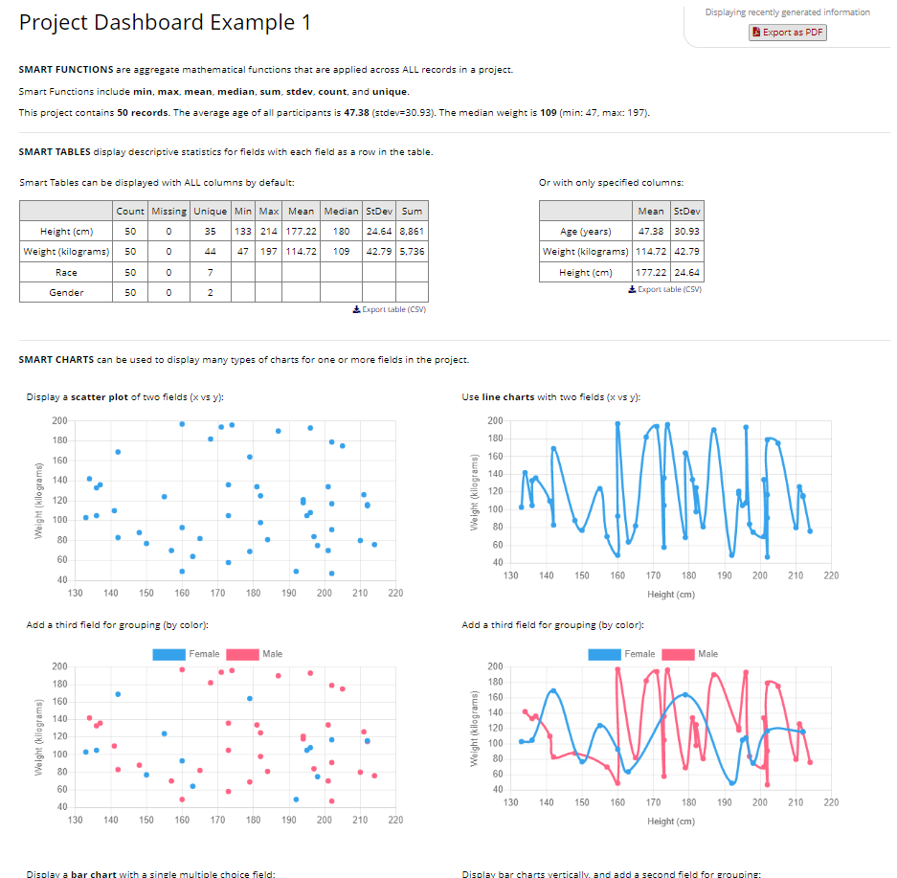
Project Dashboards (new-ish)

Slide 41
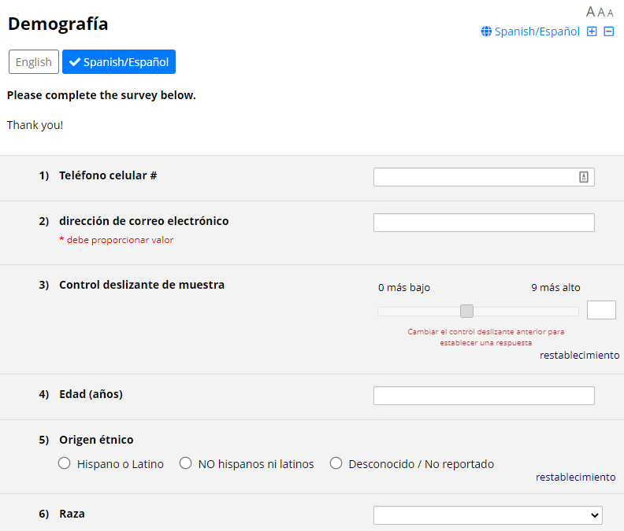
Multi-Language Management (new)

Slide 42
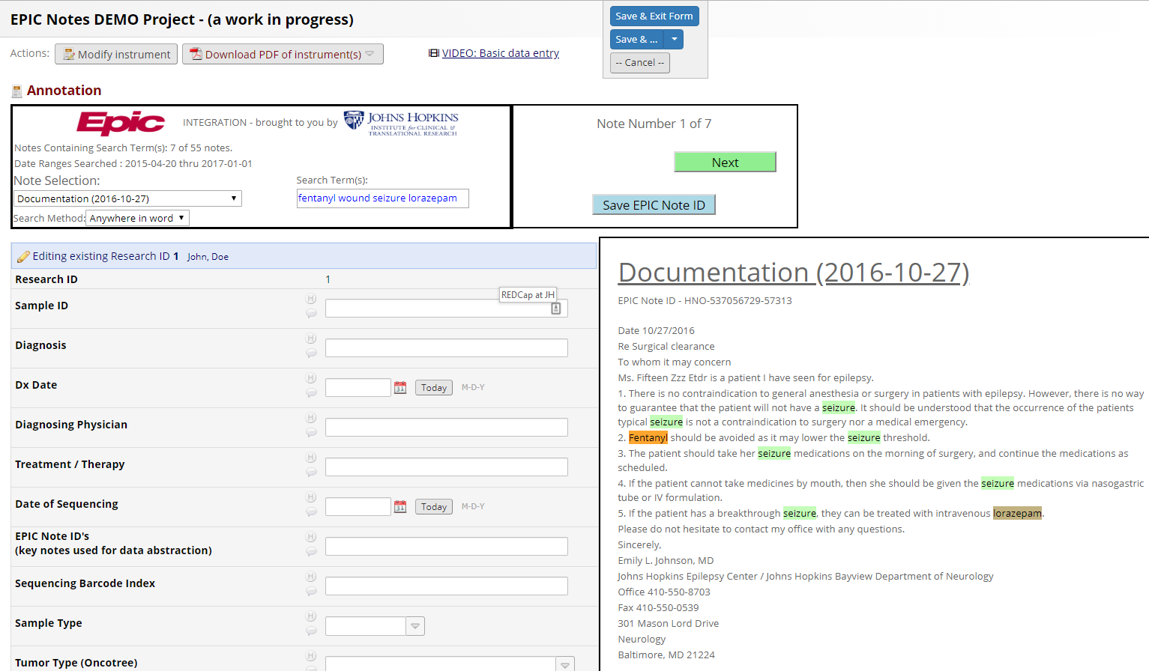
EPIC Notes Integration (new)

Slide 43
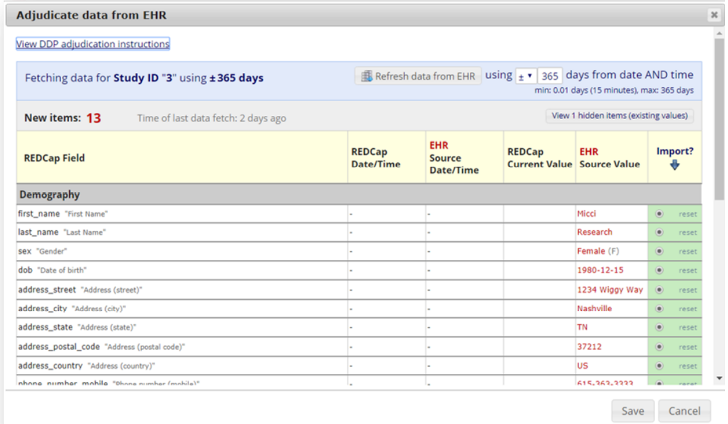
EPIC-to-REDCap Field Mapping (new)
Review & Approve REDCap Updates From EPIC

Slide 44

How Do I Get Started?
Easy!
Visit www.redcap.jhu.edu
Click on Getting Started w/ REDCap

Slide 45

Questions?
redcap@jhu.edu

Slide 46
Research Coordinator Support
Tony Keyes

Slide 47
ICTR Summer Showcase
Research Coordinator Support Service
(RCSS)
Research Personnel Onboarding Program
(RPOP)
June 06, 2025

Slide 48
Research Coordinator Support Services (RCSS)

Slide 49
Research Coordinator Support Service
Institute for Clinical and Translational Research
(ICTR) – Dr. Dan Ford
RCSS
RPOP
CAP
RCSS: Research Coordinator Support Service
RPOP: Research Personnel Onboarding Program
CAP: Coordinator Apprentice Program

Slide 50
Research Coordinator Support Service
A pool of research coordinators that are available for hire on a part-time basis by Johns Hopkins researchers.
Since 2020
  >300 requests, >30 different departments
  >170 projects assigned to CRCs
Current
  12 staff
  33 active studies

Slide 51
Overview of Program/Core
SCAMP was established in 2012
  Provide coordinator training to trainees with no clinical research training
RCSS was established in 2014
  Provide services to investigators who needed part-time research support
SCAMP was been re-branded as CAP in November 2020
SCAMP: Study Coordinator Apprenticeship and Mentoring Program
RCSS: Research Coordinator Support Service
CAP: Coordinator Apprentice Program

Slide 52
Rapid Onboarding → Early Assignments
Comprehensive Training Regimen
  150+ hours of onboarding
  Mentoring
Multiple short-term work assignments of escalating responsibilities
  Drugs, devices, behavioral
  Sponsored, federally-funded, investigator-initiated
  Study stage (beginning, middle, end)
  Study phases (I, II, III)

Slide 53
Impacts
The program has trained 61* coordinators since 2012
  86% (49/57) are still in research
  58% (33/57) are still at JHU (including Clinical RNs)
Investigators have turned to RCSS
  To take on projects they would normally have to turn down
  To support research teams that have lost staff members
  To supplement their own staffing/knowledge gaps
  To grow research portfolios
*Percentages reported based on 57 we are still in contact with, as 4 are lost to follow-up

Slide 54
Who Can RCSS help?
  Johns Hopkins School of Medicine (JHSOM)
  Johns Hopkins School of Nursing (JHSON)
  Johns Hopkins School of Public Health (JHSPH)
  Sidney Kimmel Comprehensive Cancer Center (SKCCC)

Slide 55
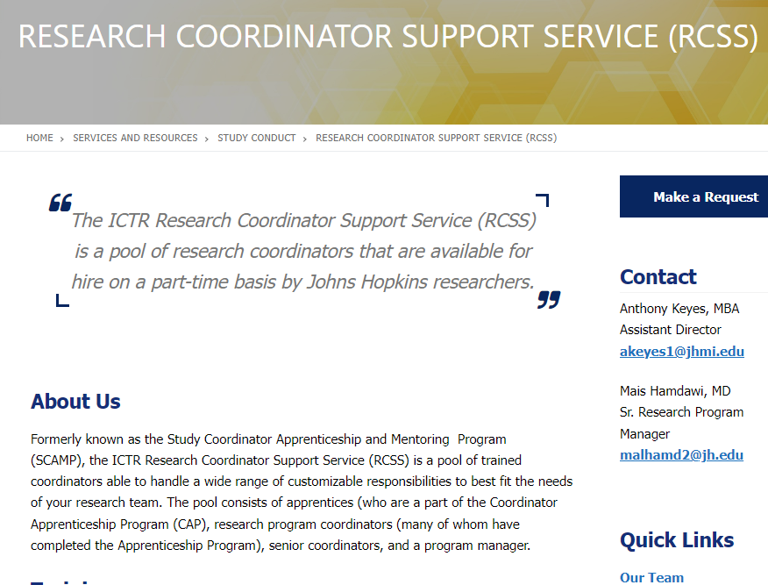
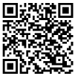
How to Connect with Us
https://ictr.johnshopkins.edu/service/study-conduct/rcss/

Slide 56
How to Work with Us
Connection request
  REDCap Survey, 1:1 meeting
  Work Agreement
Scheduling
  Prefer fixed times
  Can be flexible
Location
  East Baltimore
  Bayview
  Greenspring
  Other sites (case-by-case)

Slide 57
RCSS Rates: Effective July 1, 2025
Research Coordinator support is $65/hour
Senior Research Program Coordinator support is available for more complex studies and situations at $70/hour
Rate is inclusive of fringe and fees
PI will be billed for the hours that were worked
FY25 total average/month = 950

Slide 58
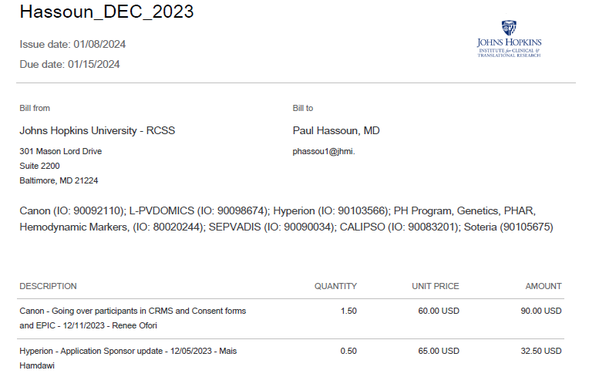
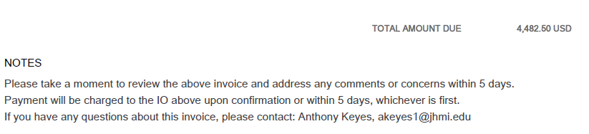
Monthly Invoicing
PI Last Name
PI Information
Name and IO # of all studies

Slide 59

Priorities
I. Growing research professionals
  Hire the right candidates
  Rapid onboarding
  Shadow, Assignments
  Ecosystem, Apprentices become mentors
II. Supporting researchers
  FY25 total average/month = 950
  Assist onboarding Investigator’s staff
  Train your newly hired or less experienced research staff/coordinator.
  Provide ongoing support.
III. Fiscal responsibilities

Slide 60
Research Personnel Onboarding Program (RPOP)

Slide 61
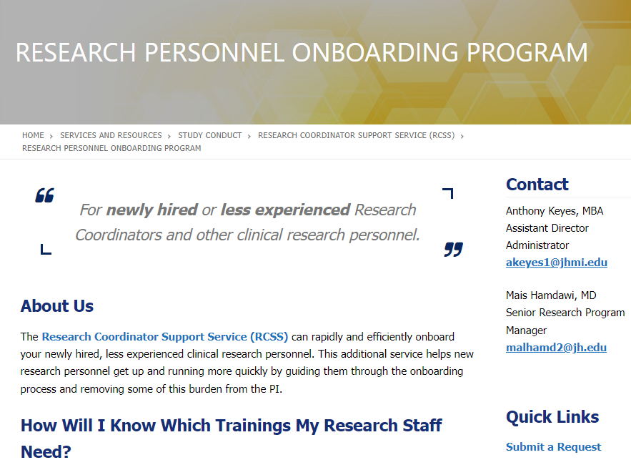

How to Connect with Us
https://ictr.johnshopkins.edu/service/study-conduct/rcss/onboarding-program/

Slide 62
Research Personnel Onboarding Program
Support Principal Investigators, Managers
  Rapidly and efficiently onboard their inexperienced clinical research personnel with an Ongoing support
Quality of work → Multiple Requests to train CRCs
Launched in September 2022 as a pilot
Requests to onboard Sr. CRCs, Research Managers, Fellows
  Little/no experience in research
  Little/no experience at JHU

Slide 63
Research Personnel Onboarding Program
When?
  As early as Day 1
Where?
  Online courses, “Why”, unscheduled
  Instructor-Led trainings, scheduled
  1:1 mentoring sessions “How”, scheduled
Why?
  RCSS has trained 61 coordinators since 2012
  Strong feedback (Survey data coming soon)

Slide 64
How? (SCOPE of Work)
Service request
  PI’s need
  Study’s need
  Trainees' need and future goals
Plan
  Personalize a training plan
  Menu (0 - >200) training hours, online, and instructor-led
  ~ (6-8) weeks, Interactive 1:1 onboarding sessions, 1-2 mentoring hrs./week
  Provide weekly PI and/or hiring manager updates

Slide 65
Available Trainings (200+ hrs.)
Ethics, ICH,
Good Clinical Practice
JHU and IRB requirements
Data Entry
More!
Study Binder
Submissions
Recruitment
Clinical Skills
Visits Conduct
Monitoring
Auditing
OnCore
Feasibility
Startup
Closeout
Epic
Shipping samples
Soft Skills

Slide 66
Ongoing Support (Keep the Door open)
Optional
Sr. staff will be available for guidance
Bridge the gap between initial training and ongoing challenges
Averaged 1 hr./month for the first 3-6 months
>70% opted in
Cost of the Onboarding Program
  $65/hour
  Monthly Invoices to the Internal Order number (IO#)

Slide 67
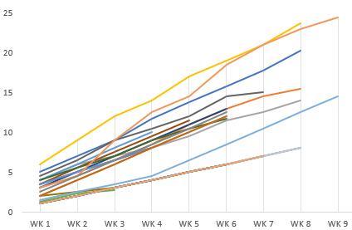
Cumulative Onboarding Hrs./Trainee
39 completed
Average billed:
8.51 hours ($553.31)
Range: (3 to 24.5 hours)

Slide 68
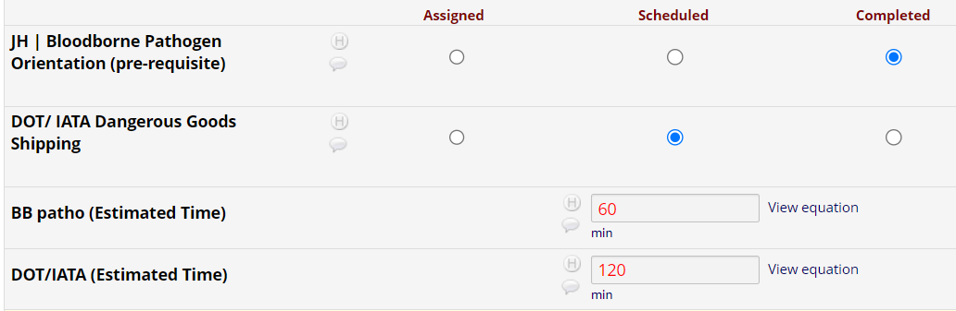
Smart Training Time Estimation

Slide 69
Impacts
Study/Study Team
  → Faster hiring process
  → Less compliance issues
  → Smoother collaboration
  → Enhance research productivity
New Hire
  → Know they are being invested in
  → Positive work environment
  → Higher employee satisfaction and retention
Research
  → Improve research outcomes
  → Contribute to the national discussion with other CTSAs (Poster at ACTS 2024)
5,885
Total hours of Training completed
Mean: 150.90, Range: 37.5-270.7

Slide 70
Questions?
THANK YOU!
akeyes1@jhmi.edu
malhamd2@jh.edu
RCSS
RPOP

Slide 71
Recruitment Resources
Cassie Lewis-Land

Slide 72
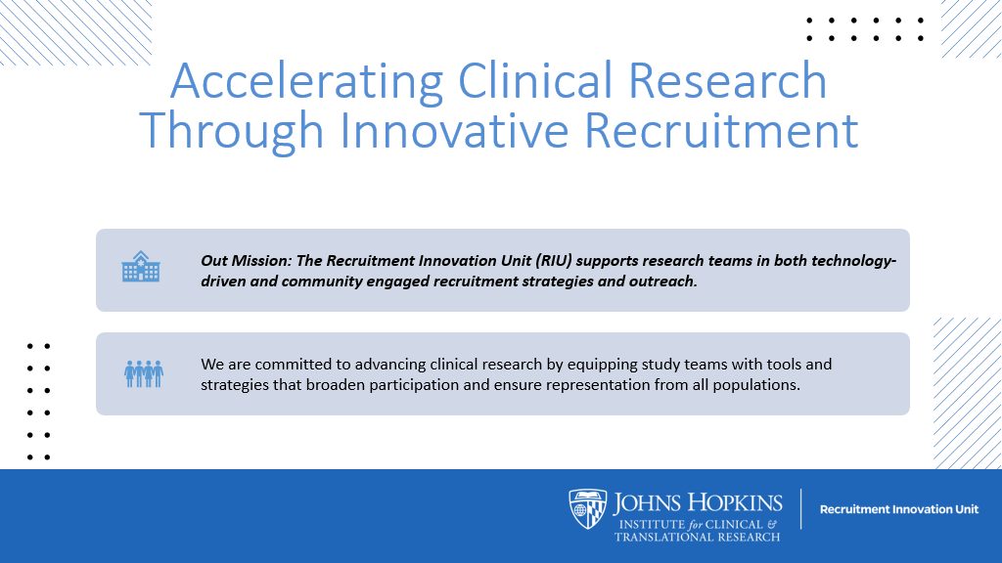

Slide 73
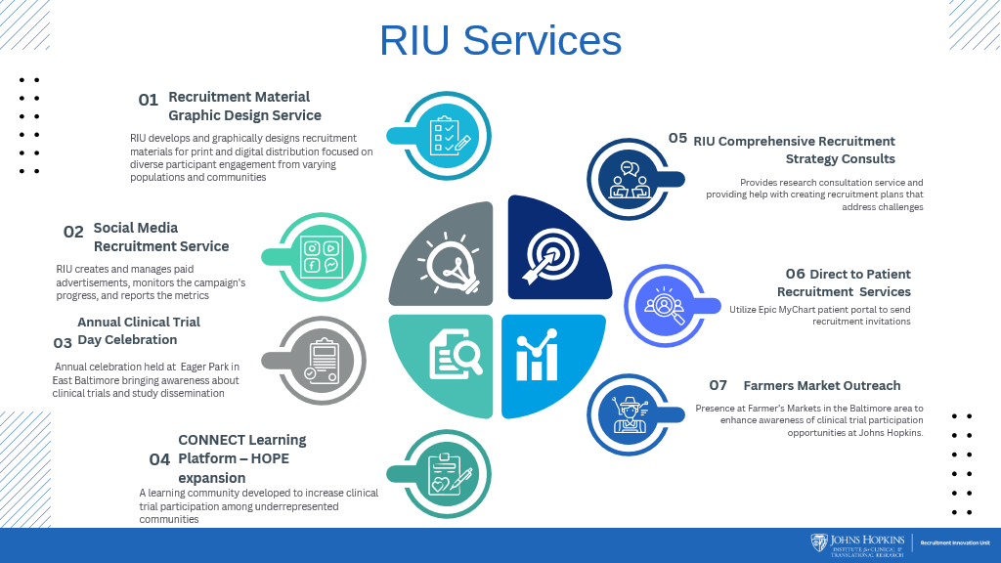

Slide 74
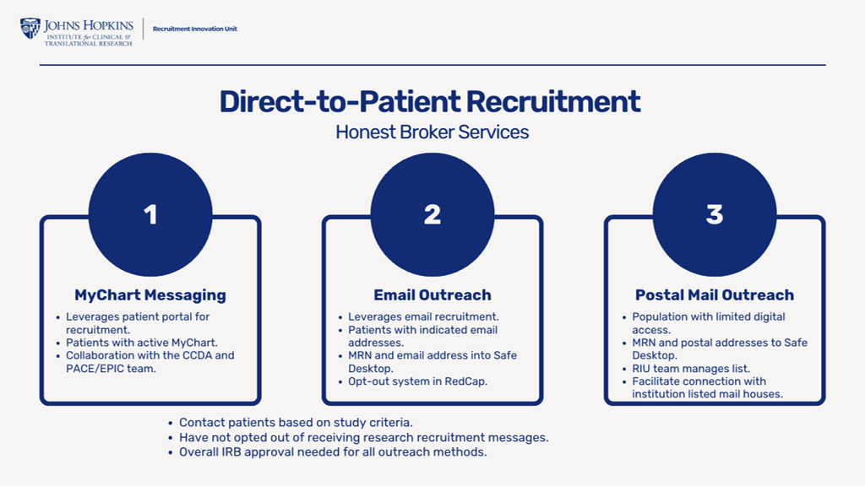

Slide 75
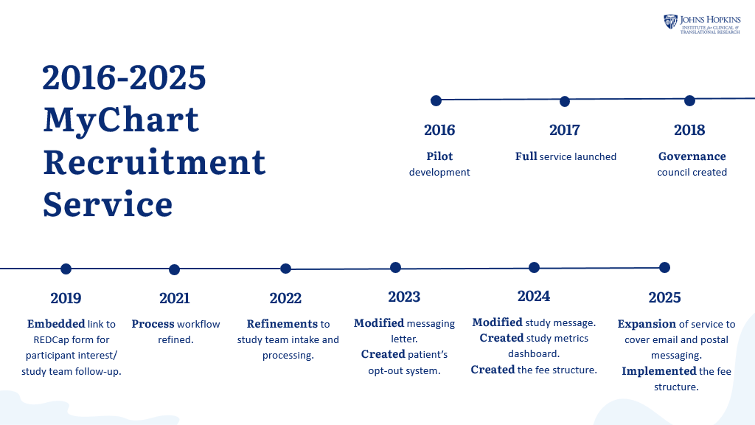

Slide 76
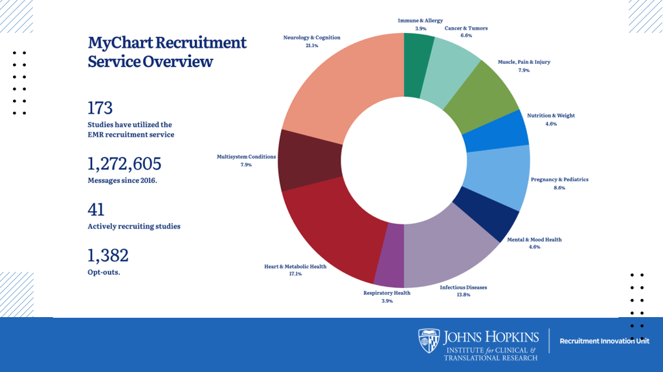

Slide 77
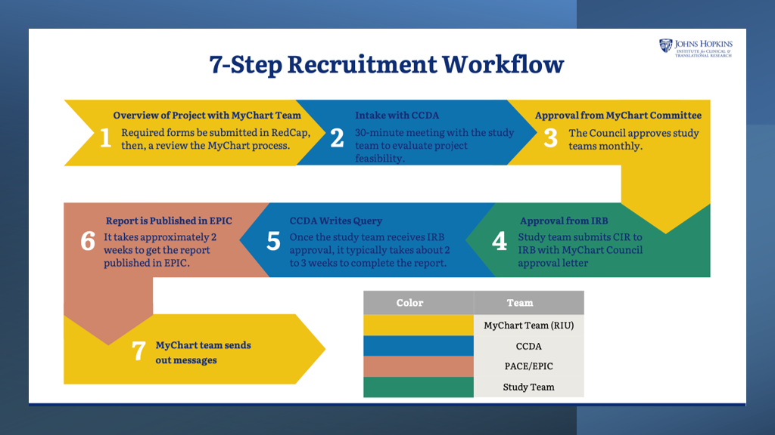

Slide 78
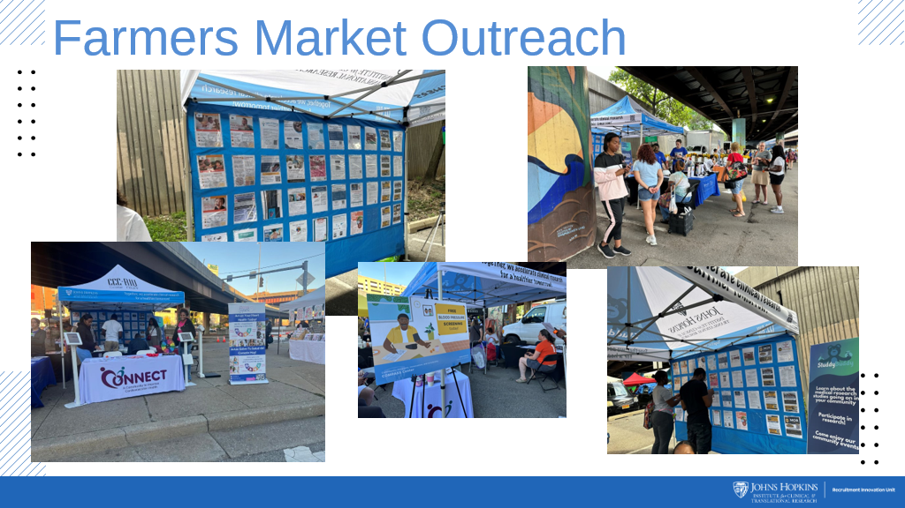

Slide 79
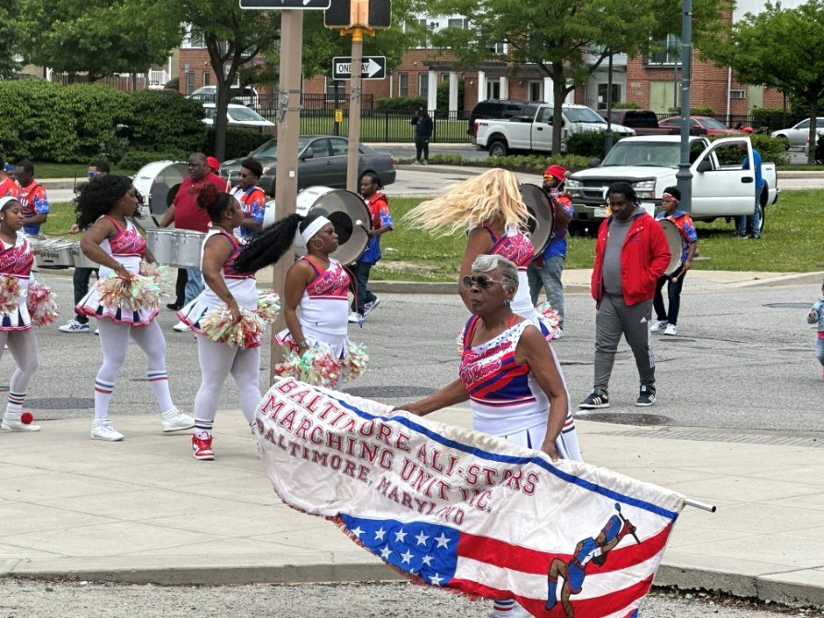
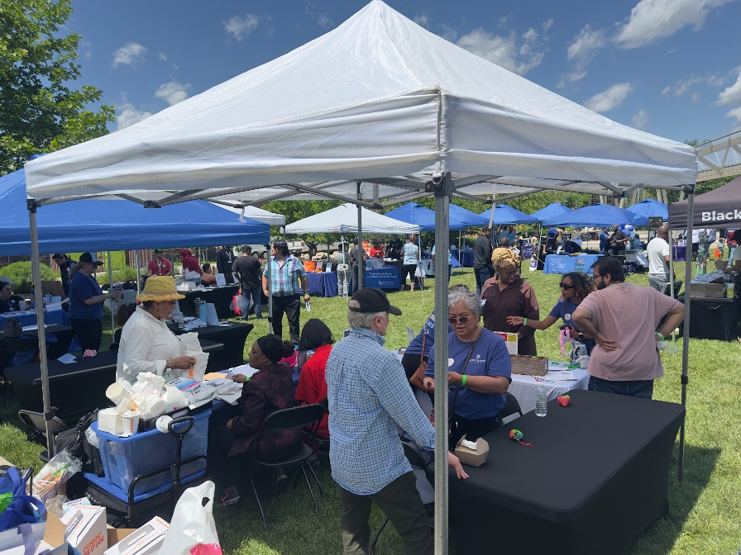
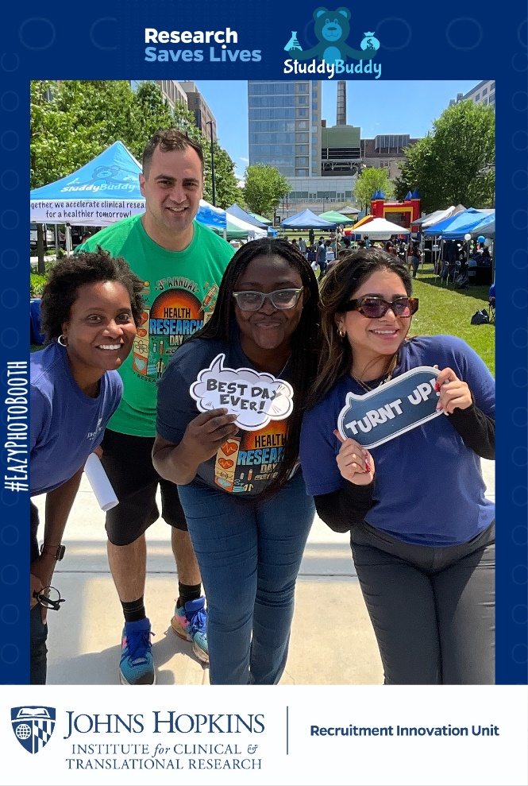
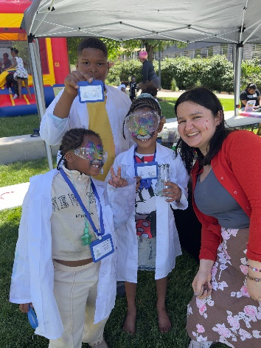
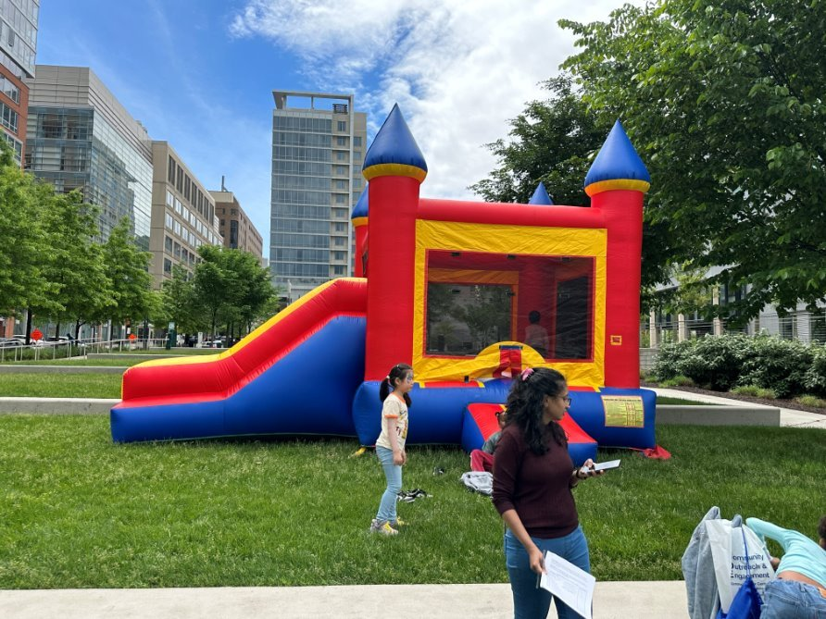
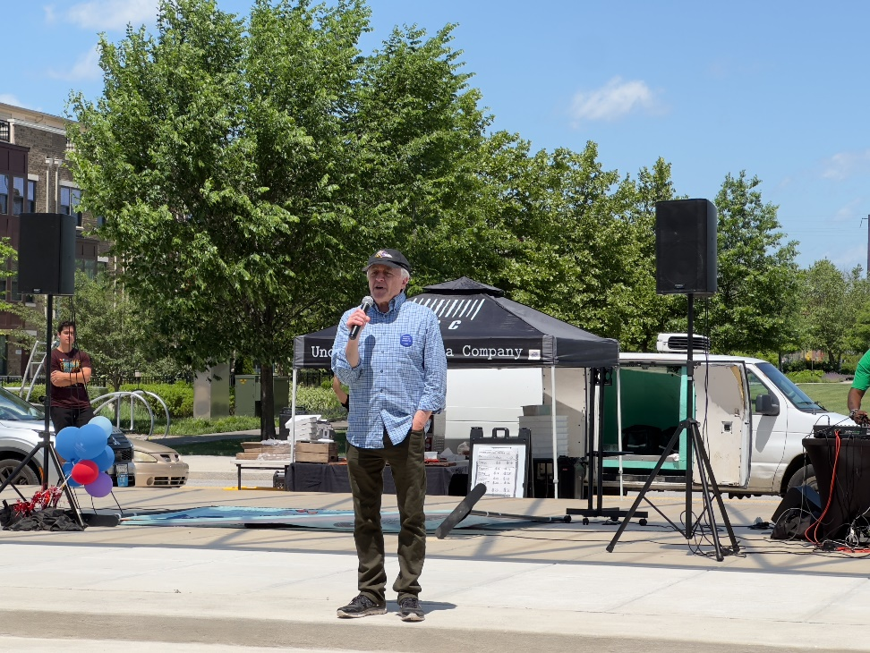
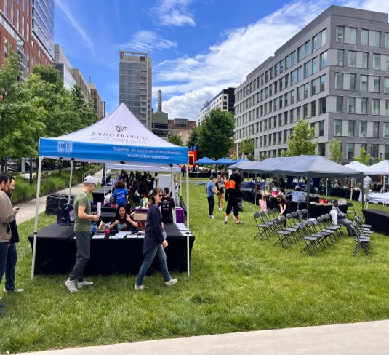
Clinical Trials Day 2025

Slide 80

Please Give Us Your Feedback!
https://t.jh.edu/ictrsurvey

