Slide 1




Monitoring N-acetyl-aspartate (NAA) in Patients with Spontaneous Intracerebral Hemorrhage for Prognostication
Wendy C. Ziai, MD, MPH, FAHA
Johns Hopkins Medical Institutions
Division of Neurocritical Care
Baltimore, MD, USA
June 2, 2017

Slide 2
Presenter Disclosure Information
October 14, 2013
ANA 2013
2
FINANCIAL DISCLOSURE
Site investigator & Safety Committee Chair – CLEAR IVH iii trial
NINDS-Genentech funded study
NIH grant #U01 NS062851
Site investigator & Safety Committee Chair– MISTIE iii trial
MISTIE sponsored by NINDS, R01NS046309
Donations from Genentech, Inc. & Codman, Inc.
STARR Clinical Research Award –
Monitoring N-acetyl-aspartate (NAA) in Patients with Spontaneous Intracerebral
Hemorrhage for Prognostication
Johns Hopkins University

Slide 3
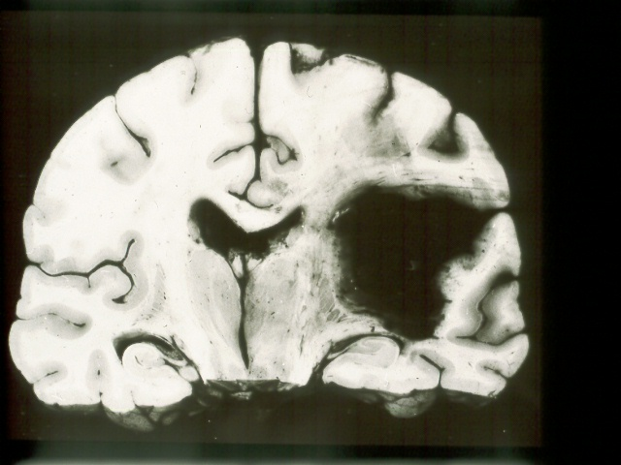
10–30 cases per 100,000/yr, 2 million ICHs annually worldwide

Slide 4
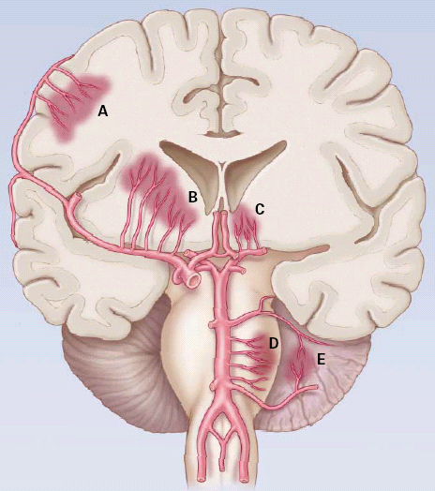
ICH: pathophysiology
50% CAA
50% Other
Majority HTN
Qureshi; N Engl J Med 2001;344:1450-60

Slide 5
Prognostication in ICH
Clinical Scores: ICH Score
ICHS 30 Day Mortality (%)
0 0
1 13
2 26
3 72
4 97
5 100
Age: < 80 : 0
> 80 : 1
GCS score 13–15 : 0
5–12 : 1
3–4 : 2
ICH location :
Supratentorial : 0
Infratentorial : 1
ICH volume (AxBxC/2)
< 30 mL : 0
> 30 mL : 1
IVH
  No : 0
Yes : 1
Total: 0 - 6

Slide 6
Background
Anticipate many future clinical trials focusing on treatment
Assessment of spontaneous intracerebral hemorrhage (sICH) treatment response is difficult
Currently limited to clinical exam and imaging findings and does not include disease-specific markers of progression

Slide 7
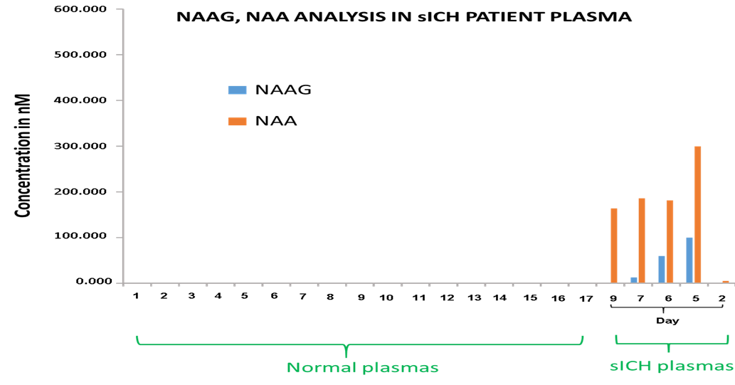
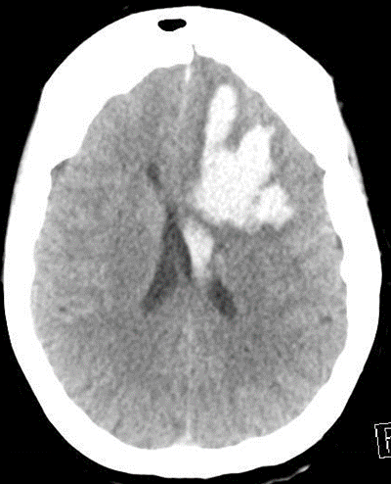
Pilot Case
ICH volume 54 mL
? Source of increased plasma concentrations of NAA
blood brain barrier leakage from dead or injured neurons during the secondary injury phase of ICH.

Slide 8
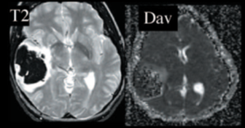
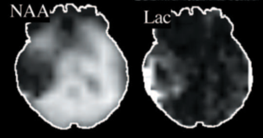
Magnetic resonance spectroscopic imaging (1H-MRSI)
Hematoma (day 3) is dark on T2-weighted images (T2WI). Peri-hematoma regions show increased signal on T2WI, increased DWI signal intensity on DAV, normal NAA concentration and no lactate
NAA concentration was 9.4 mM in ROIs surrounding the hematoma and 9.6 mM in the contralateral hemisphere

Slide 9
NAA
Located almost exclusively in neurons of adults
More sensitive marker of neuronal injury than lactate
NAA is formed in neuronal mitochondria
Marker of mitochondrial integrity and neuronal function
NAA synthesis may be decreased in patients with decreased cerebral mitochondrial function without irreversible neuronal damage
Differentiation of mechanisms requires correlation with imaging

Slide 10
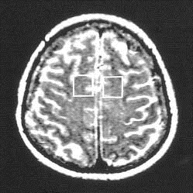
Correlation between N-acetylaspartate (NAA) in primary motor area and hematoma volume in 20 patients with basal ganglia ICH
Proton MRS
Stroke. 2001;32:2237-2245.

Slide 11
Correlation between motor impairment of extremities and NAA/ creatine (Cr) ratio of white matter in primary motor area on affected side
Neural networks in the frontal lobe could be important for recovery
Stroke. 2001;32:2237-2245.

Slide 12
Significance
Axonal injury in descending motor pathways could induce metabolic changes in higher motor pathways
Studies of subcortical metabolic changes in acute ICH have not been correlated with metabolomics data
Metabolomics applied to sICH could be of value for management of individual sICH patients
Correlation of early metabolite profiles with clot/perihematoma edema volumes and clinical outcomes could establish NMR spectroscopy as a useful predictor of clinical outcome

Slide 13
Aim 1
To determine plasma and CSF N-acetyl-aspartyl (NAA) levels as metabolic markers contributing to the prognosis of sICH patients
Hypothesis 1: Perturbed metabolic patterns can be defined in the acute phase of ICH and there exist metabolic discriminators associated with imaging biomarkers of disease severity and with sICH outcomes

Slide 14
Aim 2
To determine NAA levels using proton MRS at 3T in vivo, and correlate with plasma and CSF results in patients with sICH and hemiparesis
Hypothesis 2: NAA concentrations in plasma and CSF are associated with NAA levels on proton MRS in patients with basal ganglia sICH causing injury to corticospinal tracts

Slide 15
Methods
Prospective observational study
Plan: Enroll 20 patients with sICH
Ten patients, all with deep (basal ganglia) ICH will have proton MRSI performed during their routine MRI scan during the first 2 weeks of admission
Enroll 20 healthy control patients from the lumbar puncture clinic at Johns Hopkins Hospital (JHH)

Slide 16
Methods
Inclusion criteria:
Patients admitted to NCCU with spontaneous supratentorial ICH with or without intraventricular hemorrhage (IVH) with hemiparesis, and no plan for surgical evacuation
Healthy patients undergoing lumbar puncture
Exclusion Criteria: (i) <18 years of age
(ii) Traumatic ICH or a structural brain lesion
(iii) History of stroke, structural brain lesion, neoplastic, inflammatory or infectious disease condition

Slide 17
Preliminary Results
N=23
Mean age (SD): 63 (14) years
Median [IQR] ICH volume: 13 [7, 32] mL
IVH extension: 12 (47.8%)
Median NIHSS on admission: 10 [5,22]
N=16 subjects with a mean of 3 samples per subject (range: 1-7)
First sample was obtained at median 1.5 (range 0-4) days from symptom onset

Slide 18
Serial Levels of NAA and NAAG by Subject
[*: surgical evacuation prior to sample collection]
*
*
*
*
Notes:
Figure 1 below shows serial concentrations of NAA and NAAG by subject.

Slide 19
Pilot study results
Metabolite | First sample (ug/mL), median [IQR] | Peak level (ug/mL), median [IQR]
NAA | 75.51 [32.0, 97.7] | 93.3 [40.4, 140.7]
NAAG | 0.028 [0.022, 0.035] | 0.048 [0.027, 0.047]

Slide 20
Pilot Data
NAA
ug/mL

Slide 21
Long-term goal is to determine whether NAA measurement may be a clinically applicable biomarker for prognosis and ultimately a targetable pathway for future therapies for ICH patients

Slide 22
Thank You

