Slide 1



BEHAVIOR MATTERS
The science of implementation and learning with health systems:
Innovative Intervention Strategies to Improve Academic Productivity and Creativity while intervening on health systems
Karina W. Davidson, PhD, MASc, FAHA
Vice-Dean, Columbia University Medical Center
Chief Academic Officer, NewYork Presbyterian
Executive Director, Center for Behavioral Cardiovascular Health

Slide 2
I have no conflicts to declare

Slide 3
You will learn:
1) About behavior change theories applied to academic research productivity
2) Latest findings in creativity science
3) How to improve your research productivity
4) A little about learning with health systems

Slide 4
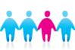

Center for Behavioral
Cardiovascular Health (CBCH)
To be a national resource and opinion leader in the field Cardiovascular Behavioral Medicine.
To use our research program as a vehicle for advancing basic and applied knowledge in the fields of Medicine and Behavioral Medicine.
To become a national leader in Patient-Centered Trials or Truly Individualized Medicine.
To develop enduring interdisciplinary, translational research collaborations for addressing those medical problems that have resisted previous approaches to care.
To enhance the academic potential of junior faculty

Slide 5
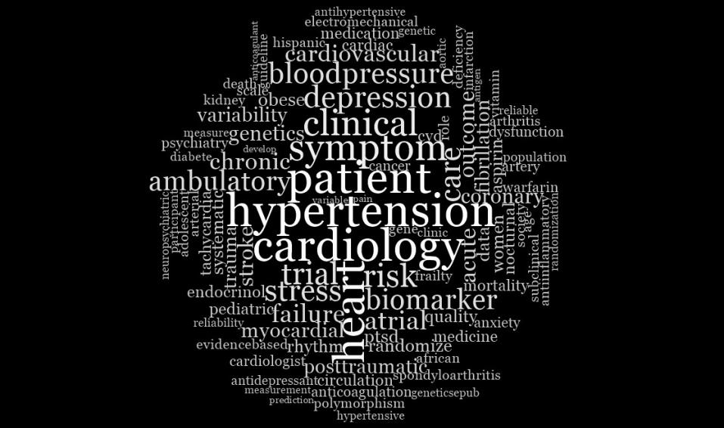

Slide 6
Director:
Karina Davidson, PhD
Professor
Faculty:
D Edmondson, PhD
Asst Prof
I Kronish, MD
Asst Prof
J Schwartz, PhD
Visiting Lecturer
N Moise, MD
Asst Prof
K Diaz, PhD
Assoc Rsch Sci
D Shimbo, MD
Assoc Prof
J Sumner, PhD
Instructor
Fellows:
B Haji, PhD
PostDoc Scientist
D Kumaraiah, MD
Instructor in Med
M Lewis, MD
PostDoc Fellow
I Louh, MD
PostDoc Fellow
J Peacock, MD
PostDoc Fellow
L Wasson, MD
PostDoc Fellow
J Wessler, MD
PostDoc Fellow
CBCH Director of Operations: Joan Duer-Hefele
Officer
Nurse Manager
CBCH Director of Administration & Production: Gabrielle Osorio
Officer 105
Program Administrator
RESEARCH EXECUTION CORE
Responsible for: Research resource allocation, coordinator management and performance, devices, ABP, lab
DATA CORE
Responsible for: data management and analytics
ADMINISTRATIVE CORE
Responsible for: administrative management and performance, finance, HR, grant/regulatory oversight
RESEARCH PRODUCTION CORE
Responsible for: Literature reviews, manuscript/grant preparation, productivity metrics, and library services
Head: D. Hiti
Officer 105
Project Manager
Head: A. Cather
Officer 105
Project Manager
Head: F. Parsons
Officer 105
Data Manager
Head: TBD
Head: A.L. Falzon
Staff Associate
Librarian
M. Chang
PT Of105, Rsc Nurse
M. Moran
Of105, Rsc Nurse
S. Mota
Data & IT Support (50%)
L. Meli
Officer 103, Dissemination Coordinator
V. Medina
Officer 105, CCIII
S. Navarrete
Officer 104 Prj Cor II
S. Grossman
Officer 104, PT Data Manager
J. Veloz
Officer 104, Admin Assistant II
B. Toledo
Officer 104, CRCII
S. Zhao
Officer 104, Lab Mng
J. Sung
Officer 103, Data Coordinator
A. Cusmano
Officer 103, Grant Coordinator
D. Mangan
Officer 103, CRCI
L. Oyesiku
Officer 103, CRCI
TBD
Officer 103, Data Analyst
M. Mendoza
Officer 103, Admin Assistant
J. Retuerto
Officer 103, CRCI
T. St.Onge
Officer 103, CRCI
K. Sundquist
Tech 5, Junior Programmer
E. Santana
Officer 103, Admin Assistant
B. Swan
Officer 103, CRCI
TBD
Officer 103, CRCI
M. Kautz
Tech 5, PT Junior Programmer (nights)
D. Cannone
VHO, IRB Coordinator
O. Garcia
Officer 103, CRCI
J. Fu
Tech 6, Rsch Worker
D. Mota
Supplementee/Visitor
A. Sullivan
Officer 103, CRCI
K. Homma
Tech 5, Rsch Asst
N. Habboosh
Tech 5, Rsch Asst
J. Julian
Tech B, Rsch Asst
S. Trignano
VHO, CPET
E. Brondolo
VHO, NYP
M. Hampsey
Casual
R. Prifti
Casual
R. Umland
Casual
Z. Velazquez
Casual

Slide 7
CBCH
Brainstorm
Create 30 grant ideas
Pitch
Spend 10 minutes on each idea, rate on a number of dimensions
2
1
Create Portfolio
Vote, consider all needs, balance on relevant dimensions.
Grant
Cycle
3
5
Implement
Write up those ideas that survived
Kill Phase
Try as a team to find any fatal flaw; challenge, criticize, contest
4

Slide 9
Recent Successes 2015
U24
6 R01s
1 K01, 3 Diversity supplements
N-of-1 contract
24-hour Blood pressure Clinic opening
NYP Grant for Quality Improvement

Slide 10
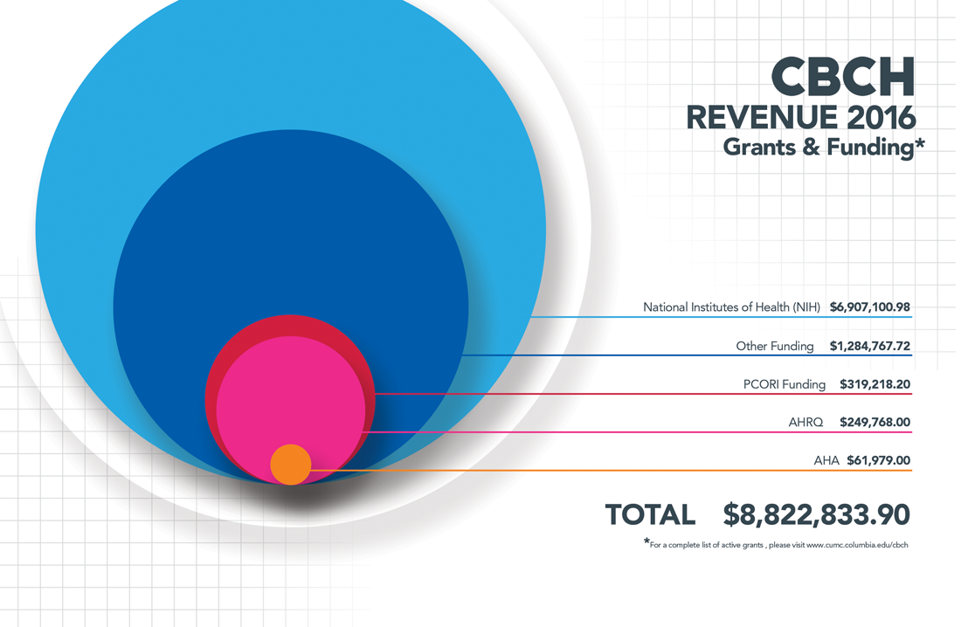

Slide 11
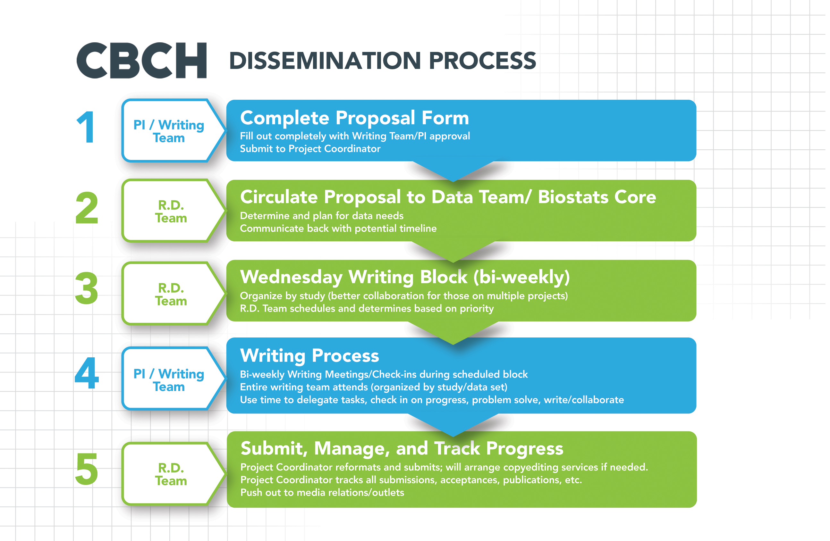

Slide 12

From: Hiti, David T.
Sent: Monday, January 09, 2017 7:21 AM
To: Duer-Hefele, Joan; Abdalla, Marwah; Chang, Melinda J.; Cusmano, Amberle; Davidson, Karina W.; Diaz, Keith; Edmondson, Donald E.; Falzon, Louise; Fu, Jie; Garcia, Othanya G.; Habboosh, Noor S.; Julian, Jacob E.; Kautz, Marin M.; Konrad, Beatrice M.; Kumaraiah, Deepa; Lee, Sung A J.; Meli, Laura; Moise, Nathalie; Monane, Rachel; Moran, Maria D.; Mota, Sean J.; Navarrete, Stephanie; Osorio, Gabrielle A.; Parsons, Faith E.; Retuerto, Jessica; Schwartz, Joseph E.; Shimbo, Daichi; Sullivan, Alexandra M.; Kronish, Ian M.; Ensari, Ipek; St. Onge, Tara B.; Sumner, Jennifer A.; Sundquist, Kevin J.; Swan, Brendan W.; Thanataveerat, Anusorn; Velazquez, Zunelly P.; Zhu, Deanna R.; Veloz, Jacqueline; Wasson, Lauren; Lopez Veneros, David; Ye, Siqin; Cuddeback, Maris R.; Blanco, Luis V.; Sanchez, Gabriel J.; Umland, Redeana C.; Rojas, Chanel; Cea, Emily K.
Subject: RE: Out of office message 1/9/17 - updated
Good morning CBCH – please find out of office updates below.
The following staff will be out of the office today
· Tara St. Onge
· Marwah Abdalla (available by email)
· Jacob Julian
· Othanya Garcia until 1/11
· Stephanie Navarrete until late January
· Irene Louh is out of the office (maternity leave)
The following staff are in the office with adjusted schedules today:
· Jenny Lee will be in by 1030am
· Joan Duer Hefele will be in by 11am
The following staff are working from home today:
· Keith Diaz
· Louise Falzon (Monday and Tuesday)
Please forward any updates that I have missed. Thanks!
Joan Duer-Hefele, RN, MA, CCRC
Director of Operations
Center for Behavioral Cardiovascular Health
Columbia University
622 West 168th Street, PH9-316
New York, NY 10032
212.342.4507
jd2171@columbia.edu

Slide 13
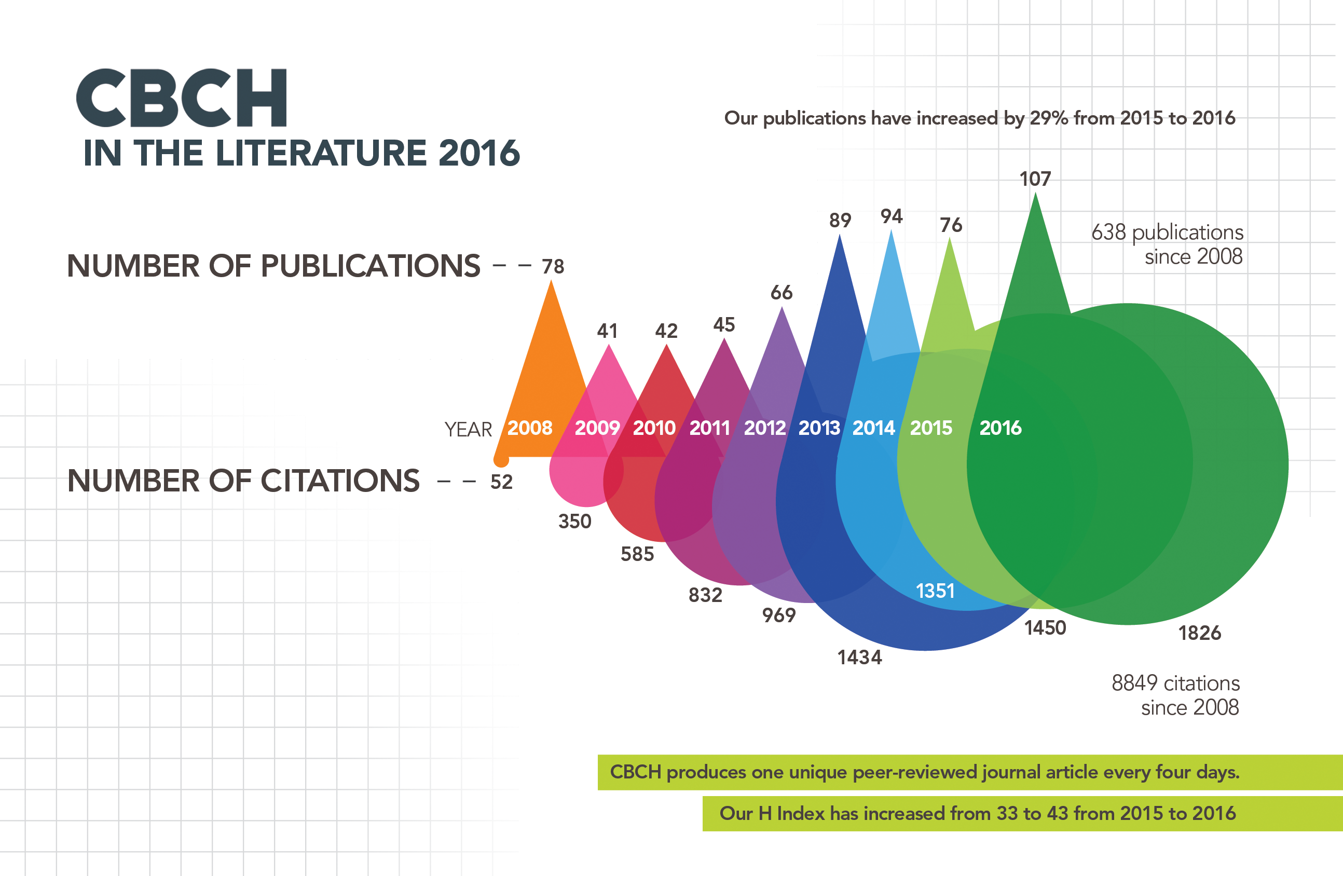
51 published in journals with ≥5 Impact Factor
Including…
JAMA, Circulation, JACC, Lancet Psychiatry

Slide 14
Readmissions
1
Behavior
Patient, provider and system behavior
2
Creativity
How creativity science can help
3

Slide 15
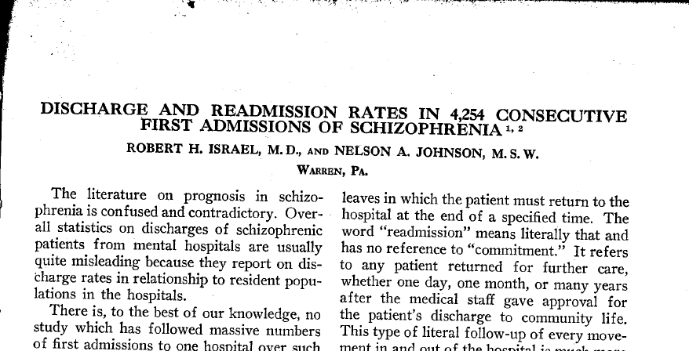
Readmissions
What is old is new
American Journal of Psychiatry, 1956
Notes:
http://ajp.psychiatryonline.org/article.aspx?articleid=146039
Second oldest article in pubmed for readmissions

Slide 16
Readmissions
Affordable Care Act, Penalties, and Incentives
In 2000s, recognition that many Medicare patients are readmitted early after discharge
  15-20% of Medicare patients readmitted within 30 days
  Thought to be a marker for quality of care, e.g., gaps in transition of care, poor medication reconciliation
  Considerable geographic variation and associated cost
As part of the Affordable Care Act, CMS began penalizing hospitals with high 30-day readmission rates in FY2013
Notes:
In 2011, 15.3% of all hospitalized Medicare patients are readmitted within 30 days of discharge (Medicare Payment Advisory Commission). More than 1 in 8 discharged patients will be readmitted before 30 days

Slide 17
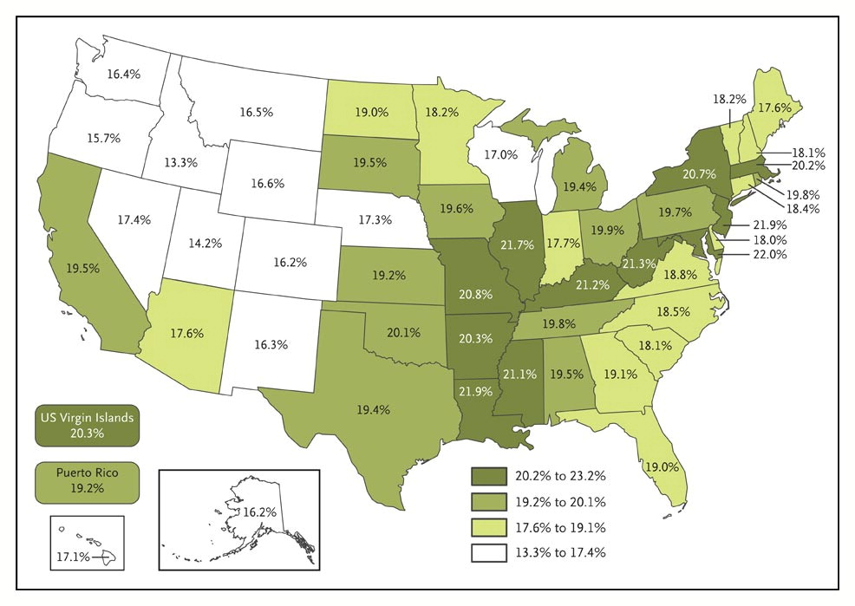

Jencks SF et al. N Engl J Med 2009;360:1418-1428.
Rates of Rehospitalization within 30 Days after Hospital Discharge.
Geographic Variations for Rates of Readmissions
Notes:
Figure 1. Rates of Rehospitalization within 30 Days after Hospital Discharge. The rates include all patients in fee-for-service Medicare programs who were discharged between October 1, 2003, and September 30, 2004. The rate for Washington, DC, which does not appear on the map, was 23.2%.

Slide 18
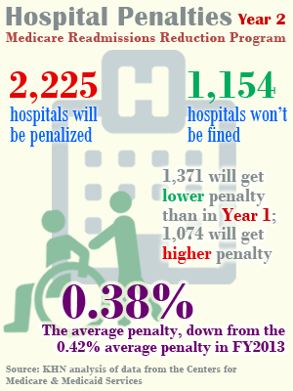
Readmissions
2014 CMS penalties
Notes:
Maximum penalty is 1% for FY2013, 2% for FY2014, and 3% all subsequent years
Big incentive for hospitals as typically operate at low margins

Slide 19
Readmissions
Concerns and criticisms
Preventable versus necessary readmissions
  Reasons for readmissions unclear / heterogeneous
    Limits of administrative data
How to identify patients at risk for readmissions?
  What to intervene on, in whom, and when?
  Factors at the level of patient, hospitals, and provider, can all lead to readmissions
    Medical, psychosocial, behavioral
Notes:
Patient behavior: non-adherence to medications, avoidance of follow up
Provider behavior: premature discharge, inappropriate readmissions
System behavior: Focus on decrease LOS, admitting less sick patients, longitudinal community care
http://theincidentaleconomist.com/wordpress/karen-joynt-on-hospital-readmissions/

Slide 20
Readmissions
Complex phenomenon
1
Behavior
Patient, provider and system behavior
2
Creativity
How creativity science can help
3

Slide 21

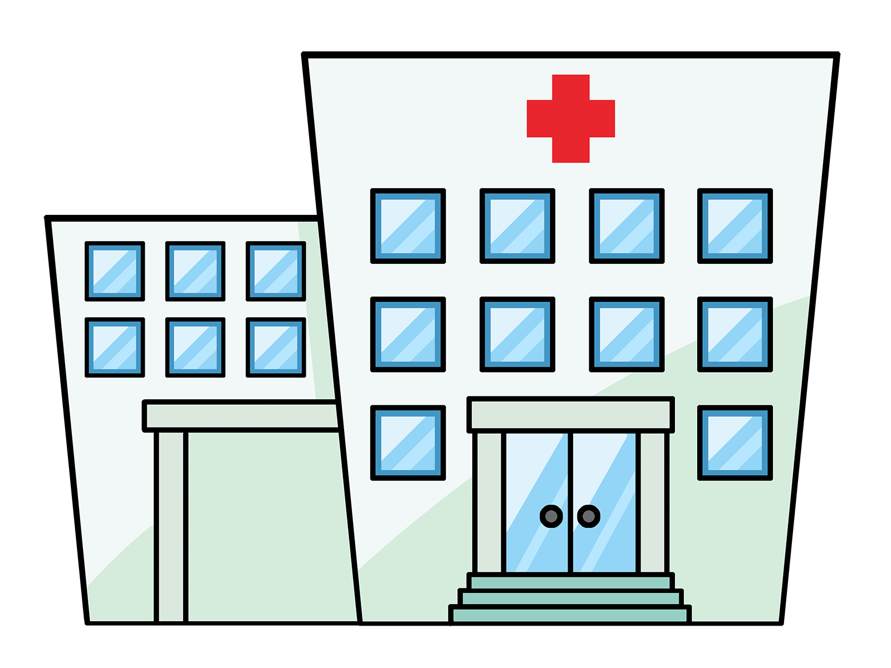

Readmissions
Factors that lead to readmissions
Patient
Hospital
Provider
Severity of illness
Social support
Patient behaviors
Processes of care
Hospital environment
Care transition
Timely follow up
Ability to escalate care without hospitalization
Risk aversion

Slide 22
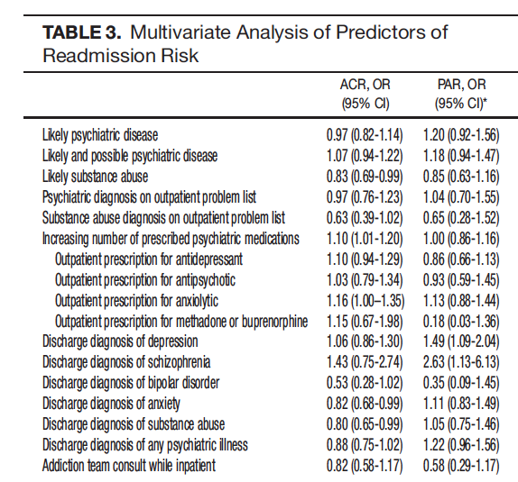
Readmissions
Patient level behavioral risk factors
Notes:
http://onlinelibrary.wiley.com/doi/10.1002/jhm.2044/pdf
One big patient level factor are psychiatric diagnosis—done at Brigham
Better mental health care followup

Slide 23
Readmissions
Provider Behavior
Decision to readmit often made at provider level
  Some preventable readmissions may occur because of discontinuity of care
Emphasis on early follow-up
  However, risk aversion can also paradoxically increase readmissions

Slide 24
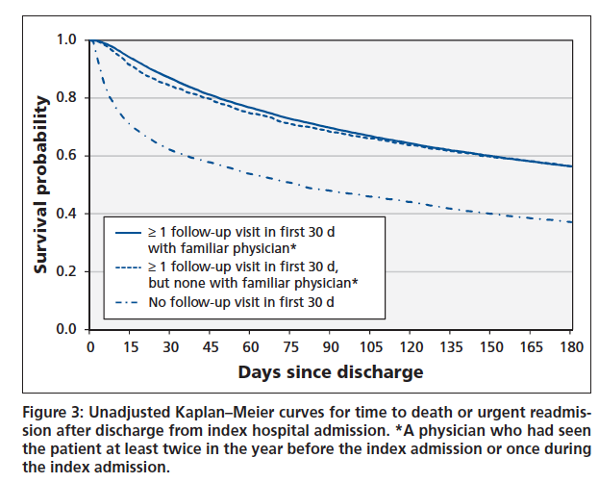
Readmissions
Provider Behavior
Notes:
Heart failure discharges and readmissions from Alberta (n=24,373)
http://www.cmaj.ca/content/early/2013/08/19/cmaj.130048

Slide 25
Readmissions
Conventional approaches to change provider behavior
Improve communication process
  Lower barriers to reach across healthcare institutions
    Phone hotlines, health information exchanges
Improve decision making
  Decision support to clarify readmission risk
  Care pathways for high risk patients
Notes:
Need to think through this a bit more…

Slide 26
Readmissions
Conventional Approaches to change System behavior
Penalties as blunt instruments
  Resource constraints, especially for safety net hospitals
  Unintended consequences (admitting less sick patients, or penalizing hospitals with good outpatient care that send patients back appropriately)

Slide 27
Readmissions
Conventional approaches to change system behavior
Features of high performance systems
  Performance excellent, accountability of results, and leadership execution
Align incentives with desired behavior
  Both at system and individual levels
Yonek J, et al., A Guide to Achieving High Performance in Multi-Hospital Health Systems, Chicago, IL, 2010
Notes:
http://www.commonwealthfund.org/Publications/Fund-Reports/2010/Mar/A-Guide-to-Achieving-High-Performance-in-MultiHospital-Health-Systems.aspx

Slide 28
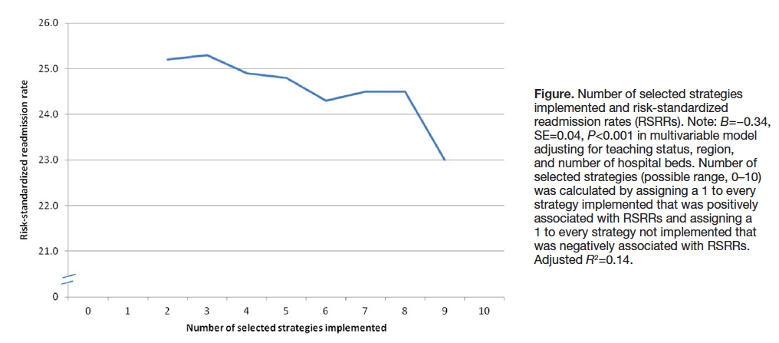
Readmissions
Conventional approaches to change system behavior
From Bradley et al., Circ Cardiovasc Qual Outcomes, 2013
Notes:
http://circoutcomes.ahajournals.org/content/6/4/444--Krumholtz data, across a couple of hundred hospitals
How to promote strategic change?
“Six strategies were significantly associated with lower risk-standardized 30-day readmission rates in multivariable analysis; these were partnering with community physicians and physician groups, partnering with local hospitals, having nurses responsible for medication reconciliation, arranging for follow-up visits before discharge, having a process in place to send all discharge or electronic summaries directly to the patient’s primary care physician, and assigning staff to follow up on test results after the patient is discharged. “

Slide 29
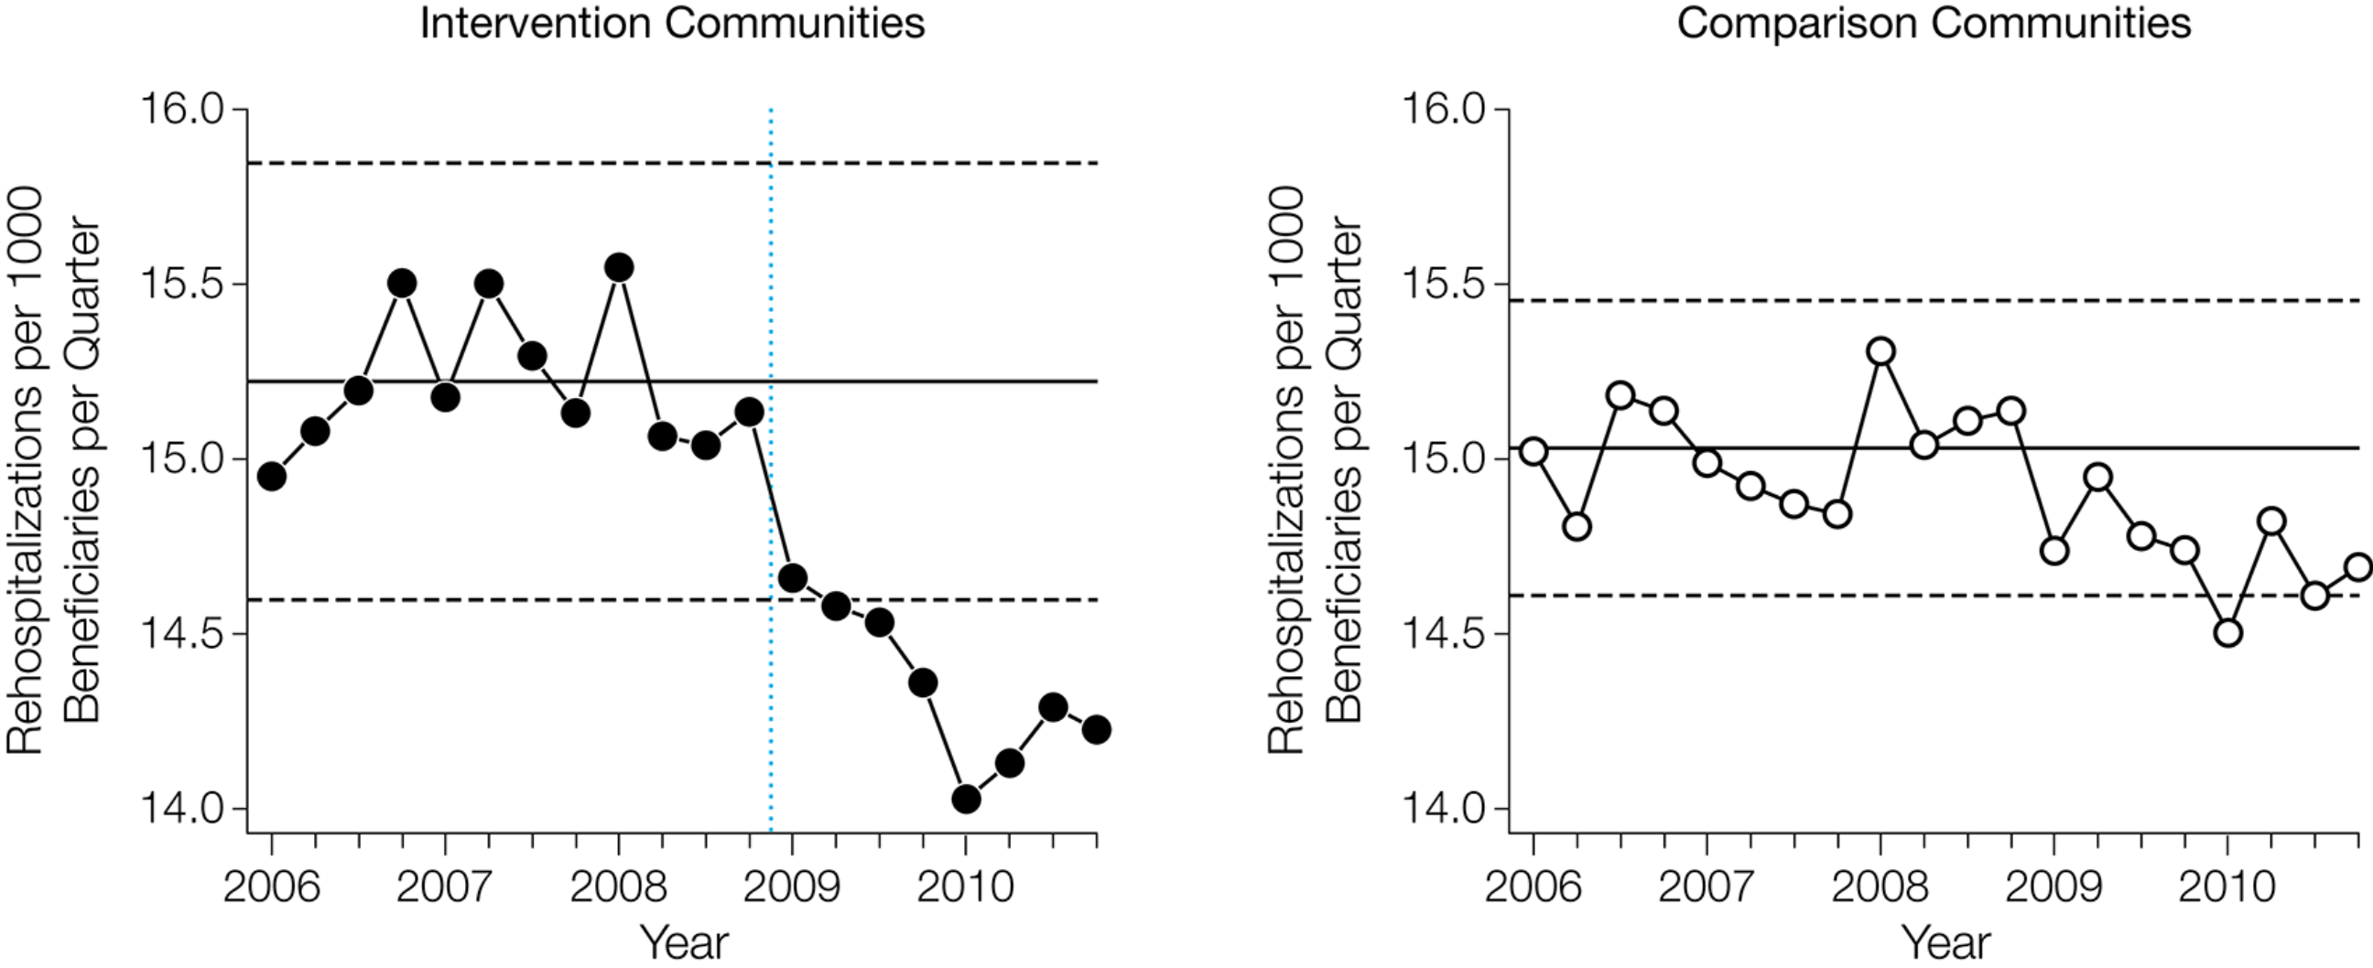
Readmissions
QI improves unnecessary readmissions, but not the rate
Brock J, et al., JAMA. 2013;309(4):381-391
Notes:
Is readmission rate the right metric?
Hospitals can improve total hospitalizations and re-hospitalization per patient, but the rate of readmissions can be unchanged.
http://jama.jamanetwork.com/article.aspx?articleid=1558278
CMS penalty not improved!

Slide 30
iSCRIPT Center
Innovative Strategies to deCrease Readmissions through Improving Patient & System sTress & behavior
Inter-disciplinary Center from Biomedical Informatics, Biomedical Engineering, Cardiology, General Internal Medicine, Emergency Medicine, the CTSA, and the Center for Behavioral Cardiovascular Health (CBCH)
Aim to identify novel hospital system, care processes, and patient factors that adversely influence 30-day readmissions, and to test and implement novel behavioral strategies targeting these factors to reduce readmission rates and increase patient satisfaction

Slide 31
Readmissions
Readmissions as a complex phenomenon
1
Behavior
Patient, provider and system behavior
2
Creativity
How creativity science can help?
3

Slide 32
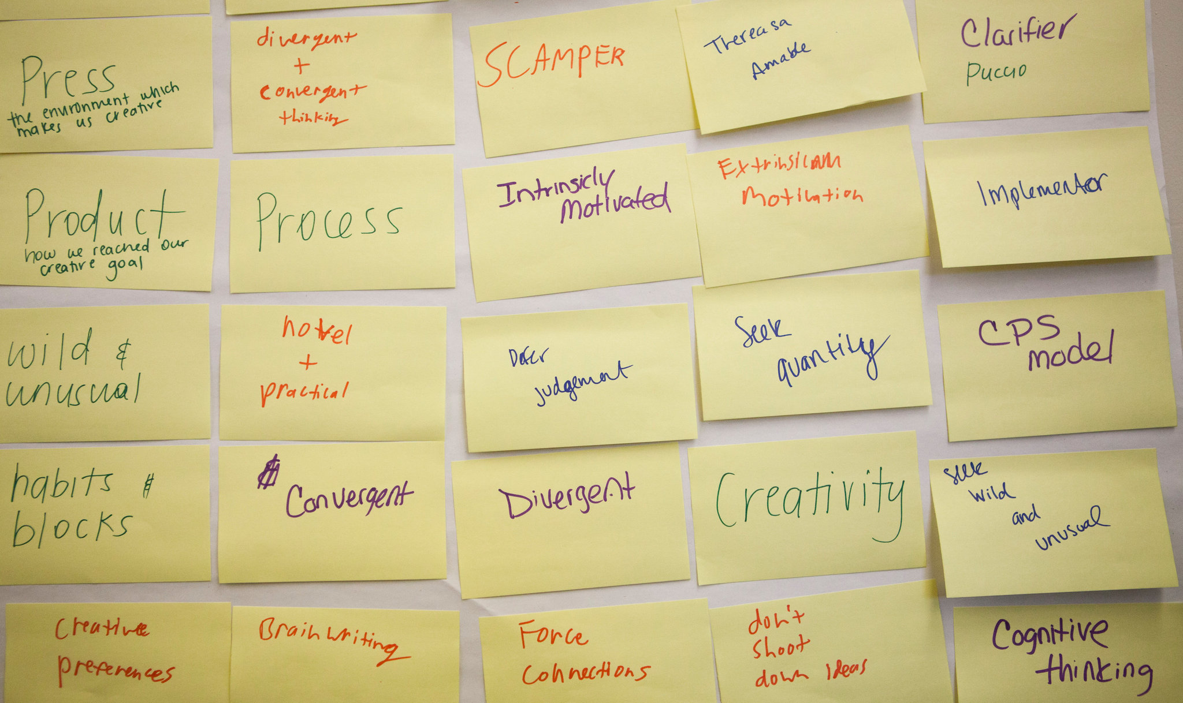
Creativity Science
Notes:
Can we understand motivation and barriers to health patient behavior? Can we predict it? Can we change it? A combination of data analysis and new approaches are needed that go beyond the systems that have been in place for the last 50 years.

Slide 33
Creativity Science
Foursight Approach
  Clarify --- Ask the right question.
  Ideate --- Create multiple ideas/brainstorm
  Develop — Build out a solution
  Implement --- Rally others and execute solution
  Team members will have natural talents in one of these areas—build teams to represent all four processes.

Slide 34
Creativity Science
Innovative environments
  Open Hallways and Sandpits
    Structurally create an environment where creativity can occur

Slide 35
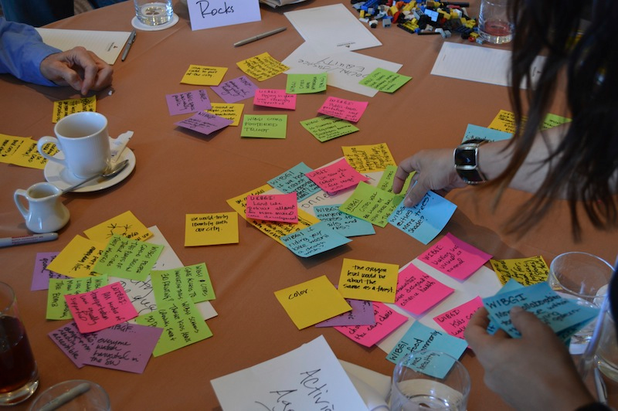
Creativity Science
Open hallways and sandpits
Notes:
http://www.epsrc.ac.uk/funding/routes/network/ideas/Pages/whatisasandpit.aspx
A sandpit is a residential interactive workshop over five days involving 20-30 participants, the director, a team of expert mentors and a number of independent stakeholders. An essential element of a sandpit is a highly multidisciplinary mix of participants taking part, some being active researchers and some being potential users of research outcomes, to drive lateral thinking and radical approaches to addressing particular research challenges.
The sandpit is an intensive discussion forum where free thinking is encouraged in order to delve deep into the problems on the agenda and uncover innovative solutions. Each sandpit is led by a director, whose role is to define the topic and facilitate discussions at the sandpit event.

Slide 36
Creativity Science
Innovative environments
  Liquid networks
    provide a happy medium between excessive order and anarchy
    new configurations can emerge through random connections
    the system isn’t so wildly unstable that it instantly destroys its new creations

Slide 37
Creativity Science
Innovative environments
  “Slow hunches” colliding
    good ideas usually start out as half-baked
    turn into crucial insights through time, toil, and “collision” with other hunches
    big ideas often need time to percolate
    connections that enable the biggest changes are often serendipitous: two hunches happen to collide through a liquid network

Slide 38
Creativity Science
  On-demand creativity is not as outrageous as it sounds.
  Employ divergent thinking (create multiple ideas; fluency, flexibility, or originality)
  Employ convergent thinking (find what works)

Slide 39
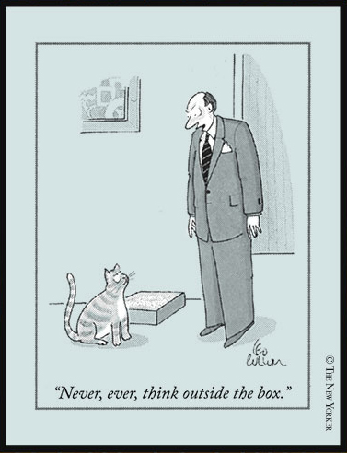
Creativity Science
Thinking outside the box
Notes:
http://pss.sagepub.com/content/23/5/502
Participants who literally performed better “thinking outside the box” on Remote Associate Tests

Slide 40
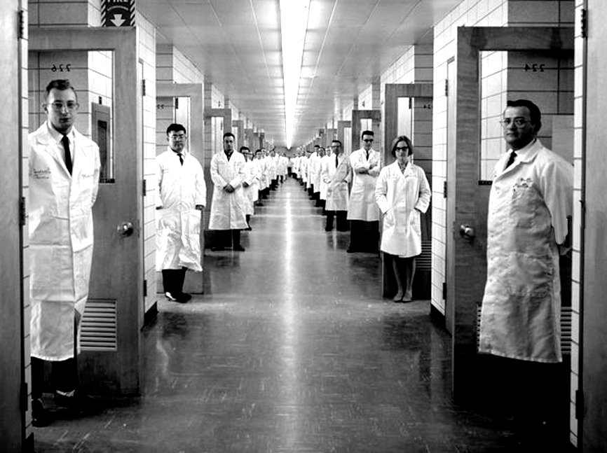
Creativity Science applied to our hospital--Open hallways and sandpits?
Notes:
Bell Labs, 1966

Slide 41
iSCRIPT Center
Innovative Strategies to deCrease Readmissions through Improving Patient & System sTress & behavior
Deploy a rapid, sequential intervention strategy design
ONLY examine novel, intervenvable behavior change targets

Slide 42
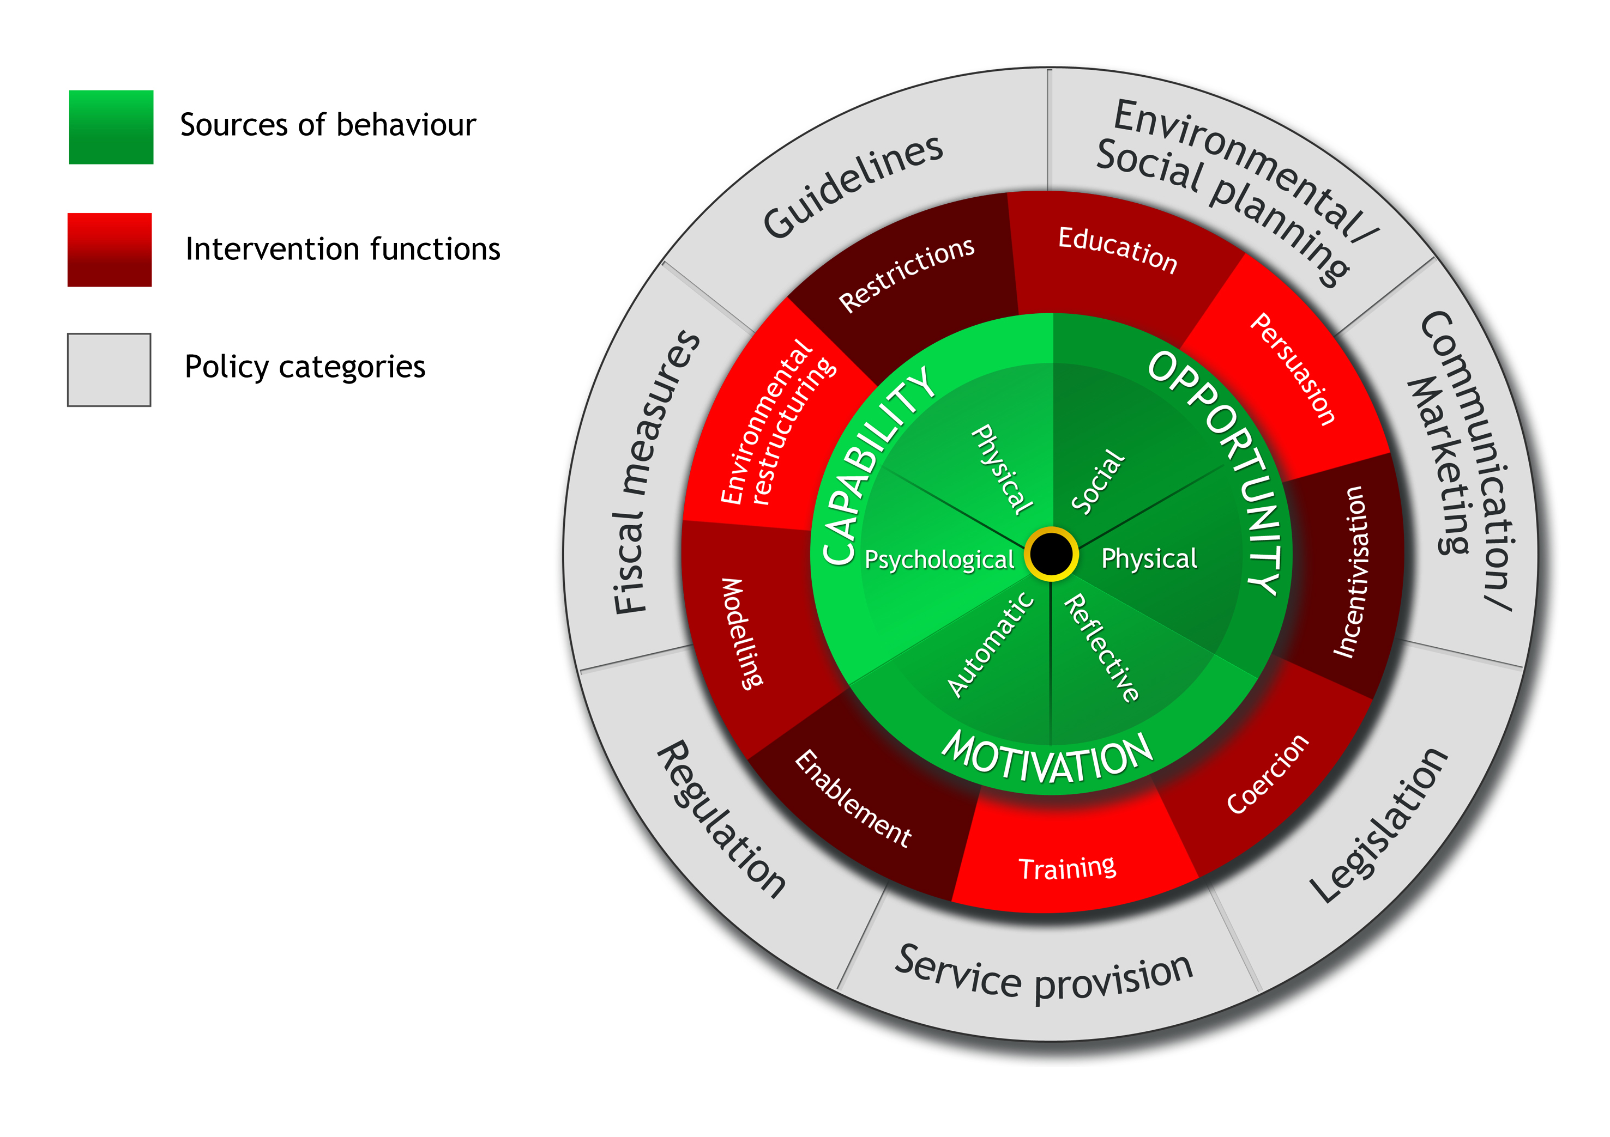
Creativity Science
Behavior Change Wheel
Michie et al. Implementation Science 2011 6:42
Notes:
Michie et al. Implementation Science 2011 6:42 doi:10.1186/1748-5908-6-42

Slide 43
Readmissions
New paradigms?
Hospital Stressors
Discomfort
Noise
Readmissions
Pain
Poor sleep
Depression
PTSD
Poor Health Behaviors
Low physical
activity
Poor diet
Poor sleep
Medication
non-adherence

Slide 44




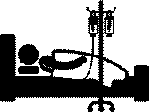
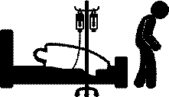
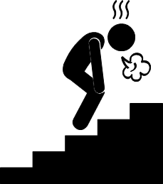

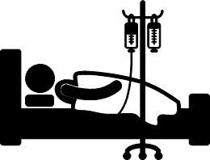



ACS
Event
within
30 days
Z
Z
Z
Z

Slide 45
Readmissions
A Complex Phenomenon
Processes
Patient Factors
(Beneficiaries)
System Medication
Discrepancies
Lack of Physician
Follow-up
Aging
Population
Increase in
Co-morbidities
Inconsistent Information:
Among Providers & Patients
Decreased Mortality
Lack of Follow-up with
Physician after Discharge
Decrease in
Length of Stay
Patient Medication
Discrepancies
Poor Self-Care
Management Skills
Increase in HF 30-Day
Readmission Rates
Physicians Not Willing
To Follow-up with
Recent Discharges
Increased
Incidence of HF
Inadequate Discharge
Follow-Up
Nutritional
Deficiencies
Economic Impact
Systems
(Environment)
Measures
Notes:
Have Faith recreate at higher resolution?
From https://www.cfmc.org/integratingcare/toolkit_rca.htm

Slide 46
Creativity Science
My Approach
  Failure 101
  (missing the engineer)

Slide 47
Readmissions
Intractable problem?
  “This is a classic example of impoverished data, on a huge, intractable problem, with poorly defined hypotheses, for which we have no useful tools or interventions.”

Slide 48

Readmissions
A Complex Phenomenon

Slide 49
Weather Forecasting
How to Approach Complexity
LaPlace’s Demon
  If “all positions of all items of which nature is composed” can be known, and if the knowledge of laws of physics is perfect, then weather can be predicted perfectly
Weather forecasting
  Non-linear process and chaos theory
  … but has improved tremendously due improved data collection and analysis
Notes:
LaPlace’s Demon is a Newtonian view of the world- articulated by Pierre-Simon Laplace in 1814
Although readmission may have stochastic elements, we treat it as if it’s deterministic, but with incomplete data
Data collection: atomospheric balloons, GPS technology, satellite tracking
Improved analysis: computing power

Slide 50
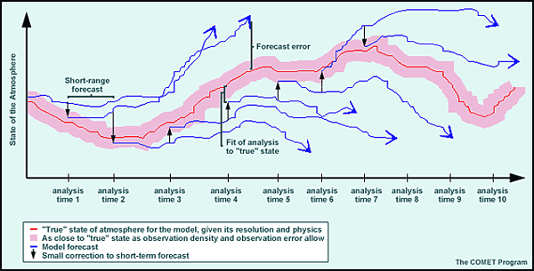
Weather Forecasting
Complexity and non-linearity
Notes:
\

Slide 51

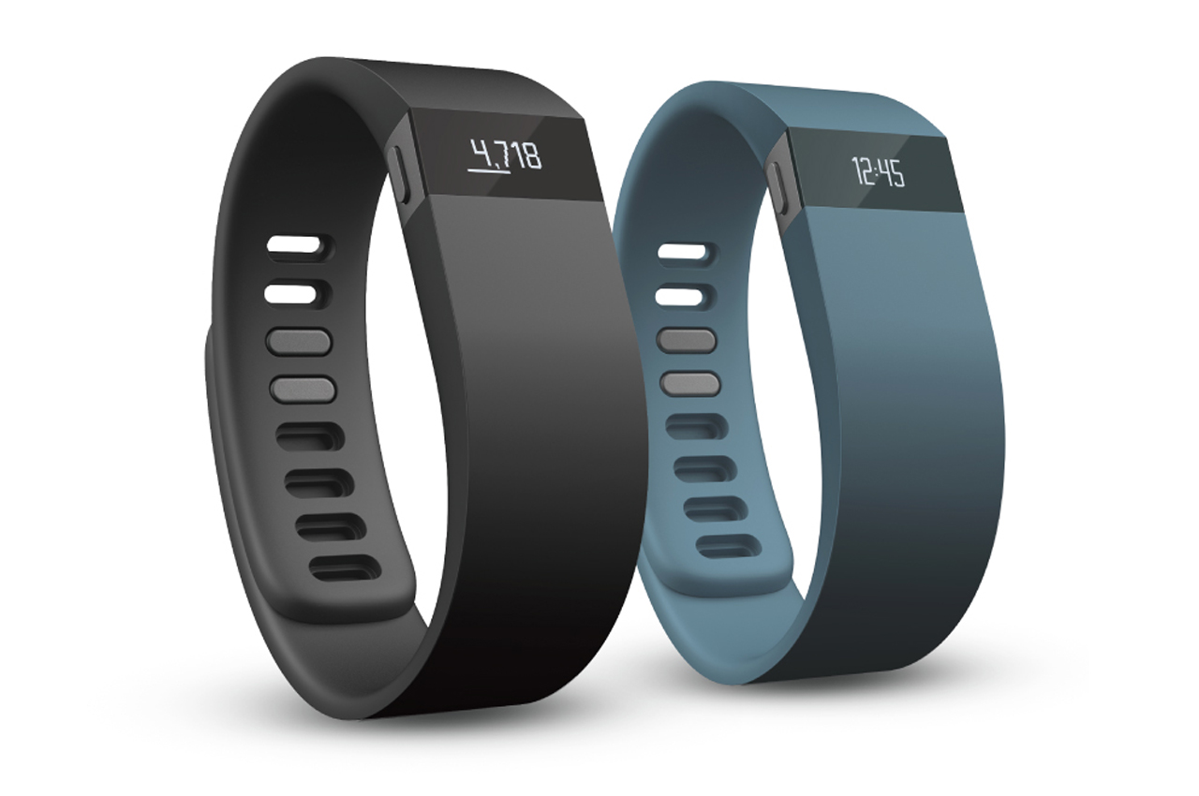

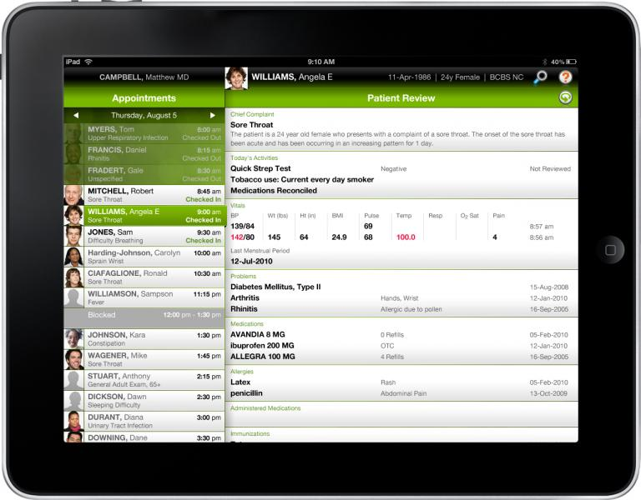

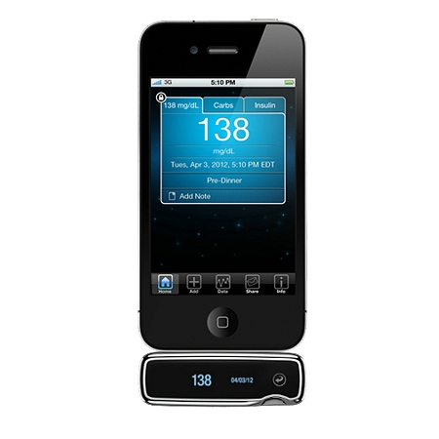
Re-admission Data as Big Data
Similar to weather analogy we are collecting more data on patients, providers, and systems than ever before
Notes:
We are collecting more data on patients than ever before from electronic medical records, home monitoring systems, social media, new consumer electronics even our own claims data. Similar to other industries including retail and marketing, medicine now has to develop the ability to analyze the “big data” and determine the best way to use it. Can we understand and then predict patient behaviors? This has real applications for 30 day readmissions whether as predictive analytics to remote monitoring to new methodologies.

Slide 52
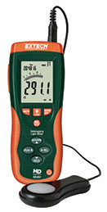
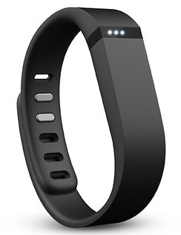
Readmissions
Another Approach for Patient Level Behavior Change?
Better data for patient behavior / exposures
  Hospitalization related stressors, such as noise, light, sleep disruption
  Post-discharge behavior, such as medication adherence, and physical activity
  Identifying “triggers” that initiate sequent of events leading to readmissions
Real-time feedback to patients and providers
Notes:
Harlan M. Krumholz, M.D—Post-hospital syndrome

Slide 53
Potential approaches
Understanding hospital stressors
  Using sensors to monitor sound and light exposure
  Devices to monitor sleep disruption, walking
  Smartphone to assess subjective stress
Improve risk prediction
  Robust electronic health records data
  Natural language processing
  Focus on modifiable mechanisms or processes
Better transitions
  Improved, user-tested decision support
  EHR tools to improve communication between providers

Slide 54
Potential approaches
Home environment
  Automated hovering
  Physical activity, medication adherence, subjective stress, sleep patterns, adherence with discharge instructions
  Complement existing home nurse visits
  Focus on clinically actionable data
Improve patient access and engagement
  Remotely deliver educational material
  Connect patients to providers at needed moments

Slide 55
Behavior Matters:
Can We Integrate Novel Paradigms into our Science?
We have the CMO taking all responsible out for positive affect inducing dinners
We have 180 house staff randomized to 2 different team care approaches they created
We have RFID bracelets about to be placed on all ED admitted patients (through 30 day readmission)
We will fail, but we will persist until we can help improve the behavior of the scientists, patients, providers and system

