Slide 1

Chicago Area Patient Centered Outcomes Research Network (CAPriCORN)
Creating Authentic Community-Academic Partnerships in Clinical Research: Chicago Area Patient Centered Outcomes Research Network’s
Patient and Clinician Advisory Committee (PCAC)
Doriane C. Miller MD
Associate Professor of Medicine
University of Chicago
Research Participant Recruitment and Retention Conference
ICTR/Johns Hopkins University
September 9, 2016

Slide 2
Objective
Discuss the rationale behind developing a Patient-Clinician Advisory Committee within the context of a clinical data research network

Slide 3

















Who is CAPriCORN?
CAPriCORN Partners:
Blue Cross Blue Shield of Illinois ◦ Chicago Asthma Consortium ◦ Chicago Health IT Regional Extension Center (CHITREC) ◦ Comer Children’s Hospital ◦ Have a Heart for Sickle Cell Anemia Foundation ◦ Illinois Hospital Association ◦ Lurie Children’s Hospital ◦ Next Step/Strive ◦ Office of Health Information Technology ◦ Respiratory Health Association ◦ Sickle Cell Disease Association of Illinois ◦ The Peggy Lillis Memorial Foundation

Slide 4
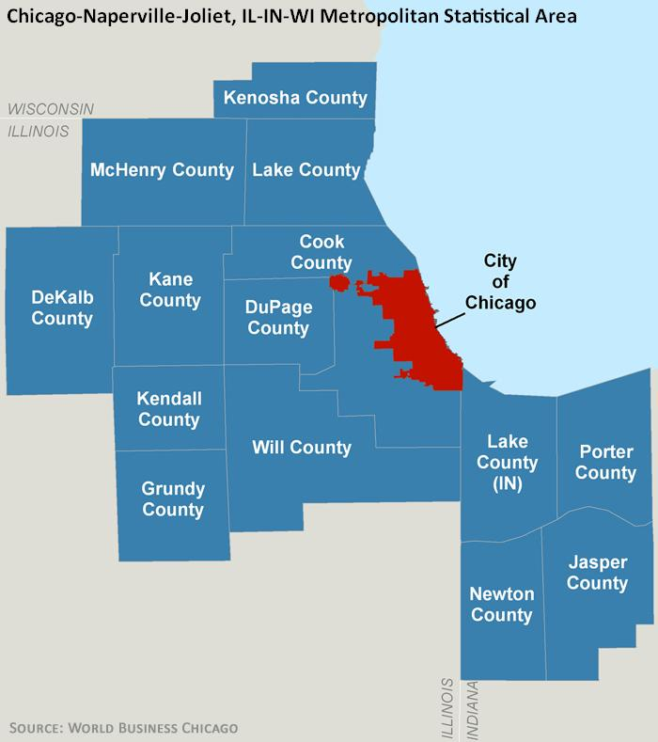
CAPriCORN Region
Region of 9.5 million residents/EHR data population of over 5 million

Slide 5
Rubric: Patient and Family Engagement in
Patient-Centered Outcomes Research (PCOR)
Planning the Study
Conducting the Study
Disseminating the Study Results
PCOR Engagement Principles
Notes:
Broken down into 4 elements
For future
The rubric is a response to frequent questions from the patient and research communities asking what we mean by “engagement in research.”
The rubric is a framework that provides a variety of options for incorporating engagement, where relevant, into the research process.

Slide 6
PCORI Patient Engagement Principles
Reciprocal relationships: roles and responsibilities
Trust, transparency and honesty
Co-Learning: all teach, all learn
Partnership: sharing of resources

Slide 7
Patient-Clinician Advisory Committee
The PCAC will allow patients and health professionals (clinicians) to collaborate to provide guidance about:
  governance of data use,
  research priorities, and
  processes to incorporate patient and clinician perspectives regarding the design, implementation and reporting of research and related results.

Slide 8
Recruitment Challenge
Diversity
Health conditions
Multiple partners
Geography
PCORI engagement principles

Slide 9
PCAC Statistics Slide
Conditions: anemia, sickle cell, diabetes, recurrent c. difficile, asthma, obesity
Gender: 63% women
Special Populations: veterans, faith community
Key Stakeholders: public health, health insurance, public hospital, academic providers, voluntary health organizations

Slide 10
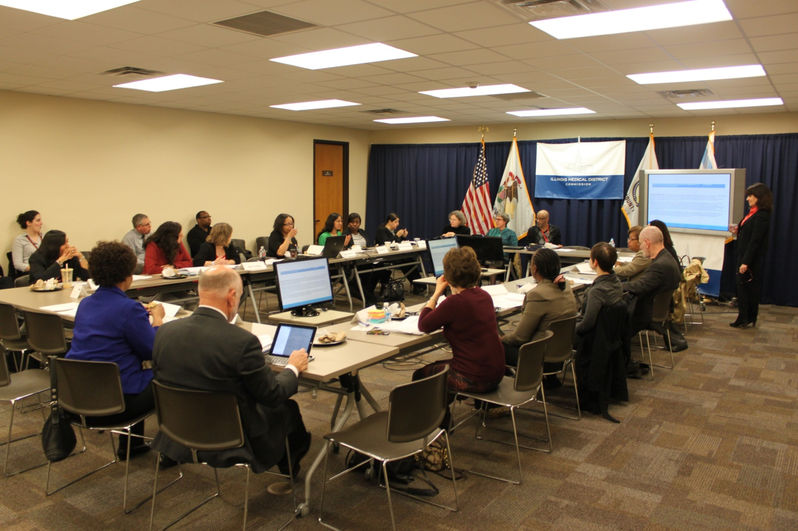
Patient and Clinician Advisory Committee
March 31, 2015

Slide 11

Network Organization
CAPriCORN
Steering Committee
Patient Consumer Engagement WG

Slide 12
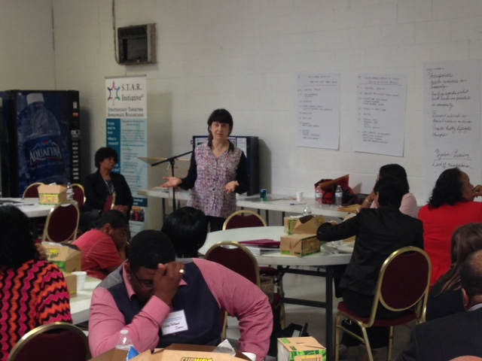

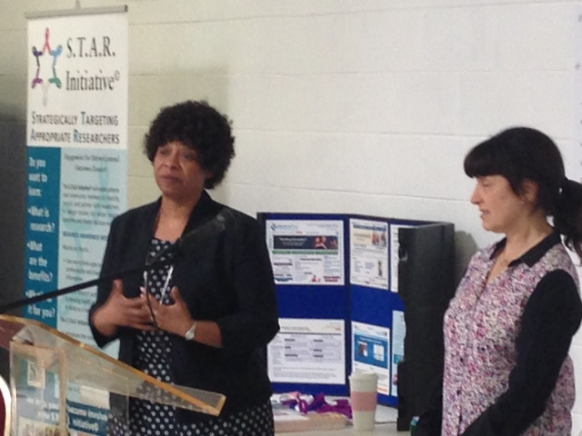
CAPriCORN Engagement in the Community –
1st and 2nd Annual Community Day of
Research and Engagement – South Cook County, IL
Drs Doriane Miller & Madeleine Shalowitz presented CAPriCORN and its work each year
CAPriCORN is a partner in informing undeserved communities in PCOR and CER
Pastors4PCOR Article
file:///F:/S.T.A.R.%20INITIATIVE/GOSPEL%20TRIBUNE/Research%20Ready%20Churches%20Healthcare%20Research%20Associates%20a.pdf

