Slide 1
ICTR
The Johns Hopkins Institute for Clinical and
Translational Research
Preparing for ClinicalTrials.gov Results Reporting and
Module 2: Baseline Characteristics
October 19, 2014
ICTR Research Navigators

Slide 2
ICTR
Module 2
Baseline Characteristics

Slide 3

ICTR
Purpose
The Baseline Characteristics module is designed to summarize important attributes of the participants enrolled at the start of the study.

Slide 4
ICTR
Module 2: Baseline Characteristics
Baseline Characteristics Definition
“A table of the demographic and baseline data collected overall and for each arm of the clinical trial…”
http://prsinfo.clinicaltrials.gov/results_definitions.html
Explaining FDAAA Sec. 282(j)(3)(c)(i)

Slide 5
ICTR
Module 2: Baseline Characteristics
Baseline Characteristics Module Description
Table of demographic and baseline data for the entire trial population and for each arm or comparison group
Accommodates different data types:
  Continuous: measure of central tendency (e.g., mean) and measure of dispersion (e.g., standard deviation)
  Categorical: for each category – (1) a count or (2) measure of central tendency and measure of dispersion.

Slide 6
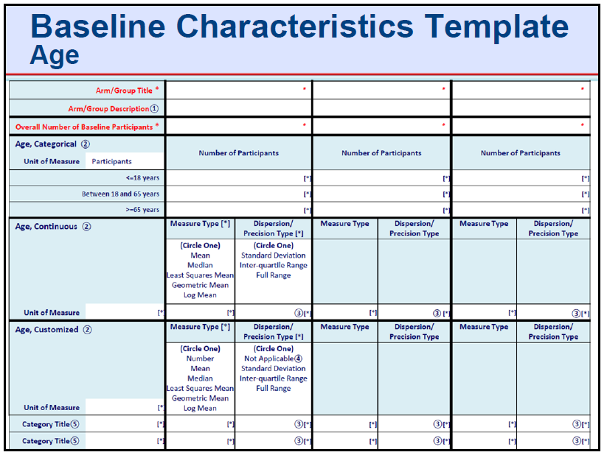
ICTR
Module 2: Baseline Characteristics
Get organized using the Templates
As with the Participant Flow, the template sheets might helpful to gather your data.
This one is only for the default criteria, but there are others for Gender, Race, Ethnicity, Region, and Study Specific Measures downloadable from http://prsinfo.clinicaltrials.gov/results_table_layout/ResultSimpleForms.html

Slide 7
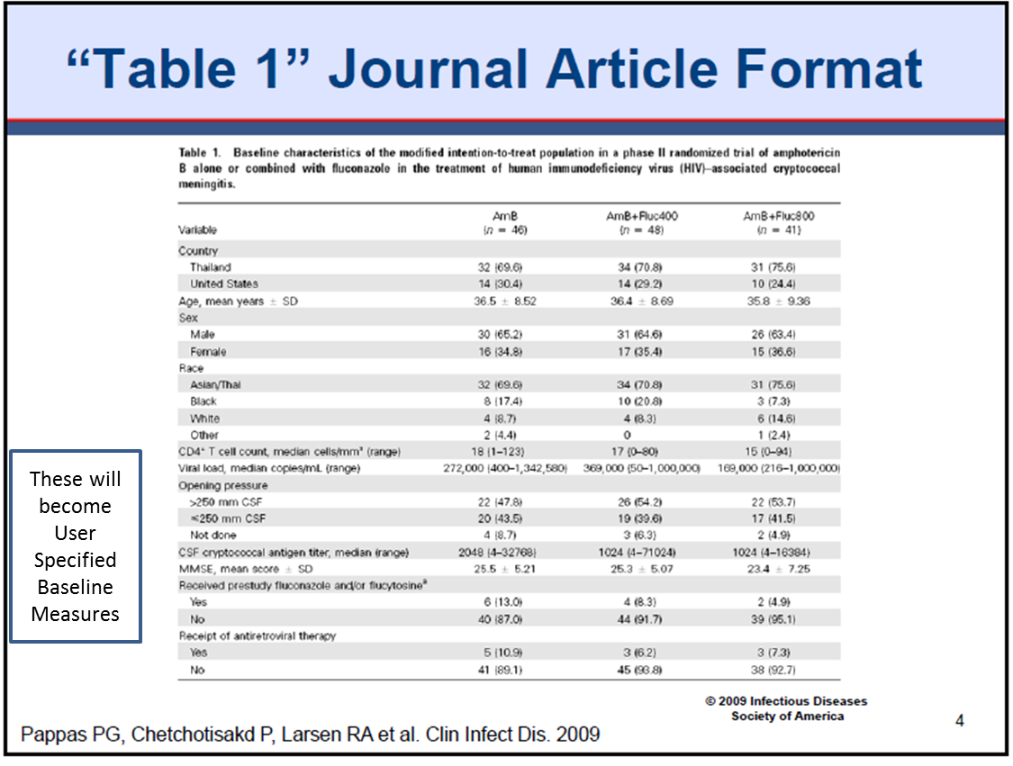
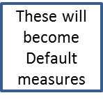
ICTR
Module 2: Baseline Characteristics
If it’s in Table 1, it probably belongs in Baseline Characteristics
Much of the data you need will come from Table 1, if an article has been published.
If not, that still may be a good way to ask your PI for the data you will need, “What would you put in Table 1, if you were publishing this trial’s results?” If s/he can articulate those fields, you can use those “simple templates to ask your data manager to run the reports necessary to fill out the templates, and the ClinicalTrials.gov baseline characteristics module.

Slide 8
ICTR
Module 2: Baseline Characteristics
ClinicalTrials.gov Format

Slide 9
ICTR
Module 2: Baseline Characteristics
Default Baseline Characteristics
Age and Gender are required characteristics by default, however, best practice would include other relevant information.
Choose and display characteristics that are most applicable to your study.
Region defines “nation”, not states or regions within the U.S.
NOTE: Is there a benefit to showing age in both ways? (That is, age can be expressed as either categories or as mean and standard deviation). Sometimes there is; however both ways are not required.
Even if a trial never included gender data collection, the baseline measure of gender will still need to be in the table. One approach is to use Gender, Customized and to specify a category of “Unknown” or “Gender data not collected”. The Baseline Measure Description can be used to explain why “unknown” (e.g., not collected as part of the study protocol).

Slide 10
ICTR
Module 2: Baseline Characteristics
Data Elements

Slide 11
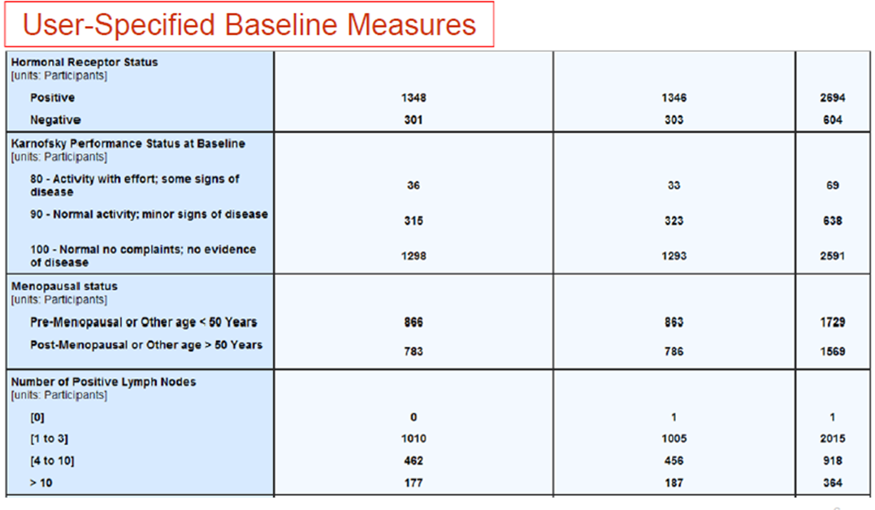
ICTR
Module 2: Baseline Characteristics
ClinicalTrials.gov Format
NOTE: Here is the way the user specified criteria will look if they are all represented by “participant”.
If the units of measure are something more variable, you are more likely to have medians with standard deviations represented.

Slide 12
ICTR
Module 2: Baseline Characteristics
User-Specified Baseline Characteristics
Do include all meaningful elements that make your study understandable/ useful to others, both demographic and clinical measures, such as baseline values of outcome measures or prior and concurrent treatment characteristics.
Make sure units and scales are labeled, and understandable – (e.g. what the range of a scale is and what it means. If it’s a well-known scale, within the discipline, refer to it by name and give a citation, if necessary.)
Use Table 1, if there is a published article or draft.
If there is no article from which to work, consult with PI.
Example of a citation of a scale:
Quebec Task Force (QTF) Classification of Spinal Disorders consists of 8 classes ranging from Class 0 (no pain) to Class 7(spinal Stenosis)

Slide 13
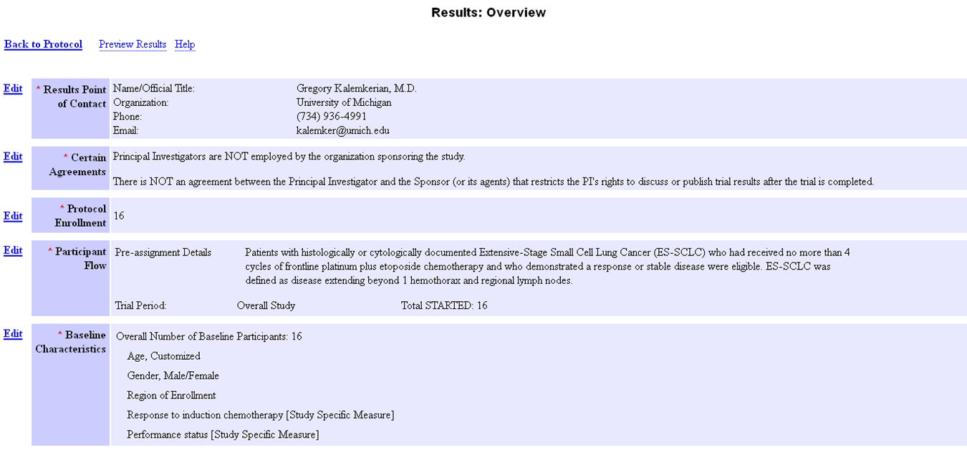
ICTR
Module 2: Baseline Characteristics
Post Baseline Characteristics

Slide 14
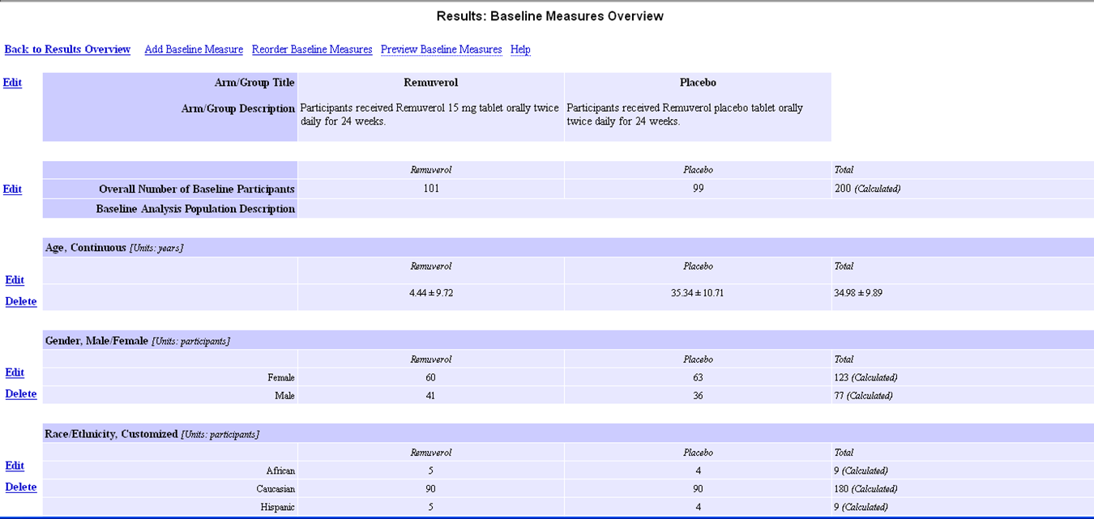

ICTR
Module 2: Baseline Characteristics
Baseline Overview
Then use the Edit or Delete to edit each “Default Measure” to edit it or “delete” that measure.
If you want to “Add Baseline Measures” highlighted texts will open up a new baseline measure which, once saved, will show up like all of the default measures and can be subsequently modified or deleted.
Modify allows you to describe Title, description, measure type, measure of dispersion and unit of measure.
Edit – over on the left, allows you to list the different characteristics and put in the actual data.
From Baseline Overview you can edit (fill in) or delete default measures, or you can add additional baseline study specific measures.

Slide 15
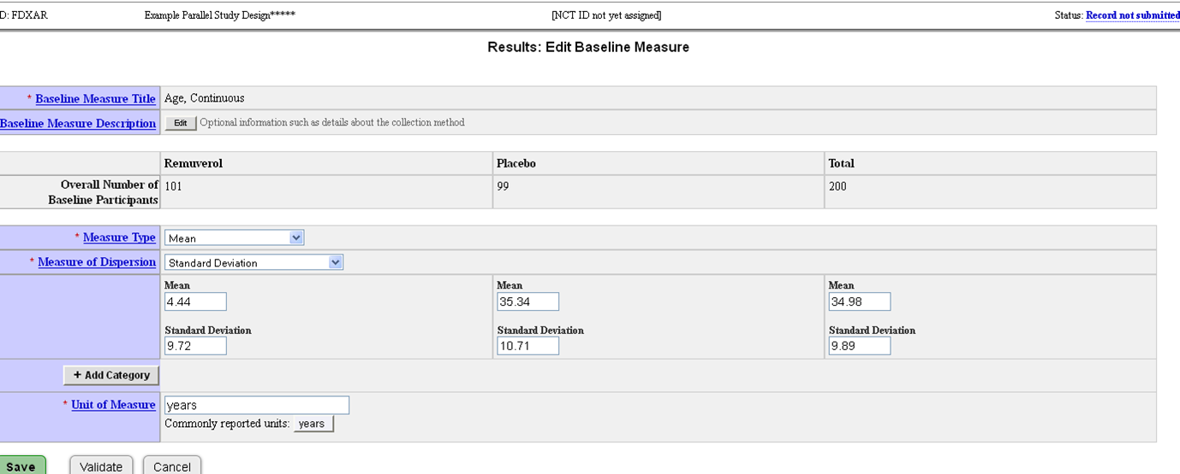
ICTR
Module 2: Baseline Characteristics
Edit Baseline Measure
If the measure states what you intended, you can go ahead, and add the data, as here. OR you can Edit the Baseline Measure Description. Make sure you click Save to save your data. Note too, you could Add a Category (which could be a subset, or could be more like a period.)

Slide 16
ICTR
Module 2: Baseline Characteristics
Baseline doesn’t always mean only at the beginning of
the study
More than one period or time point can be considered “baseline” in studies which follow more complicated protocols:
Crossover
Dose escalation
Factorial
Multiple Period
That is, not every one of these designs would require posting multiple baselines, but there may be times when the responsible party feels that to have a clear understanding of the findings of the study, it helps to show how baseline characteristics differed between one portion of the study and another.

Slide 17


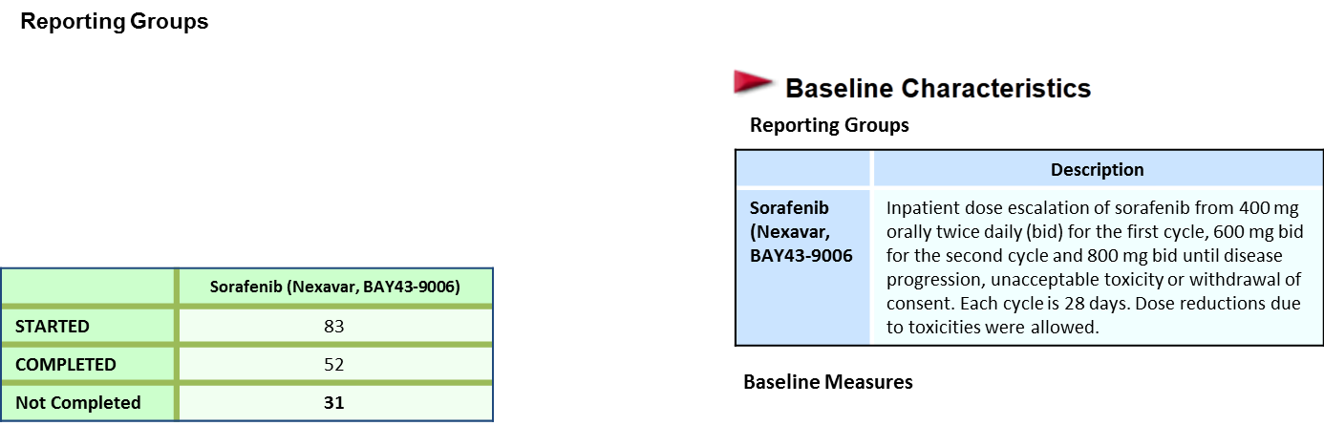

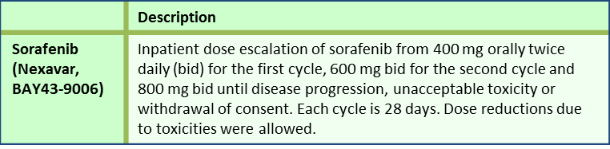

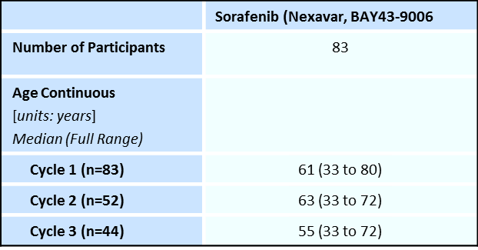
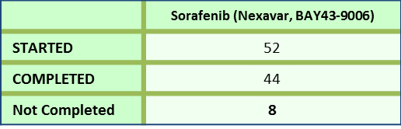

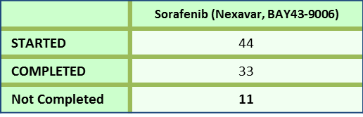
ICTR
Module 2: Baseline Characteristics
Example of Multiple Baselines shown
From supplemental slide provided at Train-the-Trainer workshops; courtesy of ClinicalTrials.gov.
Cycle 2 (28 Days)
Cycle 3 (28 Days)

Slide 18
ICTR
Module 2: Baseline Characteristics
Example of Multiple Baselines shown
The previous slide, coming from the Train-the-Trainer workshop slides, shows using “Categories” for multiple baseline measures of age, as the baseline for different cycles of the trial.
You can see, in it, that the population of participants in the study is diminishing at each of the cycles, and therefore the median age is changing as well.
By using “categories” the results reporter could show those three populations more clearly than by using one baseline.

Slide 19
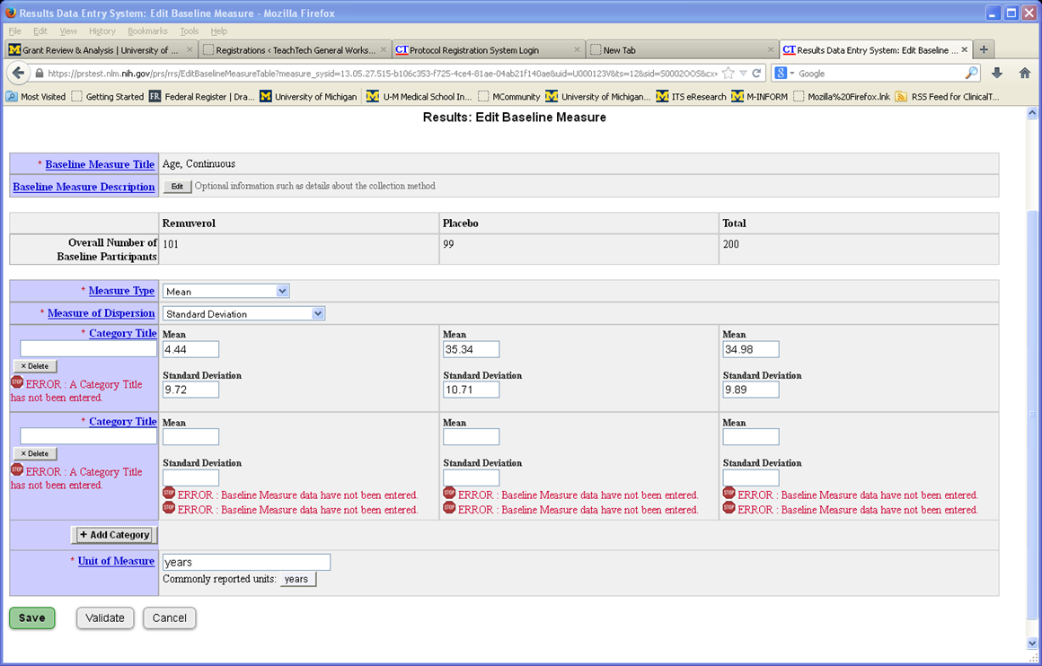
ICTR
Module 2: Baseline Characteristics
Multiple Baselines
Note how when another Category is added, it needs a title as well as data. Remember to save!

Slide 20
ICTR
Module 2: Baseline Characteristics
Important Quality Checks
Review record to ensure:
Categories do not overlap and all categories are presented
Range and direction of scores in baseline characteristics description are explained
Terms are understandable to the general public. Use footnotes if necessary to describe a score.

Slide 21
ICTR
Module 2: Baseline Characteristics
This slide set was made possible by a collaboration of CTSA organizations (Mayo Clinic, Partners, University of Michigan Medical School, Duke University) and the National Library of Medicine.
The Clinical and Translational Science Awards Program (CTSA) is part of the Roadmap Initiative, Re-Engineering the Clinical Research Enterprise and is funded by the National Center for Advancing Translational Sciences (NCATS), National Institutes of Health (NIH).
21

