Slide 1

Keeping a Three Day Food Record for Research: A How-to Guide
The Johns Hopkins University
Institute for Clinical and Translational Research

Slide 2
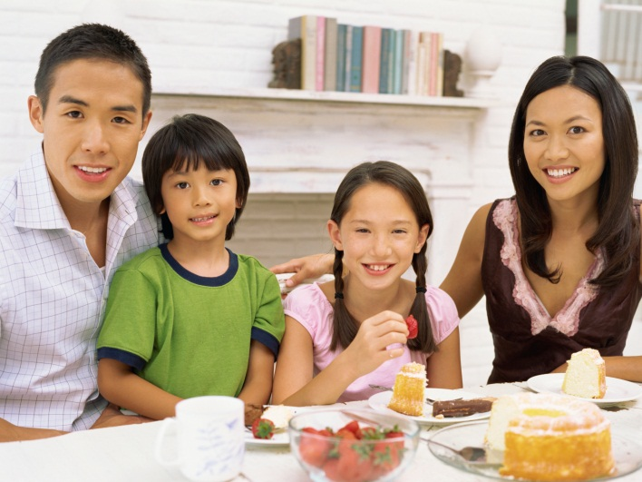

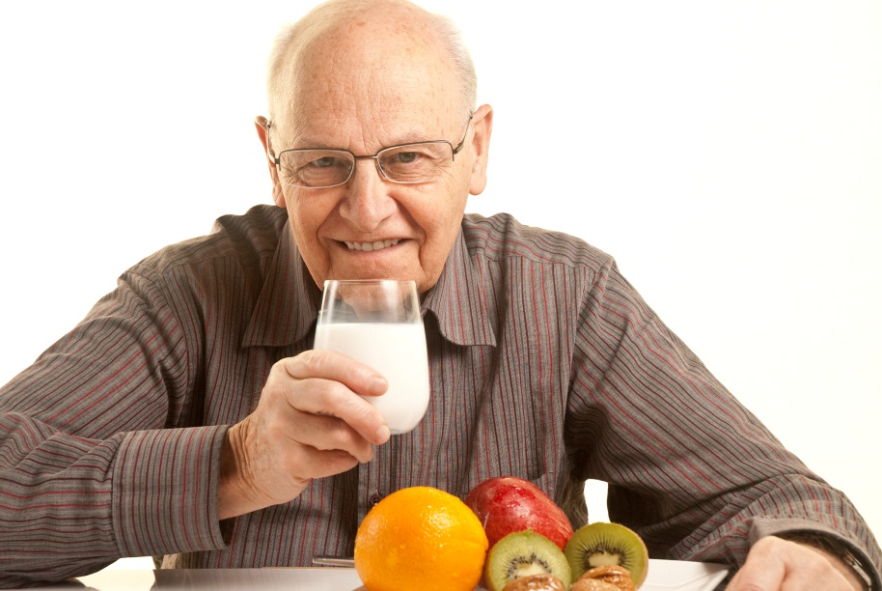
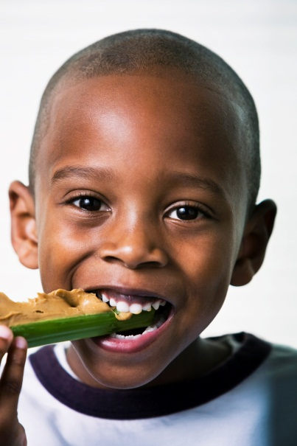
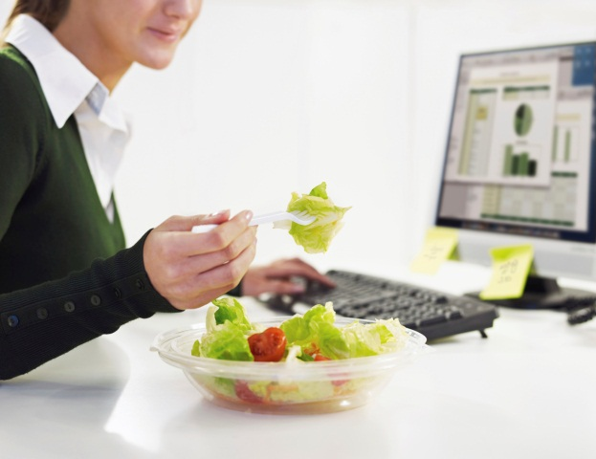

Slide 3
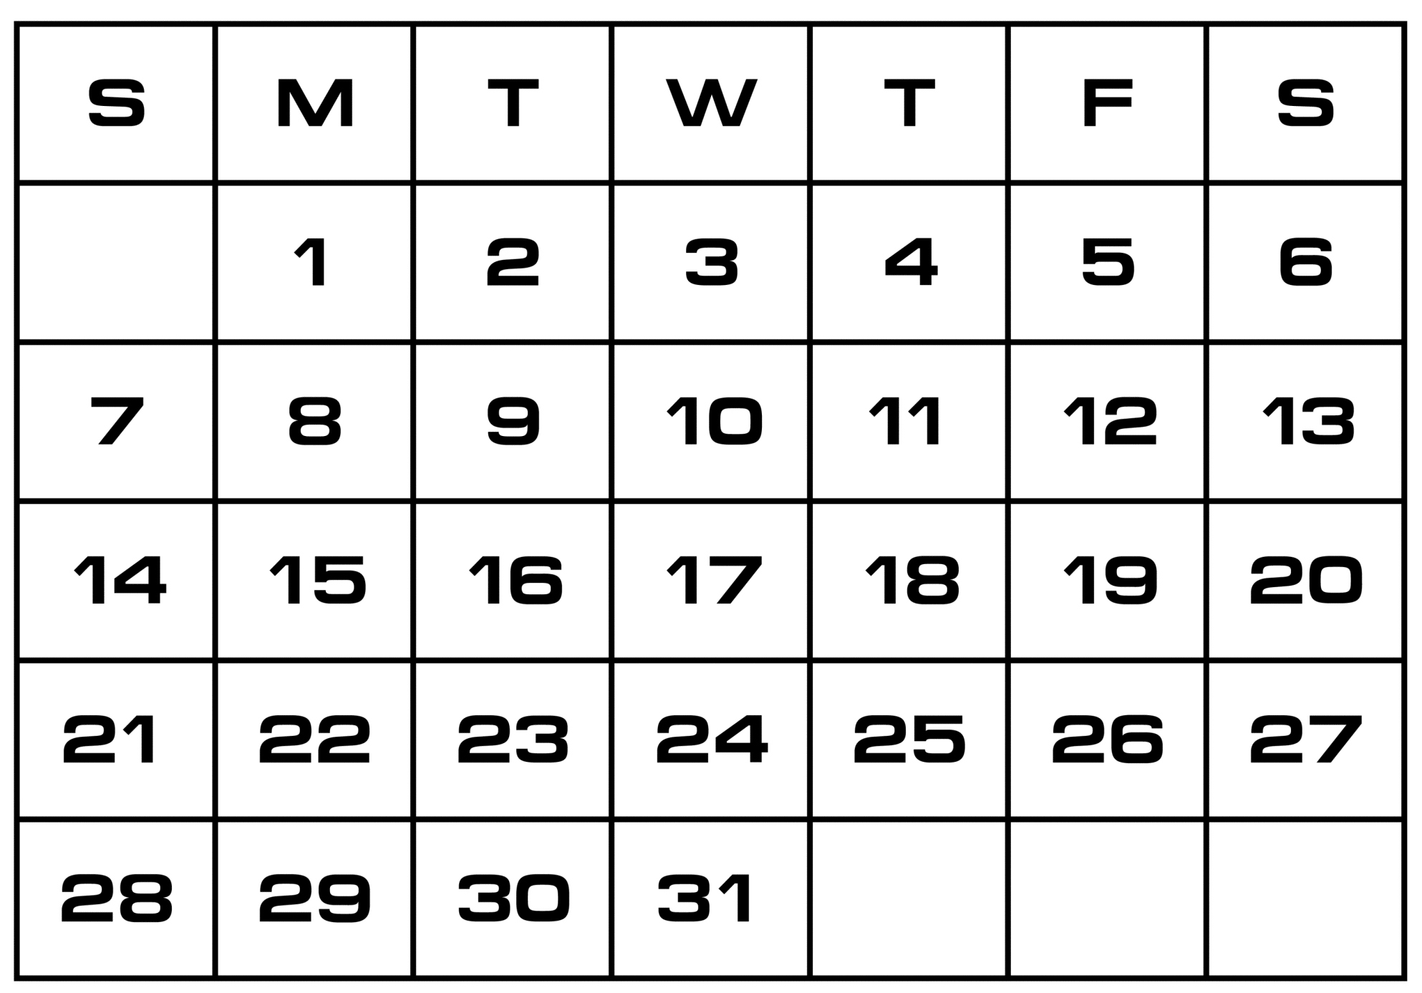
Choosing Your Three Days
Two weekdays
+ One weekend day
Three Day Food Record

Slide 4
Choosing Your Three Days
Holidays
Sick
Days
Special Occasions

Slide 5
Important Guidelines
Eat normally- do not change how you eat
Record EVERYTHING you eat and drink
Record foods and beverages immediately
Include descriptions and amounts for everything you eat and drink

Slide 6
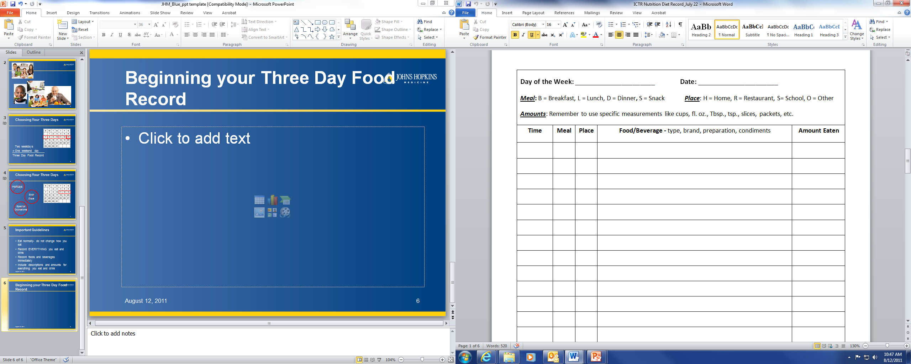
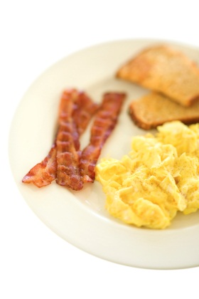

Beginning your Three Day
Food Record
Thursday
8/11/2011

Slide 7
Beginning your Three Day
Food Record
Thursday
8/11/2011
8:45am
B
H

Slide 8
Food/Beverage Details
Thursday
8/11/2011
8:45am
B
H
Eggs…
Toast…
Bacon…
Coffee…

Slide 9
Food/Beverage Details
What kind of food, beverage, or product
How it was cooked or prepared
Any additions that were made

Slide 10
Food/Beverage Details
What kind of food, beverage, or product
  Use brand names when possible
  Grains
    Type of grain (whole wheat, white, rye)
  Meat and poultry:
    Cut of meat, percent lean ground beef, with or without bone, with or without skin
  Dairy:
    Percent fat (skim, 1%, 2%..), low fat, fat free
  Fruits and Vegetables:
    Fresh, frozen, canned, dried

Slide 11
Food/Beverage Details
  Beverages:
    Details from packages like diet, sugar free, low fat, or fat free
    Consumed beverage with or without ice
    Remember to include water
  Snacks:
    Details from packages like reduced fat, low fat, or sugar free
  Dietary Supplements:
    Include brand name
    Include vitamins and minerals contained in the supplement

Slide 12
Food/Beverage Details
How it was cooked or prepared
  Method of cooking such as baked, broiled, fried or steamed
  Butter, oil, fat spray, or cream foods were cooked in
  Dipped in egg, flour, breadcrumbs, etc.
  Meat trimmed or untrimmed of fat
  Poultry skin eaten, or removed before or after cooking

Slide 13
Food/Beverage Details
Any additions that were made
  Butter, margarine, or oil
  Jam, cheese, syrup, or other condiments
  Salt, sugar, or artificial sweetener
  Creamer or half and half

Slide 14
Food/Beverage Details
Thursday
8/11/2011
8:45am
B
H
Eggs…
Toast…
Bacon…
Coffee…

Slide 15
Food/Beverage Details
Thursday
8/11/2011
8:45am
B
H
Eggs, scrambled in buttered pan, salt added at table
Toast, white wheat bread,
with Smucker’s strawberry jam
Bacon, Oscar Meyer regular, microwaved
Coffee, decaf
with liquid fat free creamer
with sugar

Slide 16
Amounts
Thursday
8/11/2011
8:45am
B
H
Eggs, scrambled in buttered pan, salt added at table
Toast, white wheat bread,
with Smucker’s strawberry jam
Bacon, Oscar Meyer regular, microwaved
Coffee, decaf
with liquid fat free creamer
with sugar

Slide 17
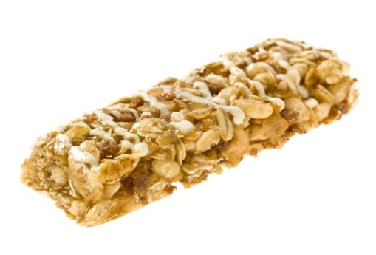

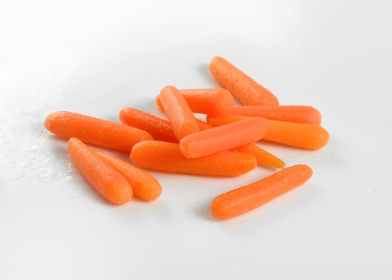

Ways to Fill Out the Amount Column
Count the number of items
= 1
= 8
= 13
= 17

Slide 18
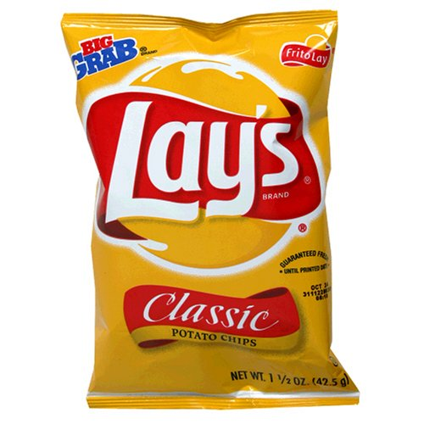
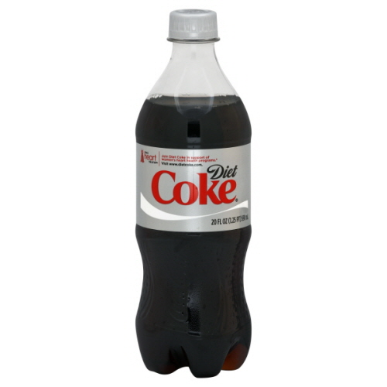
Ways to Fill Out the Amount Column
2. Record package weight or volume
20 fl. oz.
1 ½ oz.

Slide 19
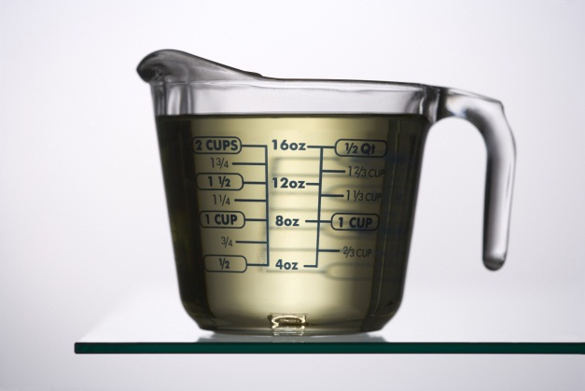
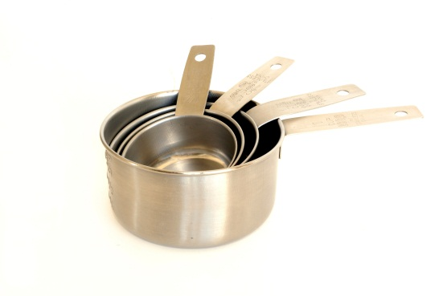
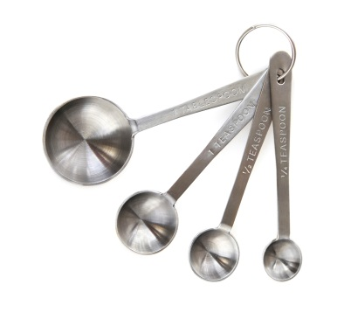
Ways to Fill Out the Amount Column
3. Use household measuring cups and spoons

Slide 20
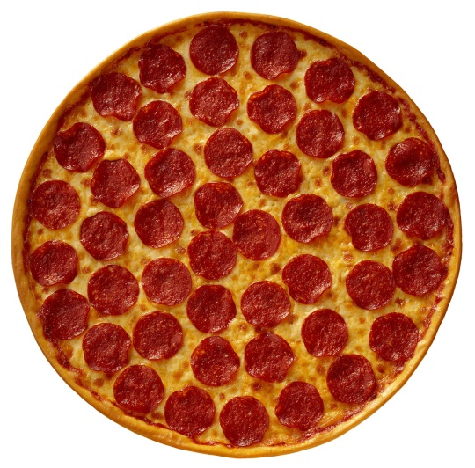
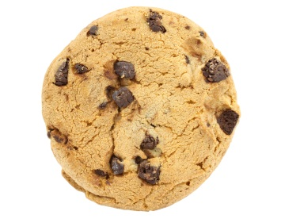
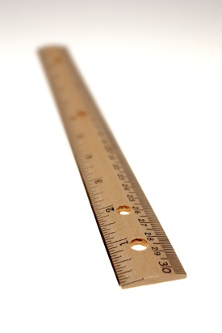
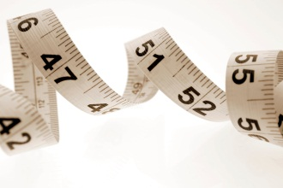
Ways to Fill Out the Amount Column
4. Measure dimensions
Round foods: measure the diameter
16 inches
2 inches
slice= 1/8 of pizza

Slide 21
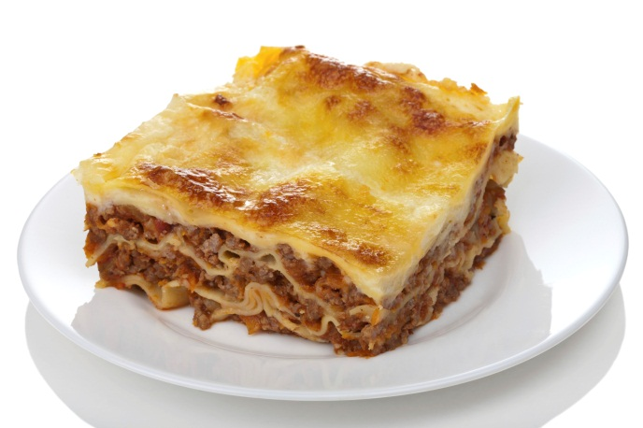
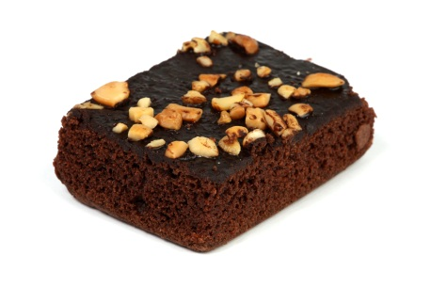
Ways to Fill Out the Amount Column
4. Measure dimensions
Rectangular foods: measure the length, width, and height
3 in. x 2 in. x 1 in.
4 in. x 4 in. x 1.5 in.

Slide 22
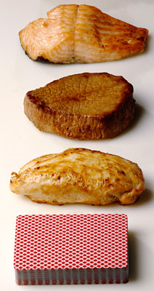
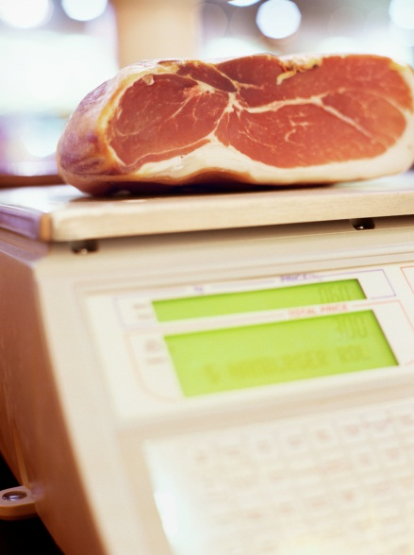
Ways to Fill Out the Amount Column
5. Meats: measure or estimate weight in ounces
8 oz. before cooking
3 oz. after cooking

Slide 23
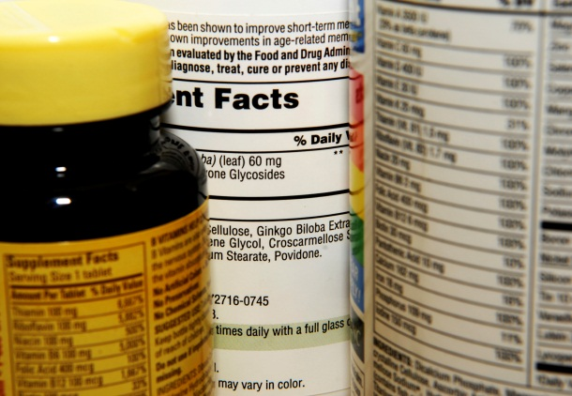
Ways to Fill Out the Amount Column
6. Dietary Supplements:
Include the dose and/or number of tablets taken
  Example:
  400 international units of Vitamin D
  1 tablet Centrum Complete

Slide 24
Ways to Fill Out the Amount Column
Count the number of items
Record package weight or volume
Use household measuring cups and spoons
Measure dimensions
Meats: measure weight in ounces
Dietary Supplements: record the dose and number of capsules taken
* See pages 3-8 in your food record instruction packet for pictures to help you estimate your serving sizes

Slide 25
Amounts
Thursday
8/11/2011
8:45am
B
H
Eggs, scrambled in buttered pan, salt added at table
2 large eggs
Toast, white wheat bread,
1 slice
with Smucker’s strawberry jam
½ Tbsp
Bacon, Oscar Meyer regular, microwaved
3 ½ slices
Coffee, decaf
8 fl. oz
with liquid fat free creamer
¼ cup
with sugar
1 Tbsp

Slide 26
Special Circumstances
Eating Out
Recipes

Slide 27
Eating Out
McDonald’s chicken nuggets
3
Wendy’s chocolate frosty
Medium
Burger King’s Double Whopper with ketchup and mayo
1
Applebee’s: Signature Sirloin with Garlic Herb Shrimp
Sirloin steak, grilled, unknown if fat added
7 oz
Shrimp cooked in light cream sauce
7 shrimp
Asiago cheese
~1 oz
Potatoes, steamed with herbs
¾ cup
Mixed vegetables: broccoli and carrots, steamed
½ cup

Slide 28
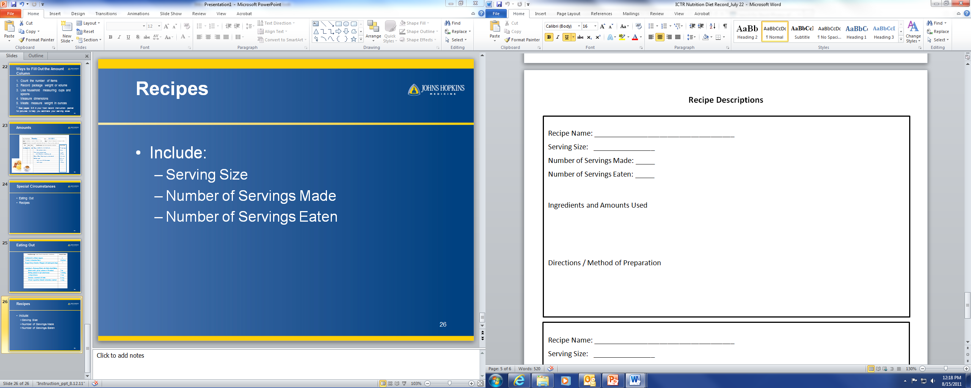
Recipes
Always include:
  Serving Size
  Number of Servings Made
  Number of Servings Eaten

Slide 29
Recipes
Always include:
  Serving Size
  Number of Servings Made
  Number of Servings Eaten
Chicken Noodle Soup
2 cups
4
1
3-pound whole chicken 2 medium onions
1 quart chicken stock 2 medium carrots
2 quarts water ¼ pound dry pasta
Boil chicken in water until cooked
Strain chicken from liquid, pull chicken meat off of bones. Discard skin, bones, and fat
Combine chicken, vegetables, and stock. Bring to a boil, then simmer
Add noodles and cook until soft.

Slide 30
Last Reminders
Use a new record sheet for each new day
Record foods and beverages right after consuming them
Use a separate line for each food or beverage
Include a full description of all foods and beverages
Include additions to foods both in cooking and at the table
Record an amount for each food and beverage listed
Remember, too much information is better than too little!

Slide 31

Thank you!
Your contribution is very valuable to nutrition research!

